Slide 1
Linking Us Together: Applications of Wikidata in Saving Ukrainian Cultural Heritage Online (SUCHO)
Kiley Jolicoeur (kjolicoe@syr.edu)
Andreas Segerberg (andreas.segerberg@gu.se)
Susanna Ånäs
LD4
July 11, 2023
Notes:
Kiley

Slide 2
SUCHO
www.sucho.org
Twitter: @sucho_org
Mastodon:@sucho@hcommons.social
Facebook: sucho.initiative
Email: info@sucho.org
Receive our newsletter!
Notes:
Kiley

Slide 3
2700+
memes archived
691
objects curated in online gallery
4,500+
items curated for
Internet Archive
Notes:
Kiley
Global grassroot initiative Supports digital preservation of Ukrainan cultural heritage
Librarians, Archivists, Software developers, DHM-Researchers

Slide 4
Notes:
Kiley

Slide 5
SUCHO Projects
Omeka Gallery https://gallery.sucho.org/
Meme Wall https://memes.sucho.org/
Equipment Fund https://opencollective.com/sucho/projects/equipment
Developing partnerships
Exhibits https://gallery.sucho.org/exhibits
Equipment
Memory Savers https://www.sucho.org/press-release-20230601-memory-savers
Notes:
Kiley

Slide 6
Why emergency web archiving?
The websites of cultural heritage institutions may contain unique documentation of tangible and intangible cultural heritage
These websites and their content are stored on physical servers, which are vulnerable to physical and virtual attacks
Physical attacks, looting, blackouts, internet outages, cyber attacks
Web archiving allows for sites to be crawled passively, without active participation by the owning institution
Notes:
Andreas

Slide 7
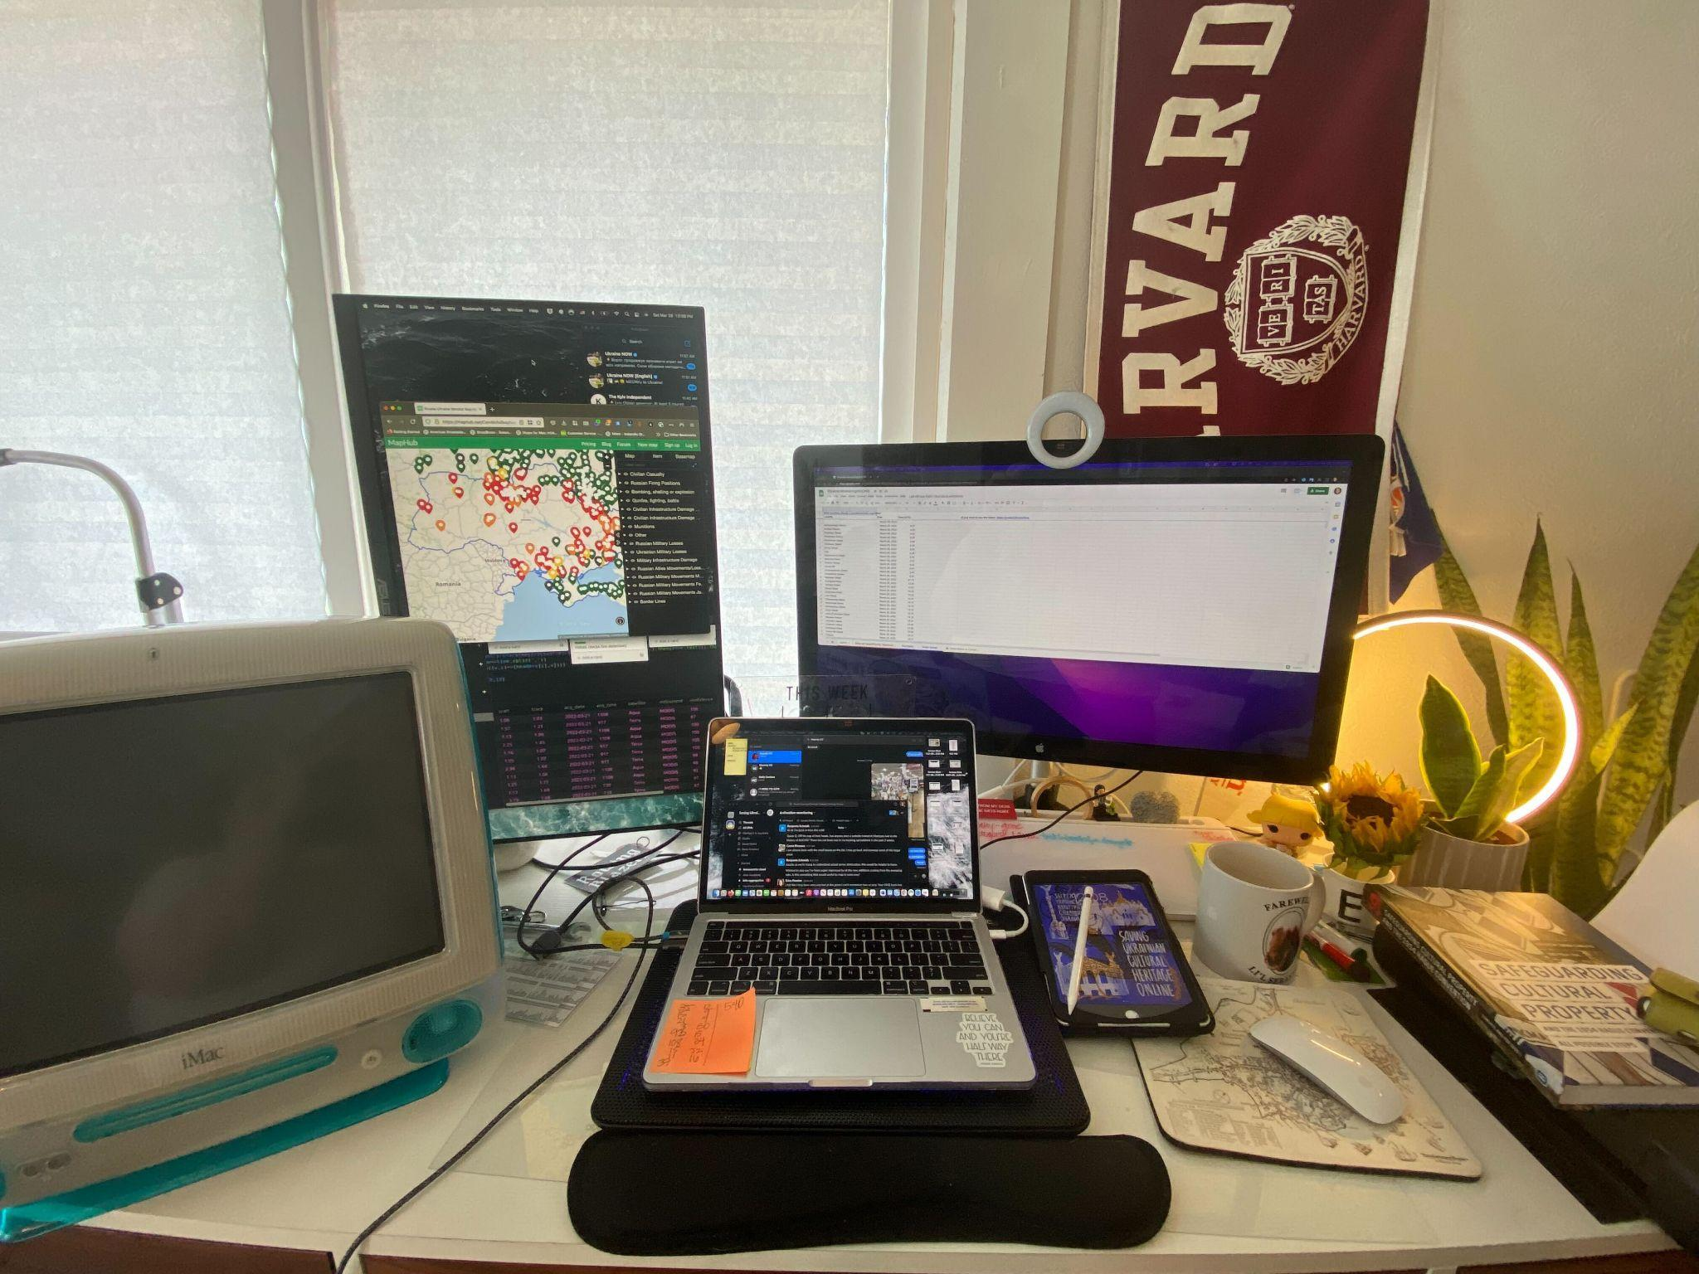
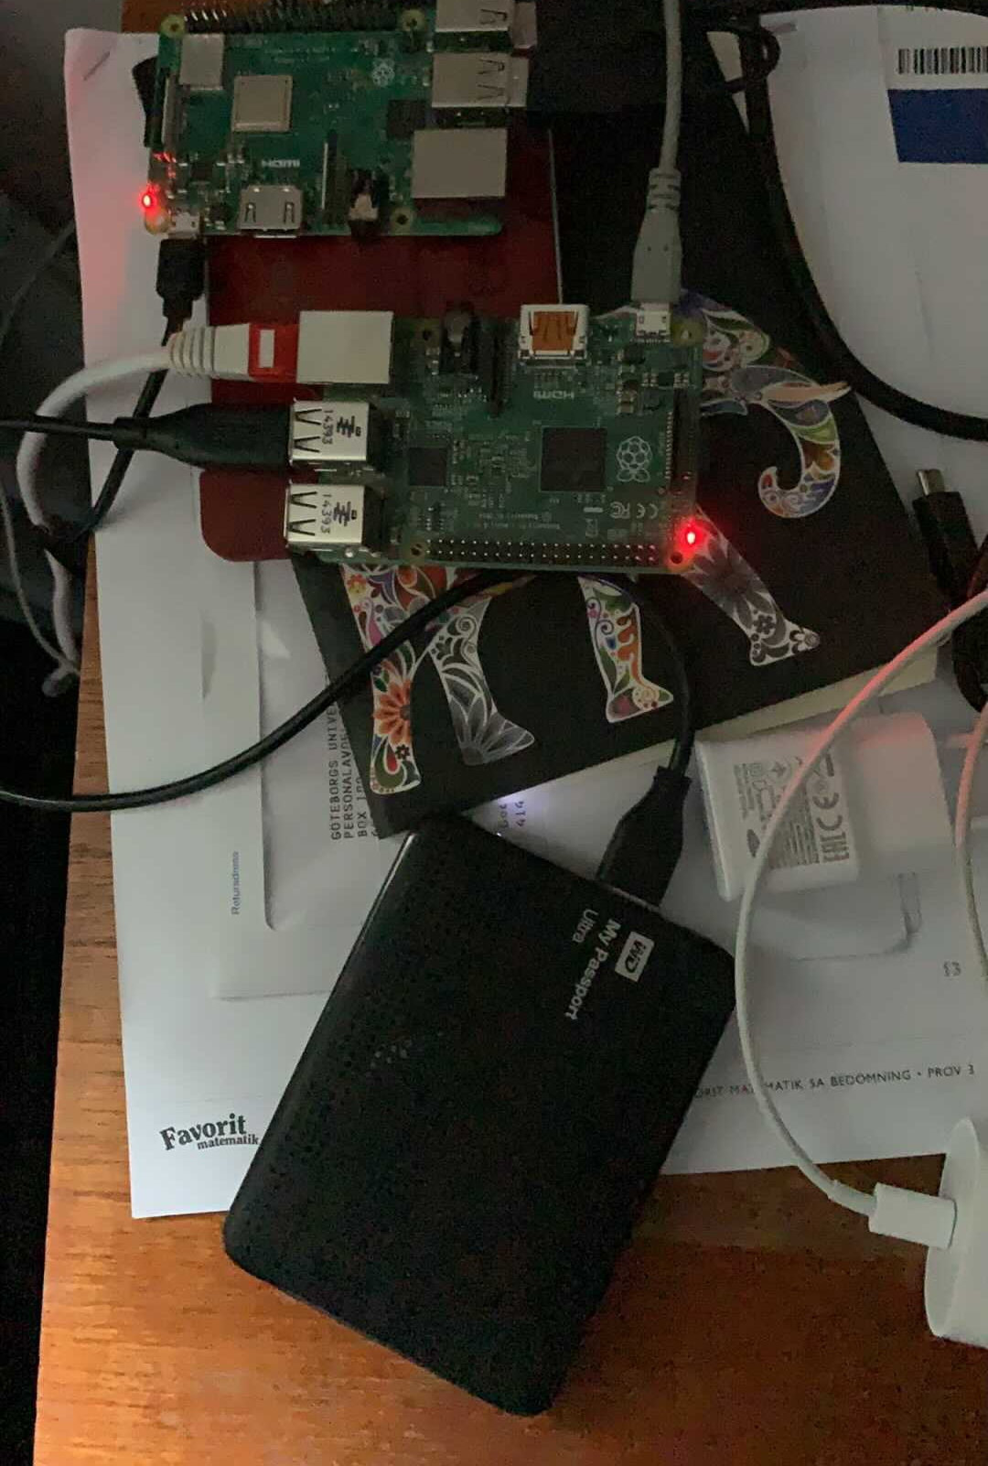
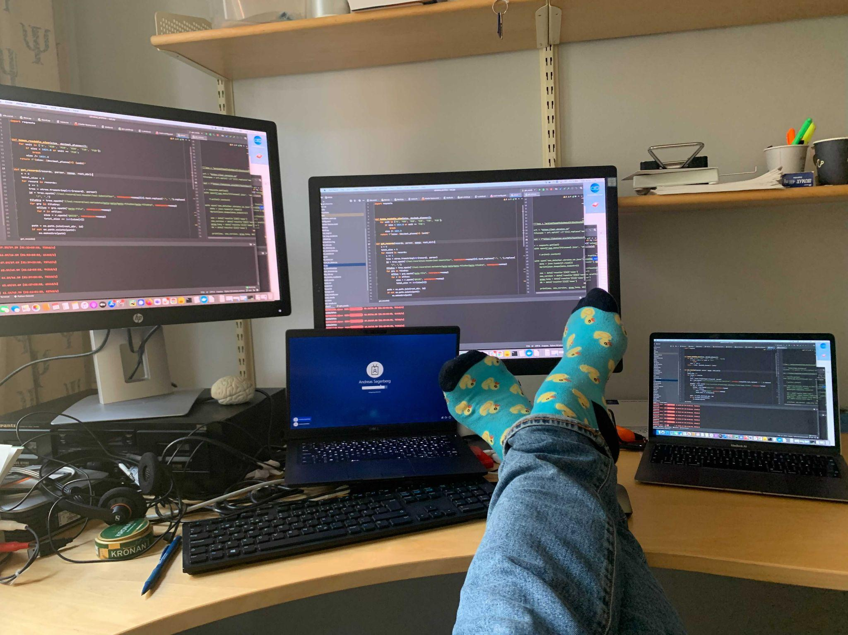
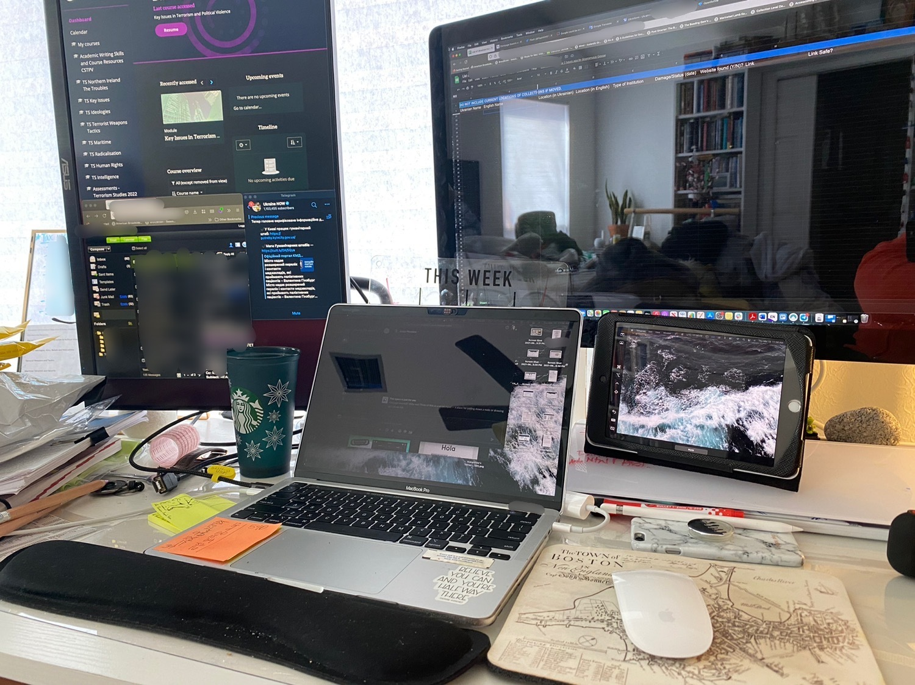
“Digital Dunkirk”
Notes:
Andreas

Slide 8
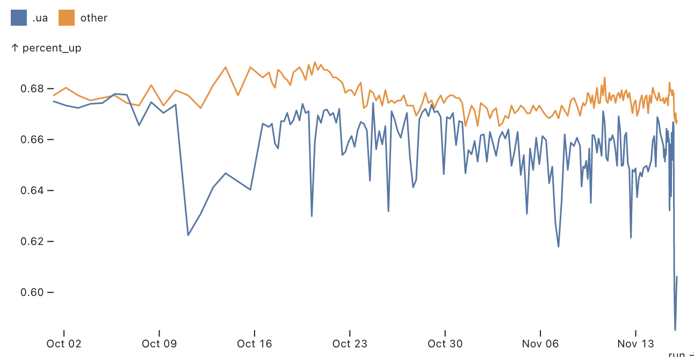
Offline Websites & Outages
Nov. 15th attacks, more than 40% of our tracked sites offline
Notes:
Andreas

Slide 9
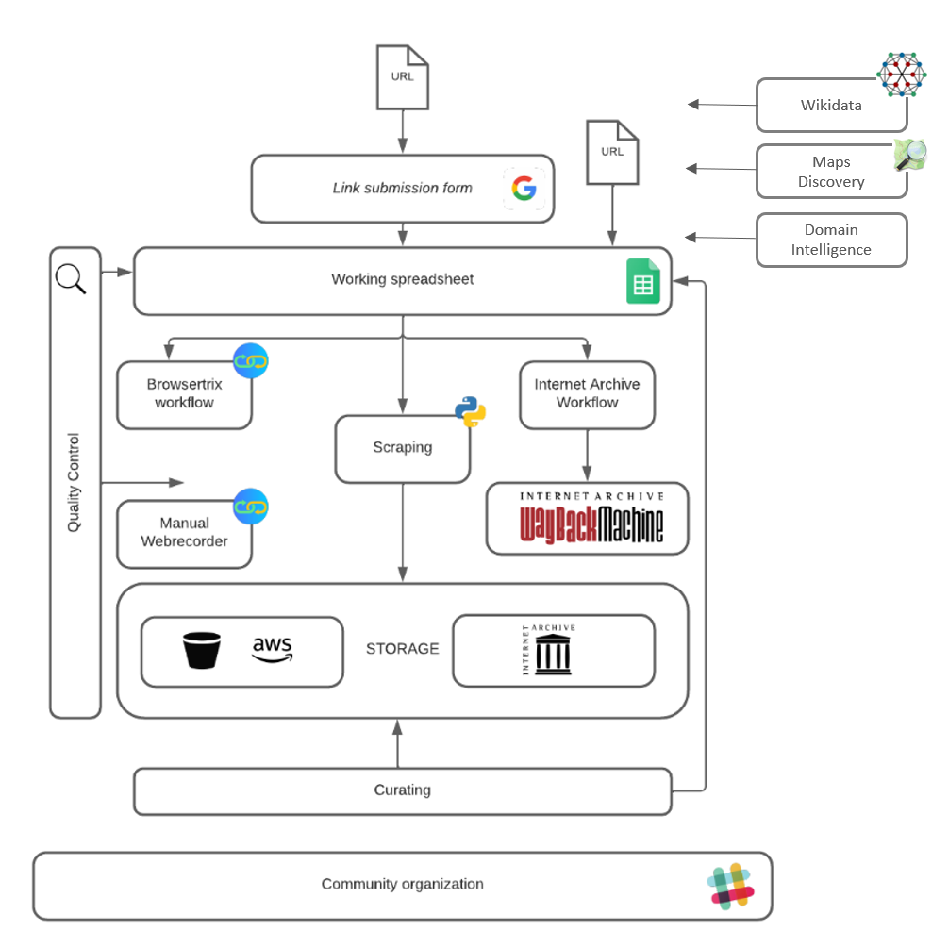
Workflow
Discovery
Prioritisation
Triage
Capture
Quality control
Notes:
Andreas

Slide 10
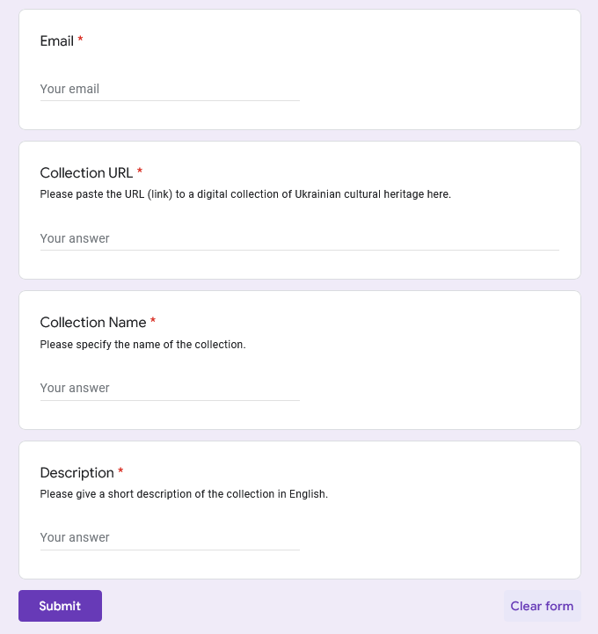
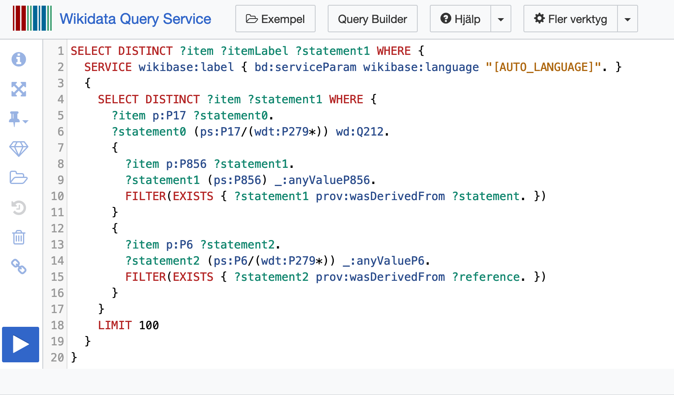
Discovery
User submissions, Wikidata and OpenStreetMap
Notes:
Andreas,
Wikidata alone gave us thousands of websites that could be crawled by volunteers

Slide 11
Discovery
Domain intelligence
Domainsproject - 1.7 billion domains
Notes:
Andreas
//We also used different zone files both from commercial sources and from from open sources. The domains project is one of them where we could extract and identify more culture institutions domains and more important subdomains that some times can be somewhat hidden but contain important collections and catalouges//
//A lot of the domain intelligence work were used for more than just discovery of websites it's also been an important input for prioritizing done by the situation monitors//

Slide 12
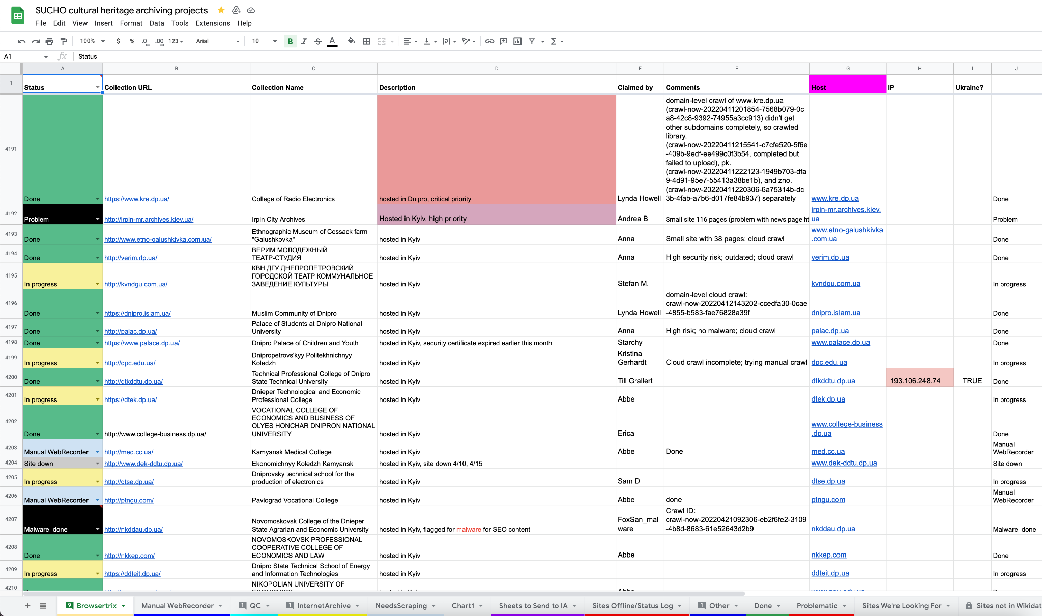
The “gigantische” spreadsheet
Notes:
Andreas

Slide 13
1,904 sites recorded based on data from Wikidata
4,300 urls retrieved from Wikidata
Instances of subclasses of cultural property, cultural facilities
Natural heritage sites, monasteries, churches
Anything within Ukraine with a web address
233 urls retrieved from OpenStreetMap
Keys historic, tourism
Data enriched for importing to Wikidata further down the line
Unique identifiers kept in order to enrich the data in Wikidata
Labels transliterated according to Ukrainian National transliteration
Labels translated into English wherever possible
Administrative units corrected for the items
Precautions
Coordinate data never included
Enriching not done to Wikidata immediately
Notes:
Susanna

Slide 14
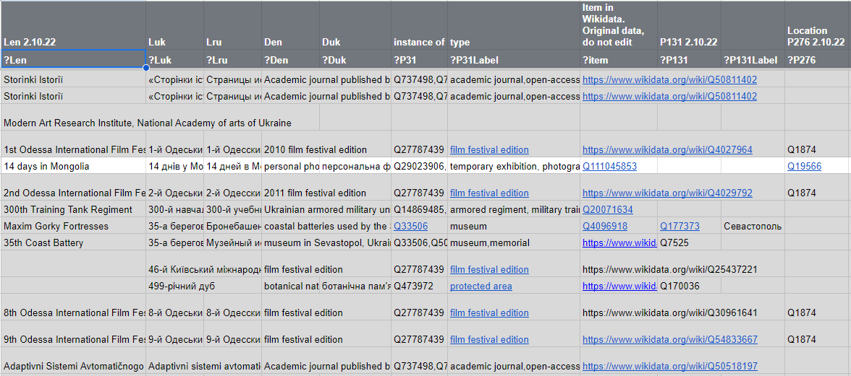

Slide 15
Cleaning up a mess
Google sheets was the key to successful coordination
But…
We had just a few records linking back to wikidata,
No links to the actual webarchive files,
Duplicate records and
All other uncleaned data you can imagine.
Notes:
But.. still just a spreadsheet
No links b

Slide 16
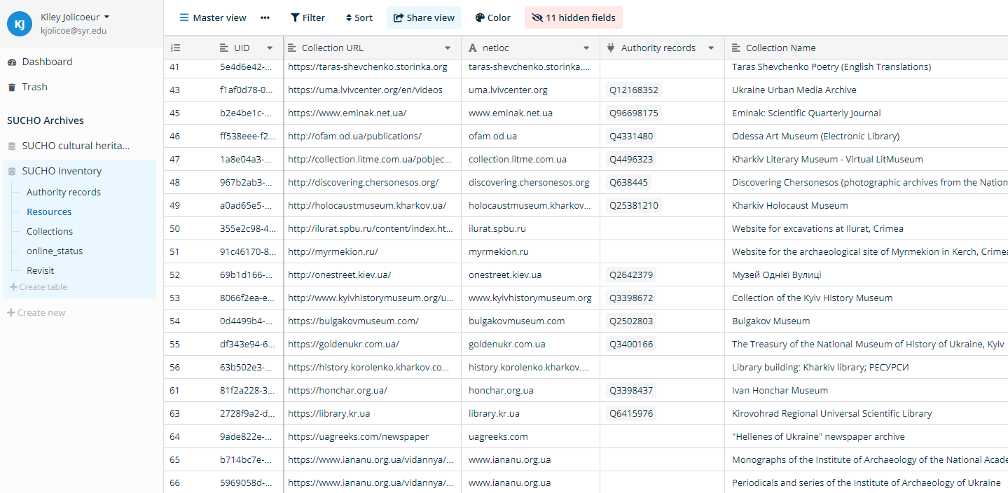
Baserow
Open source no-code database that offers more advanced features than regular spreadsheets. Like linking tables and making custom views for public access from one data source
Baserow also provides you with a ready to use API That we use with with custom python scripts to pull and push data in and out from Baserow.
Notes:
Andreas

Slide 17
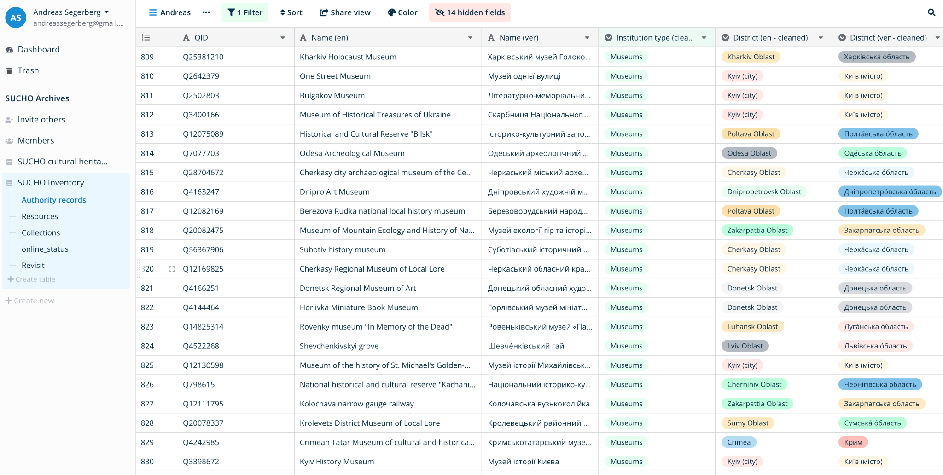
Metadata Schema for Authority Records
Based on the data assembled from Wikidata
QID, Len, Luk, P31 cleaned, P131 cleaned en/uk
Associated rows in Resources table
Part of / Has Part
Status tracking
Notes:
Kiley

Slide 18
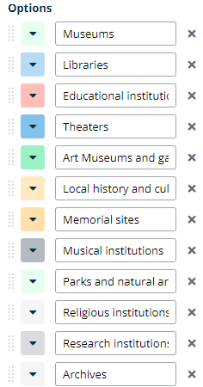
Baserow Cleaning
Normalization of imported data
Input of organization names in missing language
Locations (administrative)
Institution type (subclasses)
Notes:
Kiley

Slide 19
Ethical Concerns
Basic contributions to Wikidata
Bad actors and data used for harm
Good actors and what we use for aid
Notes:
Kiley

Slide 20
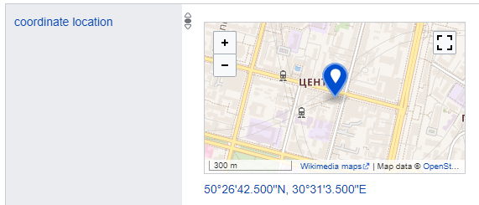
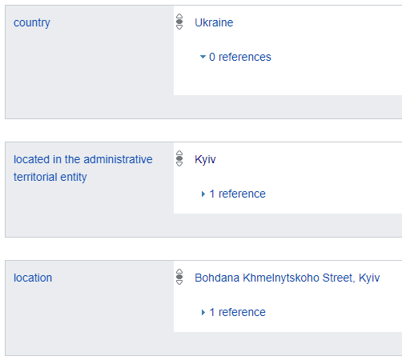
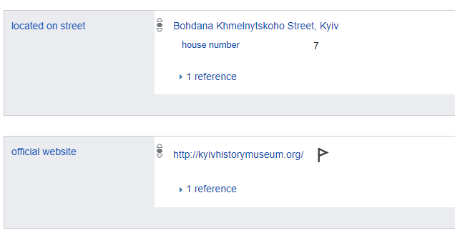
https://www.wikidata.org/wiki/Q3398672
Notes:
Kiley

Slide 21
Next steps
Further Baserow cleaning
Cleaned data to Wikidata
Wikidata query templates for use in cultural heritage preservation
Notes:
Kiley

Slide 22
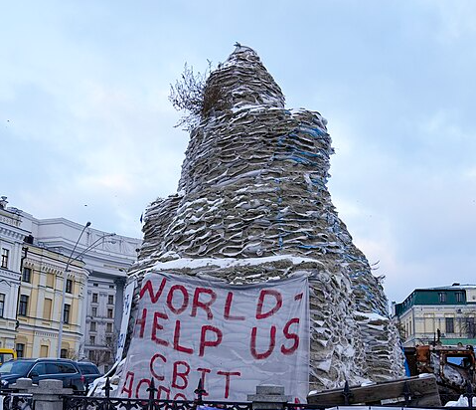
A lesson learned! Only Open Culture is Safe Culture
Digitization and Open Access are not luxuries, but necessary precautions
Someone else needs to be able to save your data if you cannot
It doesn’t take a war: cultural heritage can be lost any time
Natural disasters
Political censorship
Link-rot
DH projects are research data for other researchers, we must make sure they remain accessible
Sandbags stacked around Princess Olha Monument, Kyiv. Source: Wikimedia Commons [cropped for size].
Notes:
Kiley

Slide 23
Thank you for your attention!
Solidarity with Ukraine 🇺🇦 !
Visit https://www.sucho.org/ to learn more about all of our efforts
To volunteer go to https://bit.ly/3cbCJKE
Donate towards the purchase of equipment (institutional donations welcome!)
Go to https://opencollective.com/sucho/projects/equipment
Or reach out to equipment@sucho.org with questions
Notes:
Andreas, Kiley

