Slide 1
Linked Data Pilot Project at Syracuse University Libraries
Sarah Theimer & Brian Dobreski
Acquisitions and Cataloging
Syracuse University Libraries

Slide 2
First a Bit of Background…

Slide 3
Semantic Web
Original Web: a web of linked machines
Current Web: a web of linked documents
  Unstructured data
  Suitable for humans
Semantic Web: a web of linked data
  Structured data
  Suitable for humans and machines

Slide 4
Semantic Web Approach
Semantic Web will gradually evolve out of existing web
Utilizes Agents, programs that make use of this structured data
Semantic Web is for everyone, by everyone

Slide 5
From Silos to Distributed Data

Slide 6
Linked Data
A parallel term to Semantic Web
Practices of
  Exposing data
  Sharing data
  Connecting data
Allows web data to be queried more like a database
More than just making data available– it’s about making links!

Slide 7
Rules of Linked Data
The Four Rules
  Use URIs as names for things
  Use HTTP URIs so that people can look them up
  URIs should provide useful information in a useful standard
  Include links to other URIs

Slide 8
RDF
Resource Description Framework
A graph-based data model
Data structured as statements/triples:
  Resource: subject
  Property: predicate/relationship
  Value: object

Slide 9
The Linked Data Model
Resource (subject)
Property (predicate)
Value
(object)

Slide 10
The Linked Data Model
http://lccn.loc.gov/2007053057
Book # 15131323
has Creator
http://viaf.org/viaf/28445559
Markle, Sandra
http://rdvocab.info/roles/authorWork
<http://lccn.loc.gov/2007053057>
<http://rdvocab.info/roles/authorWork>
<http://viaf.org/viaf/28445559>

Slide 11
The Linked Data Model
Book # 3451675
has Creator
Book # 15131323
has Creator
Markle, Sandra
has Title
has Title
has Publisher
Chronicle Books
Science to the Rescue
Animals Marco Polo Saw
has Publisher

Slide 12
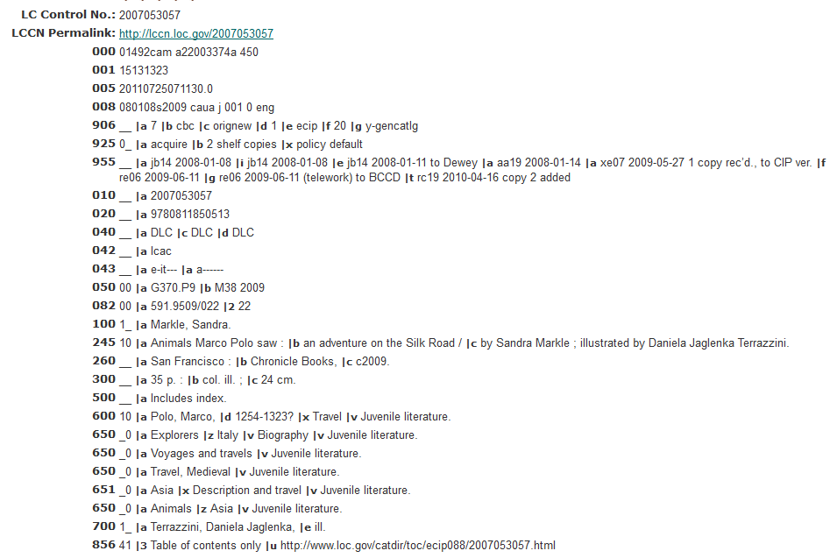
The Current Model

Slide 13
Quick Linked Data Pilot Project Overview
Why are we doing this?
Staff
Timeline
Steps
Goals and deliverables
What have we learned so far

Slide 14
Why Do It?
We watch MANY MANY webinars
You can only learn so much from watching webinars
So I looked at examples of linked data and linked data projects

Slide 15
Non-Library Examples of Linked Data
  NYT http://data.nytimes.com/
  BBC http://www.bbc.co.uk/blogs/internet/posts/Linked-Data-Connecting-together-the-BBCs-Online-Content
  BBC and NYTimes both use Linked Data because:
  Existing structured data
Content publishers
Content consumers
Notes:
Examples of linked data use outside of libraries

Slide 16
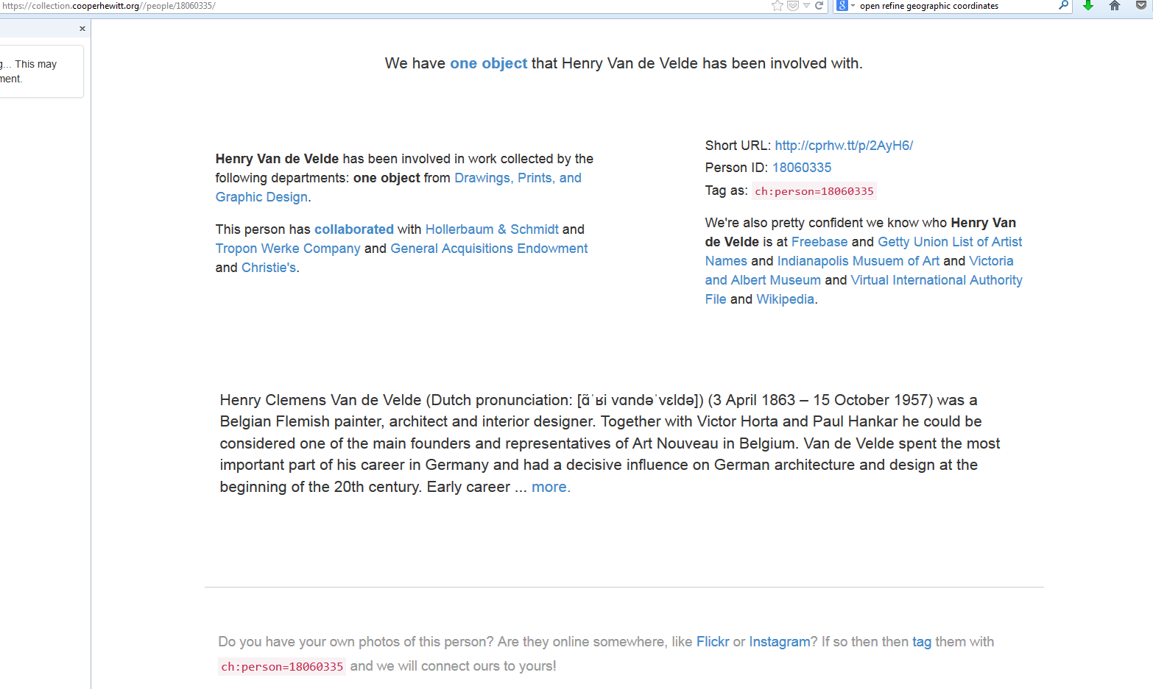

Slide 17
Library Examples of Linked Data Projects
Linked Jazz: “Linked Jazz is an ongoing project investigating the potential of the application of Linked Open Data (LOD) technology to enhance the discovery and visibility of digital cultural heritage materials. The goal of this project is to help uncover meaningful connections between documents and data related to the personal and professional lives of musicians who often practice in rich and diverse social networks”
  http://linkedjazz.org/
Sheet Music Consortium: “The Sheet Music Consortium is exposing music publisher information extracted from the Consortium's data as linked open data LOD). We have chosen publishers as the focus of this pilot project in order to provide additional information in a dimension that is of great importance in music publishing history, but which is often ignored….”
http://digital2.library.ucla.edu/sheetmusic/
But Reading Emory’s Pilot Project Proposal convinced me

Slide 18
From Emory’s Pilot Proposal: Initial Risk Consideration
Risk of doing project:
spending time on a product that may not actually lead to production use right away, when we're so busy and could have spent the time doing something else.
Risk of not doing project:
Staff are underinformed about a key technology trend, but decisions come up in the next year-2 years that require understanding
Our infrastructure strategy doesn’t take into account a key technology.
Emory libraries and customers miss opportunities for enhanced discovery and knowledge.
Emory misses out on being able to participate in collaborations and grants centered around this technology.
Notes:
I think that often we think more about the risk of action than about the risk in inaction.

Slide 19
So I Wrote Up a Project Proposal
Project Description: This pilot project will transform sample data from several different library data collections (ContentDM, SURFACE and MARC records) into a linked data (RDF) aggregation (a “triple store”). This will initially provide a demonstration of some of the uses and benefits of linked data.
Notes:
Linked data is intended to reveal the links expected and unexpected between resources.

Slide 20
Goal Summary
GOALS
Identify common process that would convert records into linked data
Identify and gather tools for RDF storage and querying, transformation from existing metadata formats, working with ontologies, harvesting and creating linked data, and providing user navigation and visualization.
Identify ways to publish data from our collections to improve discoverability and connections with other related data sets on the Web
Identify options for displaying the data and provide navigation of the linked data relationships across described information resources and the people, organizations, topics, concepts and "things" that are associated with them. If time permits, create visualizations such as maps or timelines.
Deliverables:
  A document describing our process and experience.
  A presentation to the department on our product and findings.
  A report with recommendations at end of project

Slide 21
Project Staffing
Sarah and Jeanette (Metadata Unit within Acquisitions and Cataloging Department)
Duration: Feb 1- June 30.

Slide 22
Approximate Timeline
Step 1. Identify other Linked Data Projects (February)
Step 2. Study Projects (February)
What are goals of the project.
What tools did they use?
Was the data transformed/cleaned?
Did they link to outside data (DbPedia, MusicBrainz, VIAF)
What data visualization was done?
How was the data displayed?
Step 3 Compile tool list (February-March)
Step 4. Identify a SUL data sample and extract it (March)
(ContentDM, Surface and MARC)
Step 4. Try out tools/Run our sample records through process. (April-May)
Step 5. Summarize findings/write report. (June)

Slide 23
What We Have Done So Far
Identified Linked Data best practices
Looked at other people’s projects
**Identified Tools
**Chose and defined a test population
Extracted test population
Started testing tools with our data
Notes:
I am not discussing all of these just the tools and test population

Slide 24
Identified Test Population for Pilot Project
Factors to keep in mind when selecting sample for linked data projects
    Is it of importance to institution?
    Is it retrievable?
    Is it a reasonable size?
    Will it link out? (Does it contain well defined external concepts)

Slide 25
Our Pilot Population
Our pilot project will focus on Maxwell data. Can we identify connections between documents and data produced by Maxwell (grad students and faculty) and monographs the Libraries purchased in those subject areas? Do either of these relate to resources in ContentDM?
  Surface Dissertations from Maxwell (2009-2013)
  Surface articles from Maxwell faculty (2009-2013)
  MARC records for monographs acquired from 2009-2013 with call number in a Maxwell range
  ContentDM records that do not have access restrictions
  - Additional data from Maxwell web page

Slide 26
Tool List (29 and growing)
Tool name | Used By | What it does | Comments
Viewshare.org | Utah and Old Dominion (says the article) | Adds maps, timeline and data views, free from LC to enhance visualization of historical data. Takes data from OAI, METS, and Excel
Open Refine (was Google Refine) | Sheet Music Consortium used this to normalize terms | Cleans data, create triples | open source. Can clean messy data, standardize it, link to public datasets, export it. An RDF extension will allow you to export in RDF. (more work than Drupal)

Slide 27
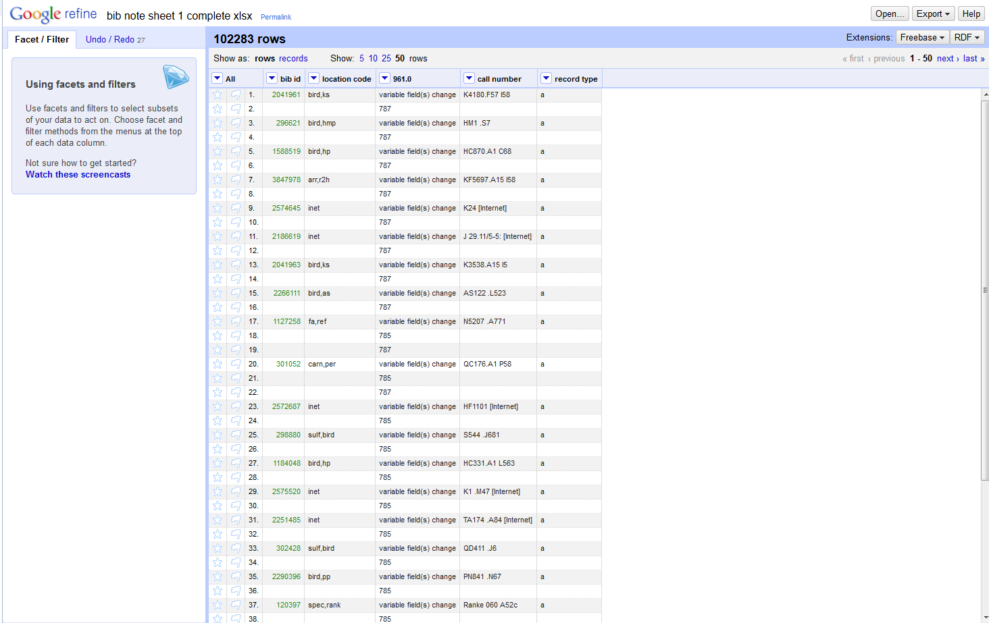
Tool Example: Open Refine

Slide 28
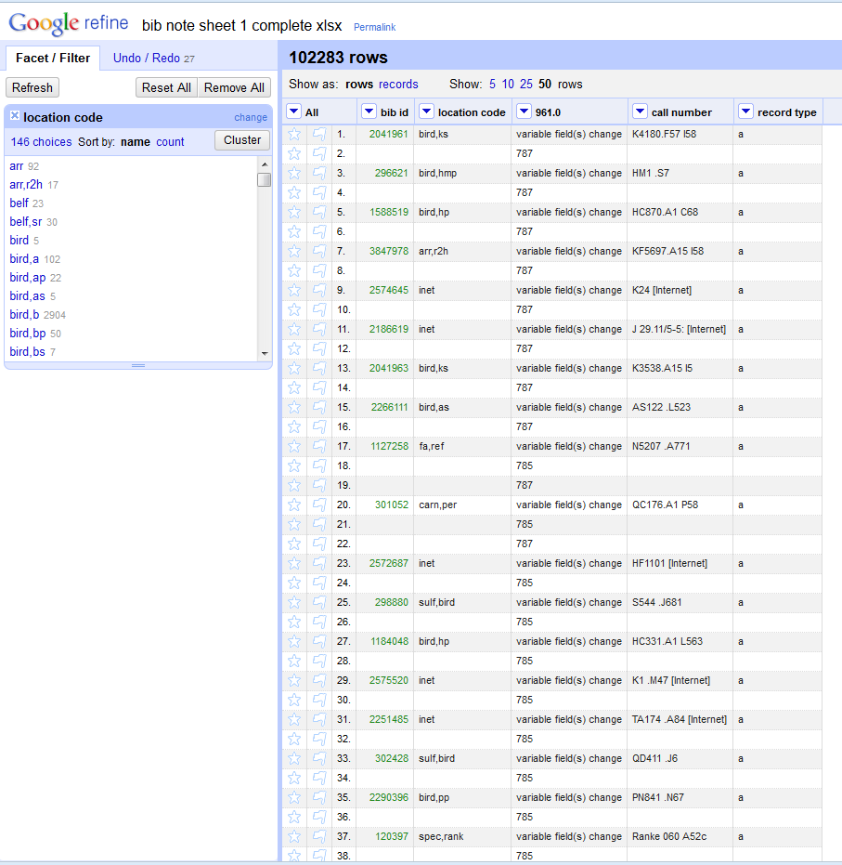

Slide 29
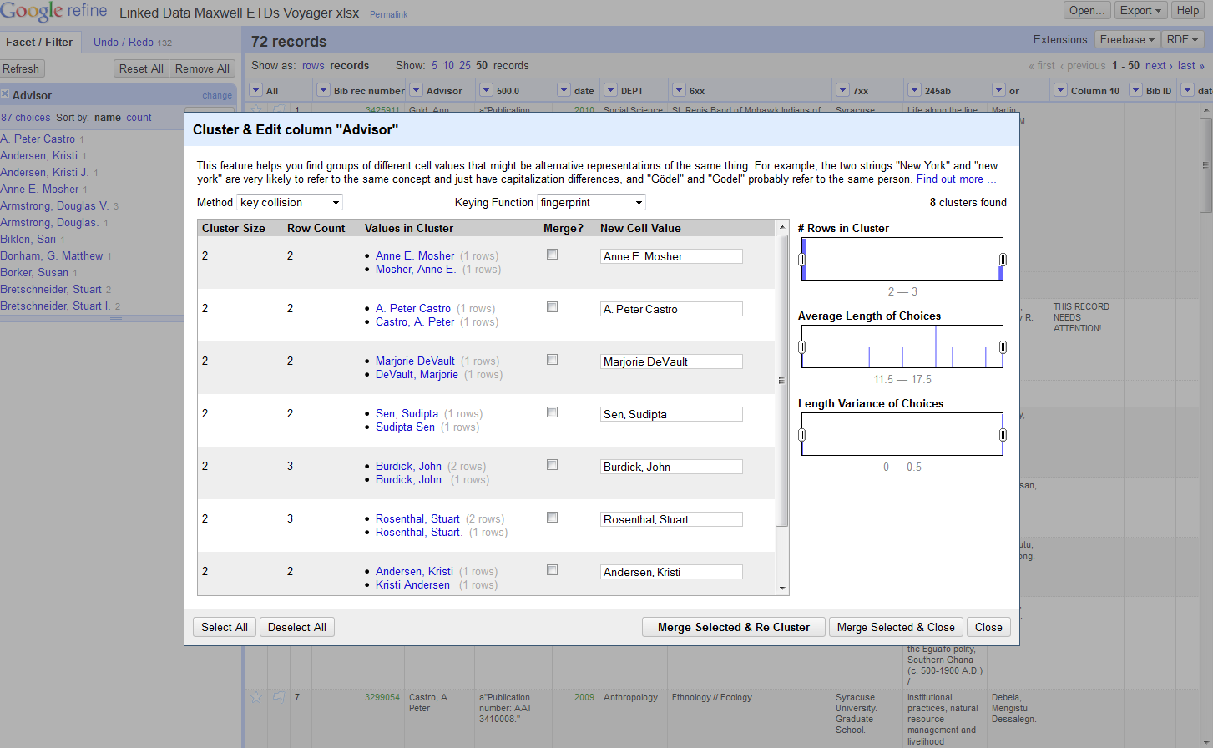

Slide 30
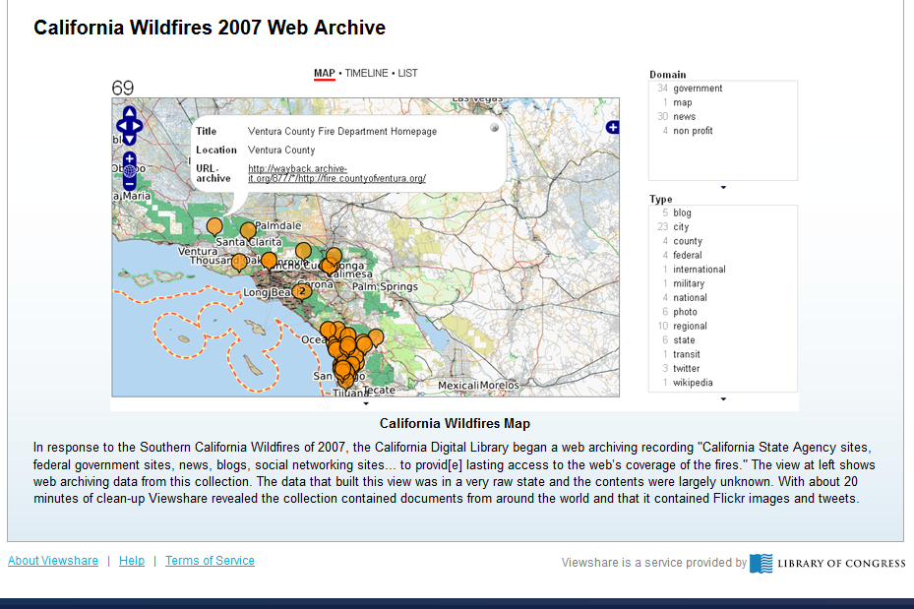
Tool Example: Viewshare

Slide 31
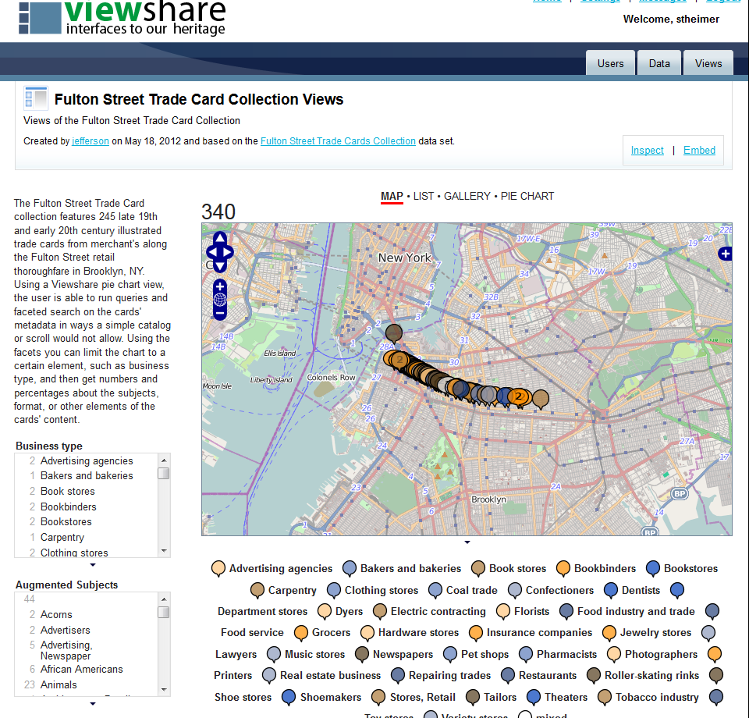

Slide 32
What Have We Learned So Far
( 2 months in)?
Tools used in linked data projects have many potential uses. (Within and outside of the Acq/Cat Department)
It is hard to balance time between work and project. (But we are doing it because I said that I would in the project proposal)
Eventually we will run out of things we can do without involving Systems.

Slide 33
So It’s a Cliffhanger …
Will we successfully discover links between data sets?
Will we link out to external sources?
Will the data visualization tools make it all seem really cool?
Are there roadblocks ahead that will stymie Sarah and Jeanette?
What will happen to the work after the pilot project ends?
Thanks

