Slide 1
All About Scholarly Publishing
Bonnie Ryan, Yuan Li
Syracuse University Libraries

Slide 2
Agenda
Why publish
Publishing Dissertations
Types of Publishing
Examples
Q&A
Notes:
How you are gonna publish
- Personal Website
- Institutional Repository (IR)
- Academic Publishers
- Commercial Publishers

Slide 3
Some questions
Why do you publish?
What do you publish?
What venue do you use to publish?

Slide 4
Why publishing
Exchange of research ideas/accomplishment
Advancement of multidisciplinary research
Establishment of the academic reputation
Job Search & Tenure Awards

Slide 5
Let’s talk about dissertations first
SU process
- Since May 2011, the Graduate School have asked all graduate students to submit their dissertations electronically through ProQuest UMI ETD website (www.etdadmin.com/syr ).

Slide 11
Notes:
Reason for delay:
Publication pending with another author
Patent pending
Material under another copyright is contained in the work
Sensitive material is included

Slide 12
Types of Publishing
Traditional publishing
Open Access publishing
Notes:
APC: Author Processing Charge
- publish in open access journals
Green OA (“publish” through IR)
- Gold OA (Publish OA journals)
- Platinum (OA journals; No APC)

Slide 13
Traditional publishing
Authors
Produce scholarly content
Free
Free
Libraries/other information distribution agencies
Purchase/Facilitate access
Editors/Reviewers
Conduct peer review process
$$$, $$$
Publisher
Perform editing, printing and online distribution
Free

Slide 14
Open access (OA) publishing
Open access
“Open access literature is digital, online, free of charge, and free of most copyright and licensing restrictions.”
- Peter Suber

Slide 15
Open access (OA) publishing
OA publishing is to publish your content as open access.
Notes:
Article-processing charges

Slide 16
OA Publishing Cycle
$$$ (APCs)
Funding agencies, Institutions
Author
produce scholarly content
Free
Free
Freely open to the world through Internet
Editors/Reviewers
Conduct peer review process
$$$ (APCs)
Perform editing, printing and online distribution
Commercial Publishers
Free
Academic Publishers
Free
Academic Libraries

Slide 18
Notes:
Reason for delay:
Publication pending with another author
Patent pending
Material under another copyright is contained in the work
Sensitive material is included

Slide 19
Embargo
What is an embargo?
An embargo is a period of time that you delay your dissertation being released.
Why do I need to put an embargo on my dissertations?
- Concerning about your ability to publish the dissertation as a book or journal article
- Pending patent
How long is enough?
- SU Policy: 6-24 months but with the option of making it longer.

Slide 20
Questions?

Slide 21
OA Publishing models
OA publishing models
- Gold OA model
- Green OA model

Slide 22
Gold open access model
Freely available to everyone through the internet
Financed by Article-processing Charge (APCs) or by academic institutions or societies (NO APCs)

Slide 23
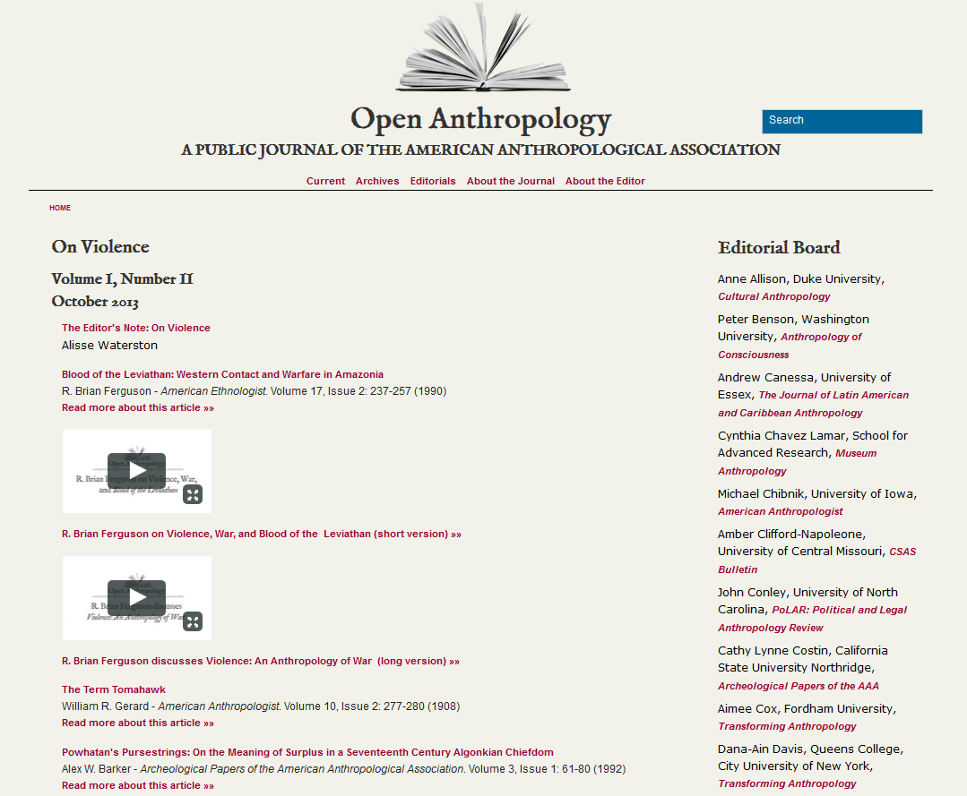
Gold open access model example (no APCs)
Open Anthropology from American Anthropological Association (http://www.aaaopenanthro.org/index.cfm )

Slide 24
Gold open access model example (no APCs)
Cultural Anthropology will go Open Access in 2014, announced by the Society for Cultural Anthropology (a section of the AAA)
(http://production.culanth.org/fieldsights/142-cultural-anthropology-will-go-open-access-in-2014 )
Cultural Anthropology will be the first major, established, high-impact journal in anthropology to offer open access to all of its research, and we hope that our experience with open access will provide the AAA as a whole, as well as other journals in the social and human sciences, valuable guidance as we explore alternative publishing models together.

Slide 25
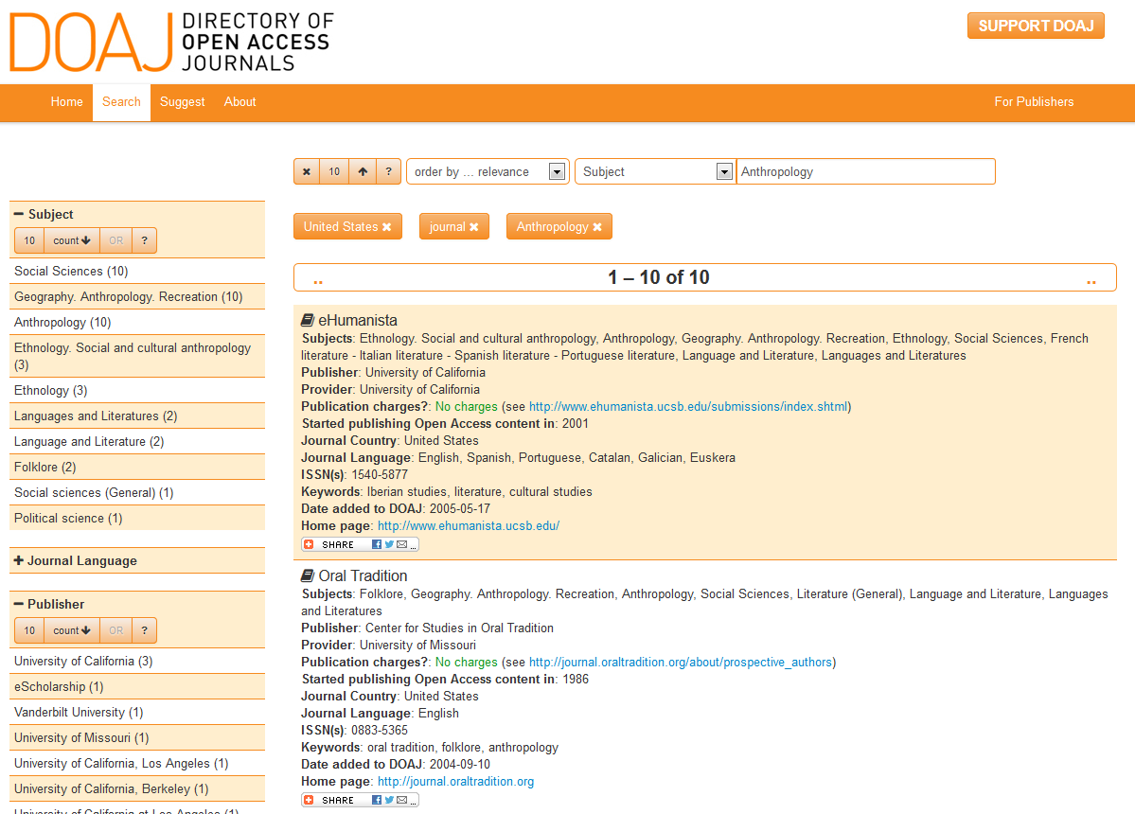
Find Gold opportunities
DOAJ.org
contains info on 8923 Open Access Journals
Indexes 1,573,847 full-text articles

Slide 26
Find Gold Opportunities
Publishers of OA books (http://oad.simmons.edu/oadwiki/Publishers_of_OA_books )
MIT press
Open Humanities Press (University of Michigan Scholarly Publishing Office)

Slide 27
Green open access model
The author self-archiving model
Pre or post prints of their published works on the personal website or institutional/disciplinary repositories*
* subject to publishers’ copyright policies
Notes:
Explain pre-prints and post-prints.

Slide 28
The bad deal you had with publishers
Most publishers require authors to sign the publishing agreement or copyright transfer agreement, in which they ask for all the rights. You sign it then you sign away all the rights.
You worked hard to produce the work. After you sign the contract, your work becomes theirs.
Do they need all the rights?
The consequence

Slide 29
It’s time for you to do something for yourself
You are the game changer. You have the right to negotiate the terms.
Attach the Author Addendum to the contract or the agreement
SPARC addendum (http://www.sparc.arl.org/sites/default/files/Access-Reuse_Addendum.pdf )

Slide 30
Questions?

Slide 31
Find Green Opportunities
Sherpa/ROMEO (http://www.sherpa.ac.uk/romeo/)
provides information about publishers’ policies on author self-archiving

Slide 34
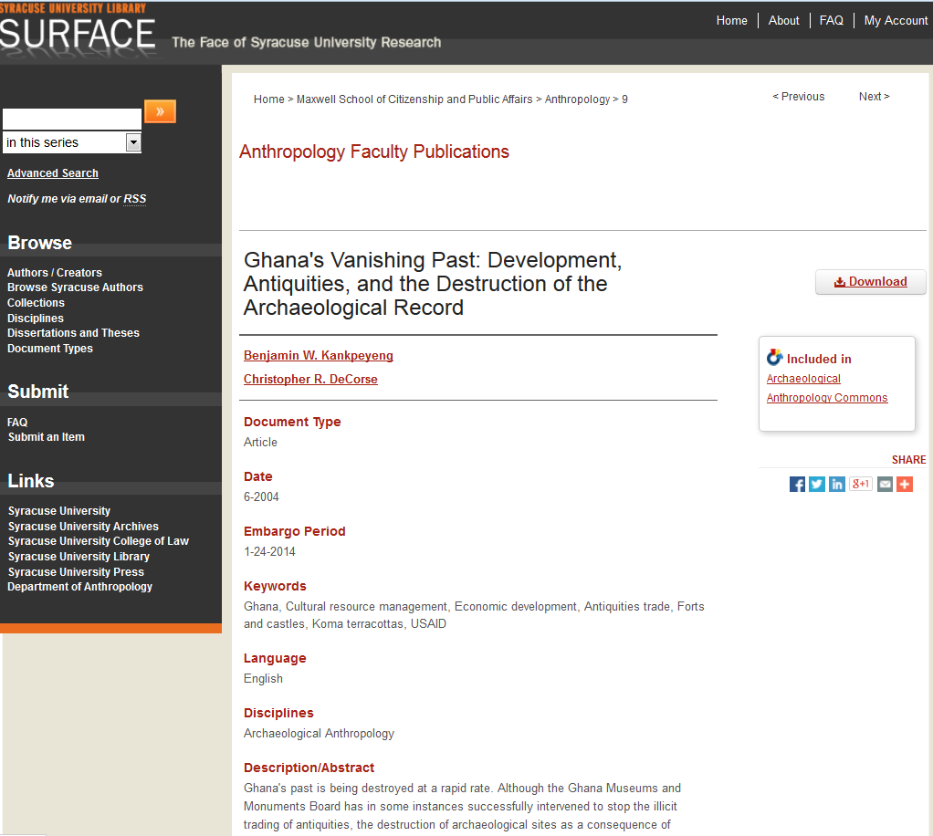
Chris DeCorse’s article (published in African Archaeological Review) on SURFACE

Slide 35
Similarities & Differences
 | Traditional Publishing | OA publishing
Peer Review process | Yes | Yes
Publishing Venue | Closed access journals | Open access journals
Financial Venue | Journal subscription fee | APCs or subsidized by academic institutions or societies
Status | Established (more high tier journals) | Under the development (less high tier journals)
Accessibility | limited | Full accessibility
Reusability | limited | More reusability based on the licenses author used

Slide 36
Creative Commons Licenses
Give authors a simple, standardized way to grant permissions to their work.
Six types of licenses

Slide 38
Why publish as OA
Discoverability
Visibility
Accessibility
Reusability
Requirement from funders and institutions (especially for the federally funded research)

Slide 39
Which publishing option should I choose?
It depends…
If you can find a desired OA journal in your field and there is no APC or there is APCs and you have the financial support to cover the APC = Gold OA
If no journal + no financial support = traditional publishing + Green OA model

Slide 40
Have you heard “predatory publishing”?
No. You might have seen this or something similar

Slide 42
Cautions to predatory publishing
Who are they?
- Predatory publishers
What’s in it for them?
- Money, money, and money
How to tell the good guys and the bad guys?
- Jeffrey Beall

Slide 45
What do you do when getting the solicitation emails?
Be cautious
Check online or check against Beall’s list
Contact Bonnie for help

Slide 46
Resources
SURFACE http://surface.syr.edu
Anthropology Commons (http://network.bepress.com/social-and-behavioral-sciences/anthropology/ ) (you can find free research resource in Anthropology)
Beall’s talk at SU “Science Communication and the Threat of Predatory Publishers” (you can learn how to identify predatory publishers) http://surface.syr.edu/cgi/siteview.cgi/oa_week/2013/events/4
Beall’s predatory publisher list (http://scholarlyoa.com/individual-journals/ )
Sherpa/ROMEO (http://www.sherpa.ac.uk/romeo/ )

Slide 47
Contacts
Bonnie Ryan, bcryan@syr.edu
Yuan Li, yli115@syr.edu

Slide 48
Questions & Discussions

