Slide 1
Assessing the Assessment Tool
ENY/ACRL Annual Spring Conference
May 21, 2012
Notes:
Assessing the Assessment Tool: Development and User Testing of the Library’s Data Repository
Thank you. I’m going to be describing a work in progress – at Syracuse University we are developing a repository for assessment data to improve the accessibility and visibility of library metrics data for use by library staff.

Slide 2
Build it and they will come?
Notes:
The goal for the Library Statistics Document Center was to make available in a central location the documents, data and assessment reports generated by the Program Management Center. PMC is the unit in the Library that manages projects, conducts assessment, and coordinates data collection and presentation for the Library.
We believe that an easy-to-use repository for metrics and assessment reports supports a culture of data-driven decision-making throughout the Library.

Slide 3
Centralization
Notes:
Prior to the Center, data was stored on local departmental drives throughout the library – inaccessible to most staff and used primarily for operational purposes. Today we have a central, web-based document center that provides improved capacity to access data and assessment reports across the functional service areas, and to connect up our library data with student and faculty demographics from the University data warehouse
Data processing is centralized as well - the Program Management Center receives data requests, collects the data and has responsibility for regular reporting as well as special assessment projects.

Slide 4
Define Scope
ARL Statistics
Circulation Reports
Usability Studies
LibQUAL
Collection Profiles
Gate Counts
Reference Statistics
Notes:
We generate a lot of reports, and the repository is populated with both quantitative and qualitative data
There are numbers-based reports, like circulation or instruction statistics, but also textual data like comments from student surveys, usability test results, interview summaries.

Slide 5
Metadata
Data elements in File (Key Fields)
Title, Author, BIB ID, Comments, Month, Year, Count
Dates of Coverage
2011, 2007
Date Type
Fiscal Year, Calendar Year, One Time
Description/Title
Use Natural language!
Data Source
Voyager, ExLibris, Vendor
Report Type
Summary, Charts, Raw Data
Method
Survey, System Query
Notes:
This broad scope requires a metadata scheme that can adequately describe and make the contents findable. After drafting a preliminary metadata scheme, we started populating the center to determine how well the metadata worked and how intuitive it is to apply.
Even in our small unit, we have one librarian, two engineers and one statistics PhD – as you can imagine, we sometimes speak different languages and use different words to describe what we’re looking for.

Slide 6
Workflow
Notes:
We established a workflow for uploading to the repository.

Slide 7
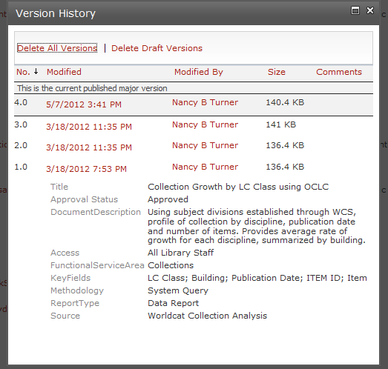
Versioning
Notes:
Including naming conventions and a versioning system.

Slide 8
Users
Notes:
Usability can be both technical requirements and ease of use.
How do we expect our users to interact with the document center. Will they access this from home? Will it be open to administration, all library staff or the public? Will users be contributing documents, or just reading or downloading files from it?
What are the skill sets for the users? Will you expect them to use the data raw, in summary tables or do they need power point presentations?
We can not assess usability without clear understanding of who users are, how they will access the system and how they will be looking for information.

Slide 9
The Assessment Cycle
Identify content
Understand users
Develop metadata scheme
Gather feedback
Make changes
Determine access process
Notes:
So this is the cycle that I’ve described.
We’ve done some traditional usability testing to ask users to located particular files or content. A key aspect in the cycle is continuing to be open to feedback and making changes based on that feedback.

Slide 10
Do They Use It?
Quantitative
Measure usage and number of unique users
Measure decrease in custom report requests
Qualitative
Is the workflow operating as expected?
Is the system easy to use?
Meeting Goals
Are users discovering the data they need to make-decisions?
Are users asking more questions?
Notes:
Our system isn’t live yet but we are hoping to see an:
Uptake in the usage
Fewer questions for items or content that already exist in the center, indicating that staff are finding information independently.
Ultimately, we want staff to use the data they find to ask more questions – to get them excited about the patterns they see in the data and the trends it helps us to discover and influence.

Slide 11
Picture Credits
Center http://www.flickr.com/photos/nest_jar/3454629674/
Light
http://www.flickr.com/photos/seier/3122721913/
Baby User http://www.flickr.com/photos/courosa/5536535796/
Baseball Field http://www.flickr.com/photos/philsnyder/3776582751/

