Slide 1
YOU CAN
DIY
(DO IT YOURSELF)

Slide 2
Learning From Best Practices in Library Assessment
Nancy Turner, Syracuse University Library
UNYOC 2010 Annual Conference - October 14, 2010 – Syracuse, New York
Notes:
This afternoon’s program is devoted to assessment – although I get the dreaded position of talking just after lunch and you are all ready for a brief doze, I hope that my comments will provide some context for the presentations that follow.
Familiar with the “Rochester study” on the impact of library services on clinical decision-making. It was conducted in 1990-01.
I imagine that if you read some of the literature on assessment today you may find it somewhat daunting. The Rochester study, for instance, involved 15 hospital libraries and the grants sponsorship of both New York state government and the Rochester Regional Library Council. You may be thinking, how could I possibly make a contribution such as that? So I named my talk DIY – do it yourself – to suggest that any library can improve its efforts in assessment.
A couple of years ago Syracuse University Library staff conducted a series of environmental scans on various aspects of library work – I chaired the group that reviewed the literature and interviewed practitioners in library assessment. So when Brad asked me to speak today, I went back to that scan and it still has relevance. I’m going to comment on 7 best practices; some I hope you can do at home.

Slide 3
Why Assessment?
Accountability
Improvement
Improve workflow efficiency
Service improvement
Advocacy
Notes:
We do we even do assessment?
We need to justify our expenditures of our budget – this is accountability.
We also conduct assessment in order to improve our workflow efficiency and provide better service to our customers.
A higher level of accountability is Advocacy – relating our work to value.

Slide 4
Funding Request - Library A
The Library's budget for last year was $5 million.
We have ten employees who are very busy, and we'd like to add three more to help with workload and turnaround times, so we need more money for added headcount.
During last year, the Library performed 500 research projects. We updated intranet content 50 times each on four portal sites.
The Library managed a collection of 230 periodicals, and 225 new books were bought and processed. Seven hundred items were circulated from the Library's collection.
All this work is very time-consuming, but the Library staff works very hard and at 100% capacity, so we're happy to say we managed all this last year with only ten on staff.
Notes:
This is the most words you’ll see on a slide today.
The example is from Roger Strouse’s 2001 article in Online, “Corporate Information Centers in the Year of Accountability”

Slide 5
Funding Request - Library B
The Library budget for last year was $5 million, an investment for which the Company received a $7.5 million return.
Ten Library employees generated this $2.5 million profit, and we believe adding three more employees will increase that margin.
Last year, the Library performed 500 research projects. Library users tell us that the Library's participation on those projects saved them an average of 14 hours per project, which translates to $168,000; that we saved them on average $2,500 in direct costs per project ($1,250,000); and that, on 50 of the projects, we found information that led to an average sale or increased sale of $85,000 ($4,250,000).
Intranet site content, which the Library pays for and posts, resulted in 14 known new sales, each valued on average at $131,000 ($1,834,000).
Notes:
Which is the library that is speaking the language of its stakeholders?
Which is the library that you imagine will receive funding for those three new positions?
Which is the library that is demonstrating its value, in both dollars and increased efficiency, to the organization?

Slide 6
Moving from A to B
Notes:
So how do we get from Point A to Point B –

Slide 7
Strategic Plan
Notes:
Best Practice #1
An effective assessment program in any library requires a context - strategic goal setting that is built on the institution’s mission and vision.
This is the foundation on which all assessment should follow, from performance evaluation to developing key metrics.
The strategic plans and directions may change from year to year, especially in this fast-changing environment, but without the goals, assessment is just counting.
What we collect is not always aligned with strategic need.

Slide 8
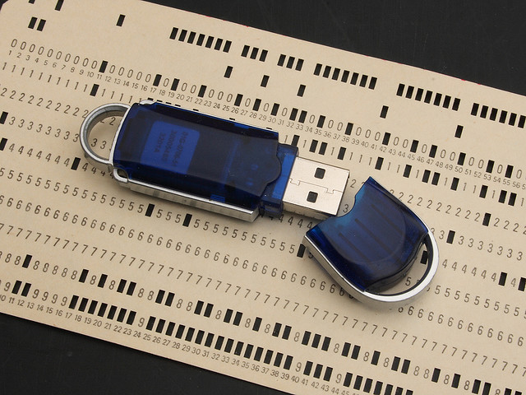
Data
Notes:
Data driven decision making – this is an expression we often hear but rarely are decisions based purely on data.
There are always intervening factors.
An example might be the electronic journal that doesn’t get used much relative to its cost, but is necessary for the
accreditation of the chemistry department.
You may have some very vocal users who go straight to the director when there is a problem – that tends to motivate decisions as well.
You may have some administrators who claim “I’ve got 17 years of gut experience – what do I need data for to make decisions”
Ideally, however, there is a certain transparency in decision-making, so staff and your stakeholders can see the library decisions are “evidence-based” or data-driven.

Slide 9
Types of Data
Quantitative
Use Statistics (print, electronic materials)
Expenditures
Staff numbers/ institutional size
Survey data
Qualitative
Focus group results
Usability testing
Suggestion box comments
Notes:
Different ways of slicing and dicing the way we categorize data:
How many books circulated?
How many articles were downloaded?
Staff to faculty and student ratios?
Expenditures for collections?
You may also have data from surveys conducted at the library? Statistics on web site use?
Interviews or focus groups conducted with faculty or users?

Slide 10
Audit
Notes:
Best Practice #2 - The Data Audit
An important step in developing a more data-driven environment is to conduct a Data Audit an Inventory of the data available to you.

Slide 11
External Sources
Institutional Data
Peer Data
ARL
AAHSL
MLA
Literature Review
Notes:
Association of Research Libraries
Association of Academic Health Sciences Libraries
Medical Library Association
Utilize the data already available through published resources.

Slide 12
What are we required to collect?
Notes:
What does MLA require us to report on?
What do our other accrediting bodies require of us?
ARL?

Slide 13
What do we already know?
Notes:
In this phase, of the audit, you’ll want to find out from your colleagues what statistics they are currently keeping;
you may know this already.
Is the data in a sharable place?
Is the format usable or is the record-keeping hatch marks, on someone’s personal computer, or maybe its numbers kept as a word file.
Metrics are more useful in a spreadsheet form, and more useful if there are many years gathered together –
If nothing else, make sure that you or someone responsible in this area has some expertise with excel and can create nice pivot charts and graphs.

Slide 14
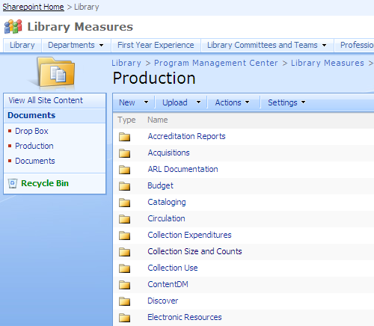
Notes:
Organize the data.
This is an example of something we have at Syracuse in the Program Management Center. SharePoint is a Microsoft product for sharing – it’s web-based.
I can upload statistics to this page make them accessible to others in the library system.
It utilizes the authentication system used by the university, and folders can be protected or limited to a few or many.

Slide 15
Is what we already know worth knowing?
Notes:
The data that we typically collect in libraries can be characterized as inputs and outputs
Inputs – how much is our collections budget; how much staff time is required to manage our interlibrary loan operations?
Outputs: How many uses did Medline get? How many users came to the Library; how many reference questions were handled?
This is all well and good, but it doesn’t say anything to our institution about the outcome of those measures
Ideally, we would think about measuring what we do also in terms of impact and outcomes.
The Rochester study is an excellent example of real outcomes that can be demonstrated potentially by library service – in their case it was patient care outcomes.
So think about what are those outcomes in your library?
Student success?
Faculty productivity?
Grants coming into the institution?

Slide 16
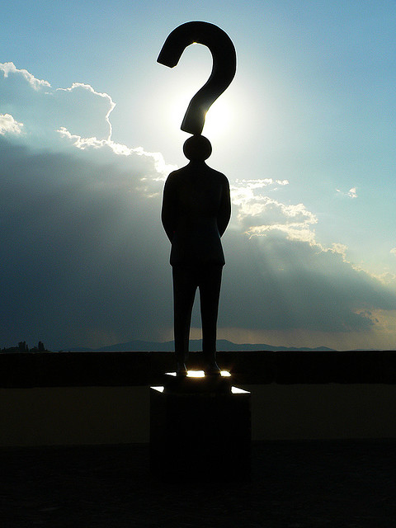
What are your key questions?
Notes:
What is the data that matters to us?
What matters to our stakeholders?
What is the story we want to tell about our library?

Slide 17
Notes:
Where are your gaps? So what do we need to get data on that we don’t already have?
Example: At Syracuse we had very spotty data on who was actually using the building and when.
Spot checks, but never anything too systematic –
It was difficult to get the different departments involved to agree on frequency, on level of detail. Do you count by floor? What about people in special study rooms
So in spite of the fact that the Dean often asked for numbers in this area, we were always scrambling to get the figures together, sometimes taking printed sheets and inputing them by hand into excel.
When the Program management Center was established, we systematized this process.
We created an online form that could be used; we provided training; we monitor the data as it is input.
We built an online dashboard or graph that allows you to see the numbers in real time.
And now we can always answer the questions that come our way.
Another question up – this was also posed by the Dean – what are students actually doing in the building.
Conducted “guerilla survey” –
printed on a card with one question – what are you doing in the library – options were work, recreation; school work –
we also asked for a students department and school and level.
Conducted this at different times of the day and days of the week, also weekends.
700 responses and were quickly able to demonstrate that students are primarily doing school work in the library.

Slide 18
Invigorate
Notes:
We tend to think about assessment as mostly a metrics or numbers driven enterprise.
But as someone whose background is in anthropology, I actually prefer the more qualitative approach to gathering data –
and there may be people on your staff that prefer this approach as well.
So Best Practice #3 is to invigorate staff with different approaches to assessment

Slide 19
Not Just Numbers: Qualitative Approaches
Ethnography (Photo Diaries, Observation)
Rochester
Usability Testing
University of Washington
Personas
Cornell
Interviews and Focus Groups
Syracuse
Notes:
It’s not hard to find examples of libraries doing more qualitative work in assessment or learning about users.
One of the groundbreaking examples is the University of Rochester.

Slide 20
Notes:
This was published in 2007 and is a compilation, by Nancy Foster (anthropologist) and Susan Gibbons (now the Vice Provost and Dean) of ethnographic work conducted with students at the University of Rochester.
Used ethnographic approaches – photo diaries, mapping journals; design charettes for information commons
The directors of these projects do not refer to their work as assessment; as that sounds evaluative ; the ethnographic approach is a neutral way of observing and analyzing what how users work; whether they be faculty or students.
The other striking aspect of this work is the involvement of so many library staff in the projects – through the training they received and the research work, it really changed how they thought about their work as librarians. One librarian describes listening in a different way to students during a reference interview, based on this work.

Slide 21
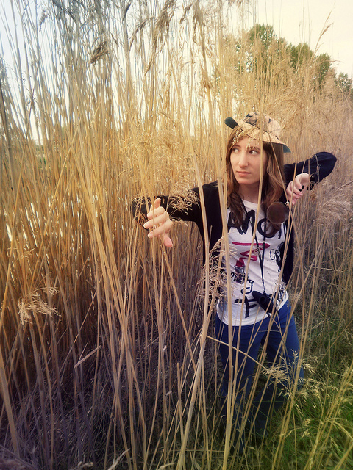
A Culture of Assessment
Notes:
Best Practice # 4
This week I was at the Library Research Seminar and one of the most powerful panels was a group from the National Institutes of Health Library
This is a library for whom each staff member has “research” participation as one of their performance goals.
So over the year they’ve conducted various research projects, after spending time getting some training in qualitative and quantitative research methods. One group of staff used focus groups and usability testing to evaluate a federated search interface for their researchers.
Another group conducted interviews with disaster response professionals to learn more about their information sharing needs.
A third group, and 27 staff members participated in this one – was to conduct a visual scan of how users were interacting with the physical space within the library – one hour each day a staff person would walk through the space and check off what behaviors were happening at each of the seating areas. This is a Library that is developing a culture of assessment. http://www.lrsv.umd.edu/abstracts/Hope_Joubert_et_al.pdf

Slide 22
Developing a Culture of Assessment
Reward assessment throughout the organization
Make assessment part of all new initiatives
Support ongoing assessment; the completion of a project is not its end
Make decisions based on data a transparent process
Make assessment ideas and trends easy to share through social networking tools
Notes:
How do we develop a culture of assessment in our organization?

Slide 23
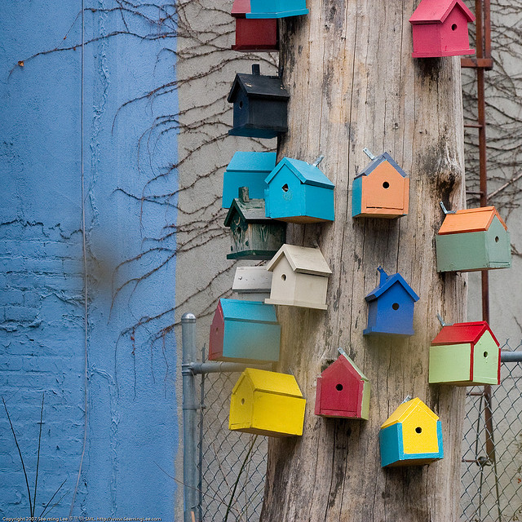
Social Networks
Notes:
Best Practice # 5 In conducting the environmental scan we also noted the use of social networking to communicate within and externally from the library what was going on both externally and internally.

Slide 24
Notes:
Outside the organization
http://libraryassessment.info/

Slide 25
Notes:
And inside the organization
The Cornell site’s Trend Tracker is a great use of creating awareness within the organization of assessment activities.

Slide 26
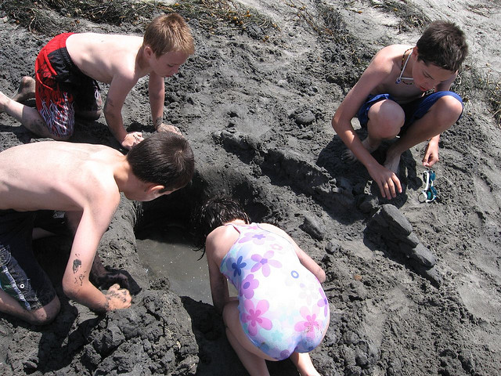
Collaboration
Notes:
Another “best practice” – number 6 is taking advantage of collaborative opportunities at your own institution or within your professional organization.

Slide 27
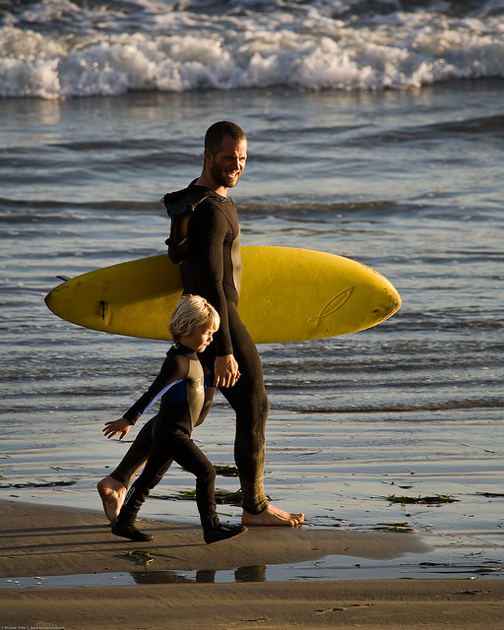
Bring in the experts
Notes:
There may also be experts in your institution that can help you to gain new skills, or may be a neutral way of moving your library forward.

Slide 28
Survey designers
Instructional designers
Focus group leaders
Usability testers
Graduate students
Office of Institutional Research & Assessment
Institutional Review Board (Human Subjects)
Technology centers
Institutional data repository
Users!
Notes:
Depending on your project, you may require a consultation with someone with more experience than you. Survey Monkey would have us believe that everyone can create a good survey – but that is not the case. Likewise, conducting focus groups with users – there may be people you can call upon to work with you collaboratively to develop a good plan for focus groups. I added “data warehouse” to this list. At Syracuse University we’ve coordinated with our institutional registrar and human resources data warehouse in order to set up an infrastructure that allows us to get demographic information on our users that we don’t collect within our ILMS.

Slide 29
Value
Notes:
Demonstrating Value and Impact is the Best Practice #7
The word we’re hearing a lot these days is Value – Return on Investment – how libraries demonstrate their value, sometimes very literally in dollars and cents, to their institutions.
A classic example of value assessment is the Rochester Study - Rochester measured
quality of information provided
cognitive value of information
contribution to patient care
whether information saved time of physician
Another example of this value trend is
Meagan Oakleaf’s
Value of Academic Libraries: A Comprehensive Research Review and Report.
Chicago: Association of College and Research Libraries, 2010.
The Association of Research Libraries recently conducted a survey of its membership to evaluate how libraries were measuring impact. How are they correlating library services with student success, library instruction with information literacy skills, or library use and research output of faculty. They report that “libraries reported shockingly little work that focuses on investigating whether use of library resources and services correlate with measures of success for library users. 19 respondents were doing something; 55 respondents from 124 libraries.

Slide 30
Strategic Planning
Social Networks
Culture of Assessment
Invigoration
Data-Driven Decisions
Demonstration of Value
Collaboration
Notes:
Think back on the two library annual reports. The requests for new funding. The successful libraries are those that not only collect, make accessible and report on solid data and cultivate a culture of assessment within the organization, but they can talk about these measures in ways of value to their stakeholders.
Our assessment practice and our assessment reporting can not be conducted in a vacuum.
We have an end goal of both supporting our institutions and advocating for what we do.
So I hope that I’ve inspired you a bit to get started on this endeavor.

Slide 31
Best Reads:
Association of College and Research Libraries. Value of Academic Libraries: A
Comprehensive Research Review and Report. Researched by Megan Oakleaf.
Chicago: Association of College and Research Libraries, 2010.
Published online at www.acrl.ala.org/value
Dugan, Robert E., Peter Hernon and Danuta A. Nitecki. Viewing Library Metrics from Different Perspectives: Inputs, Outputs and Outcomes. Santa Barbara, CA: Libraries Unlimited, 2009.
Housewright, Ross. "Themes of Change in Corporate Libraries: Considerations for Academic Libraries." portal: Libraries and the Academy 9, no. 2 (2009): 253-271.
Marshall, Joanne G. "Measuring the Value and Impact of Health Library and Information Services: Past Reflections, Future Possibilities." Health Information and Libraries Journal 24
(2007): 4-17.
Poll, Roswitha and Philip Payne, “Impact Measures for Libraries and Information Services” Library Hi Tech 24 no. 4 (2006) 547-62

Slide 32
Picture Credits:
Artist Toolbox , Photo by Gauri Ma http://www.flickr.com/photos/gauri_lama/2663421966/
Chess pieces. P. Shanmugan. http://www.flickr.com/photos/pshan427/2331162310/
Data storage: new and old http://www.flickr.com/photos/ian-s/2152798588/
Shell Collection http://www.flickr.com/photos/backpackphotography/249515782/
Mind the gap. Photo by Pawel Loj: http://www.flickr.com/photos/limaoscarjuliet/3305886294/
On Beach. Michael Baird. http://www.flickr.com/photos/mikebaird/2985066755
Collaboration. Photo by Jeff Hester: http://www.flickr.com/photos/jeffhester/165316370/
Explorer. Photo by Gemma Bou: http://www.flickr.com/photos/gemmabou/4622213880/
Question Mark Man. Photo by Marco Bellucci: http://www.flickr.com/photos/marcobellucci/3534516458/
Invigorating. Photo by Prabhu. http://www.flickr.com/photos/pshan427/2546198871/
Bird Houses. Photo by See-ming Lee : http://www.flickr.com/photos/seeminglee/2149309015/
Surfer Man and Son. Photo by Mike Baird : http://www.flickr.com/photos/mikebaird/3072645479/
Birds Flying in V shape . Photo by Cornelia Kopp: http://www.flickr.com/photos/alicepopkorn/4100873011/

