Slide 1
Learning Styles Reconsidered Peter Tagtmeyer Upstate New York Science Librarians 2022 Meeting
Learning Styles Reconsidered
Motivation for considering learning styles
Overview of cognitive style concepts
Learning styles as applications cognitive styles
Early history of the emergence and study of learning styles
Critical analysis of the evidence of efficacy in teaching to learning styles
Historical causes for continuing beliefs in learning styles
Pedagogical concerns regarding learning styles based instruction
Other theories that might guide learning and teaching practices
Notes:
Introduce Self
Go through outline
Charlie Brown story
Gaming Meyers & Briggs through time
Pursuit of learning and teaching efficacy in one shot instruction as a motivator for interest

Slide 2
Learning Styles Reconsidered Peter Tagtmeyer Upstate New York Science Librarians 2022 Meeting
ACRL Instruction Section - Research Agenda
Tailoring library instruction sessions to accommodate various learning styles – such as visual, auditory and kinesthetic – has gained prominence in the past few decades. However, recent literature has questioned librarians’ reliance on a learning styles approach. And yet, discerning how different learners will learn most effectively, how to balance the variety of styles preferred in one class, and how to adapt to these learning styles in both traditional and online learning environments requires special attention.
https://acrl.ala.org/IS/instruction-tools-resources-2/professional-development/research-agenda-for-library-instruction-and-information-literacy/
Accessed 4 Oct 2022
Notes:
Identify ACRL IS research agenda
Note ambivalence with firm support for pursuit of researching learning styles.

Slide 3
Learning Styles Reconsidered Peter Tagtmeyer Upstate New York Science Librarians 2022 Meeting
ACRL Instruction Section - Research Agenda
What evidence exists for determining different learning styles?
How effective are different methods of instruction for addressing various learning styles?
What characteristics of learning environments positively impact the experiences of people with each of the various learning styles?
What impact do different learning styles have on the effectiveness of various teaching methodologies?
What impact do online learning environments have on learning styles and what are the implications for library instruction?
How can we promote active learning to accommodate all learning styles?
https://acrl.ala.org/IS/instruction-tools-resources-2/professional-development/research-agenda-for-library-instruction-and-information-literacy/
Accessed 4 Oct 2022
Notes:
Note ambivalence with firm support for pursuit of researching learning styles.

Slide 4
Learning Styles Reconsidered Peter Tagtmeyer Upstate New York Science Librarians 2022 Meeting
Generally, styles are:
“habitual patterns or preferred ways of doing something (e.g., thinking, learning, teaching) that are consistent over long periods of time and across many areas of activity... The more specific term cognitive style refers to an individual’s way of processing information.” (Sternberg & Grigorenko, 2001, p. 2).
Notes:
Styles at the interface of intelligence and personality
Note Robert Sternberg as a prominent researcher and proponent of cognitive style research.
Note that the definitions of cognitive styles, like styles themselves, are multiple and varied.

Slide 5
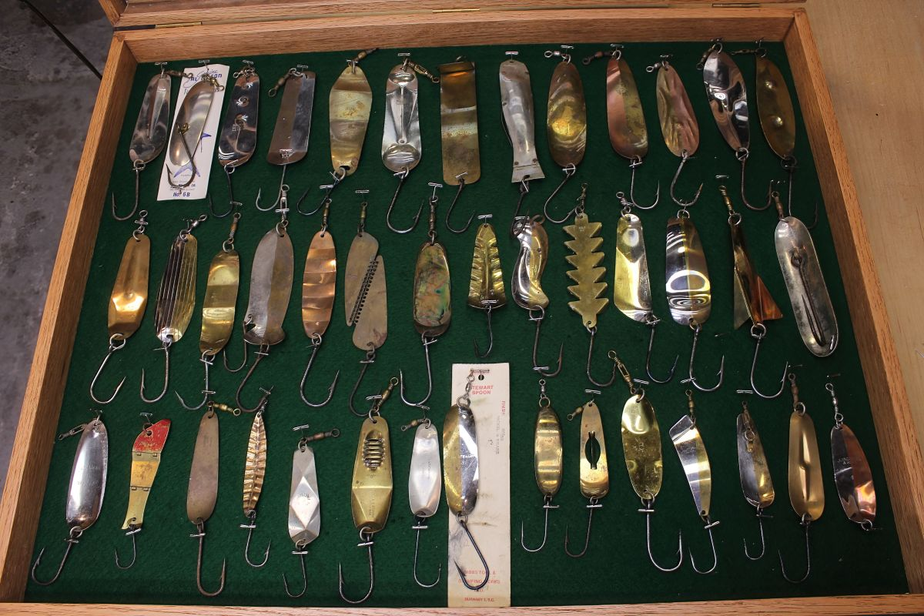
Notes:
How is a salmon spoon like a cognitive style?
All structured for the same purpose, but all taking varied approaches to the task (how they appear, how they move through the water.)
Going further, functional success is dependent on environment; for spoons, gotta be where the fish are.
Does the same hold true for successful learning and thinking? Can a person be put in a successful fishing hole?

Slide 6
Learning Styles Reconsidered Peter Tagtmeyer Upstate New York Science Librarians 2022 Meeting
Gordon W. Allport is acknowledged for early conceptualization of cognitive styles in his 1937 work Personality: A Psychological Interpretation.
He used the phrase style of execution to characterize how expressive behavior relates to adaptive behavior:
“The reason for a present act of conduct is to be sought in the present desires and intentions of the individual … but the style of execution is always guided directly and without interference by deep and lasting personal dispositions.” (Allport, 1937, p. 466).
Notes:
Allport differentiates what someone does and how someone does it, the how being a matter of style deriving from personality.
Allport’s conceptions of style are derive from Jung’s theory of personality types. (This was, to me an early indicator of the difficulties of both the breadth and variety of different styles, and well founded empirical evidence for their definitions and discernment.)
Allport supposedly coined the term “cognitive style” but it’s now believed that Riley W. Gardner is the first to use the phrase in a 1953 paper about categorizing behavior. (Not Howard Gardner, Multiple intelligence's) (Allport, 1937, p. 466)

Slide 7
Learning Styles Reconsidered Peter Tagtmeyer Upstate New York Science Librarians 2022 Meeting
Kinds of Cognitive Styles
Field dependence / independence
Leveling / sharpening (lumping vs splitting)
Category width – how big is big, how small is small (how accurate is your style? Is it ability?)
Reflection / Impulsivity – do it with care / get er done - type perfectly / fast
Conceptual Style
analytic-descriptive (grouping based on commonality of appearance)
relational (grouping based on function or theme)
inferential-categorical (grouping based on inferred, abstract similarity)
Are conceptual styles differences in style or ability?
Notes:
FD/I – visual domain - Rod and Frame Test / Embedded Figures Test – Is it style or ability?
Category Width – How is an individual’s particular perception to be known without testing?
Styles should be neutral in their relation to ability. There is evidence that FD/I correlates with spatial ability.
Here concludes consideration of cognitive styles in general.

Slide 8
Learning Styles Reconsidered Peter Tagtmeyer Upstate New York Science Librarians 2022 Meeting
Learning styles are a subset of cognitive styles that consider different ways of receiving and processing information in learning behaviors.
“The major noticeable difference between the ways cognitive styles are defined and the ways learning styles are defined is that the former concern multiple contexts whereas the latter pertain to learning situations only.” (Zhang & Sternberg, 2006, p. 6)
Notes:
Before moving on, let’s look a a bit earlier history.

Slide 9
Learning Styles Reconsidered Peter Tagtmeyer Upstate New York Science Librarians 2022 Meeting
Wayback Machine
Psychological study of learning processes and efficacy based on differences began way earlier than the formation of cognitive style theory, and in a foreign land.
Meumann suggested perceptual differences in learning processes as “ideational-types”,
He identified Visual, Auditory, Tactual-Motor as “Types of Concrete Ideation”.
“the apprehension of sensory impressions, which constitutes the first step in the act of learning, must be different in individuals whose modes of ideation are different. The visualizer imprints upon his consciousness a picture of the printed or written word and of the spatial arrangement of its parts… The individual who belongs to the auditory or to the motor type immediately transforms the visual pictures, obtained from reading, into heard or spoken words.” (Meumann, 1913, pp. 180–181)
Notes:
Meumann’s treatment of learning behavior traits suggests that ideas of differential perception in learning processes were theorized in the early twentieth century.
Comparative measure of learning performance as affected by different instruction processes were yet to be.
“Unfortunately, we possess as yet no investigations which have made a special study of the relative fidelity of retention by the various ideation types.” (Meumann, 1913, p. 182)
Other early research projects examined different instruction modalities, but didn’t consider or characterize individuals’ modal preferences.

Slide 10
Learning Styles Reconsidered Peter Tagtmeyer Upstate New York Science Librarians 2022 Meeting
Frank Riessman is said to be the first to use the phrase “learning style” in 1962.
Riessman associated learning styles with socioeconomic and racial groups of people, and not individuals.
This was seemingly a trend at the time noted by Curry in the 80’s.
Studies at the time didn’t find evidence for such.
Race and class based LST research diminished seemingly quickly in the 70’s.*
Research regarding individuals and learning styles noticeably increased.
Notes:
Riessman associated learning styles with socioeconomic characteristics of groups of people, and not individuals.
In his work a name for the group of people he considered he termed “Low Income Culture”.
The application of LST to groups of people rather than individuals happened when school integration of was occurring nationally.
Remember stories of Boston school integration
Anthropologists and sociologists were involved, and Fallace (unpublished) suggested that
“the new definition of culture inspired sociologists and anthropologists to replace theories of biological deficiency with newer theories of cultural deficiency”
So now we have anthropology and sociology being meshed with educational and psychological frames of study of LST.
* - It was determined that texts containing references to learning styles only within the context of multiculturalism lacked key aspects designated in the protocol, and thus they were not coded as covering learning styles. For example, in O’Donnell, Reeve, and Smith’s (2012) educational psychology textbook, the authors include a section labeled ‘‘Knowledge and Learning Styles’’ yet only refer to conflicts between learning styles of students with diverse cultural backgrounds.

Slide 11
Learning Styles Reconsidered Peter Tagtmeyer Upstate New York Science Librarians 2022 Meeting
Learning Style Theories (LST) Gone Wild
Lynn Curry characterized and classified 21 different learning style theories in 1983.
Coffield et. al. surveyed the field in 2004 and identified 71 theories.
Both Curry and Coffield found many learning style constructs lacking theoretical coherence
Issues regarding questionable theory constructs :
Ill-defined psychometric measures lacking reliability and validity were common in questioned theories.
Self-reported and self-discerned determination of style measures.
Paucity of empirical evidence for many theories
Notes:
Both Curry and the Coffield crew worked to organize the mass of theories into a logical order.
Both found theoretical incoherency, inaccurate instruments, and a paucity of convincing empirical evidence for many of LST constructs.
A lack of discourse among involved researchers suggested an “impression of a research area that has become fragmented, isolated and ineffective” Coffield p.136

Slide 12
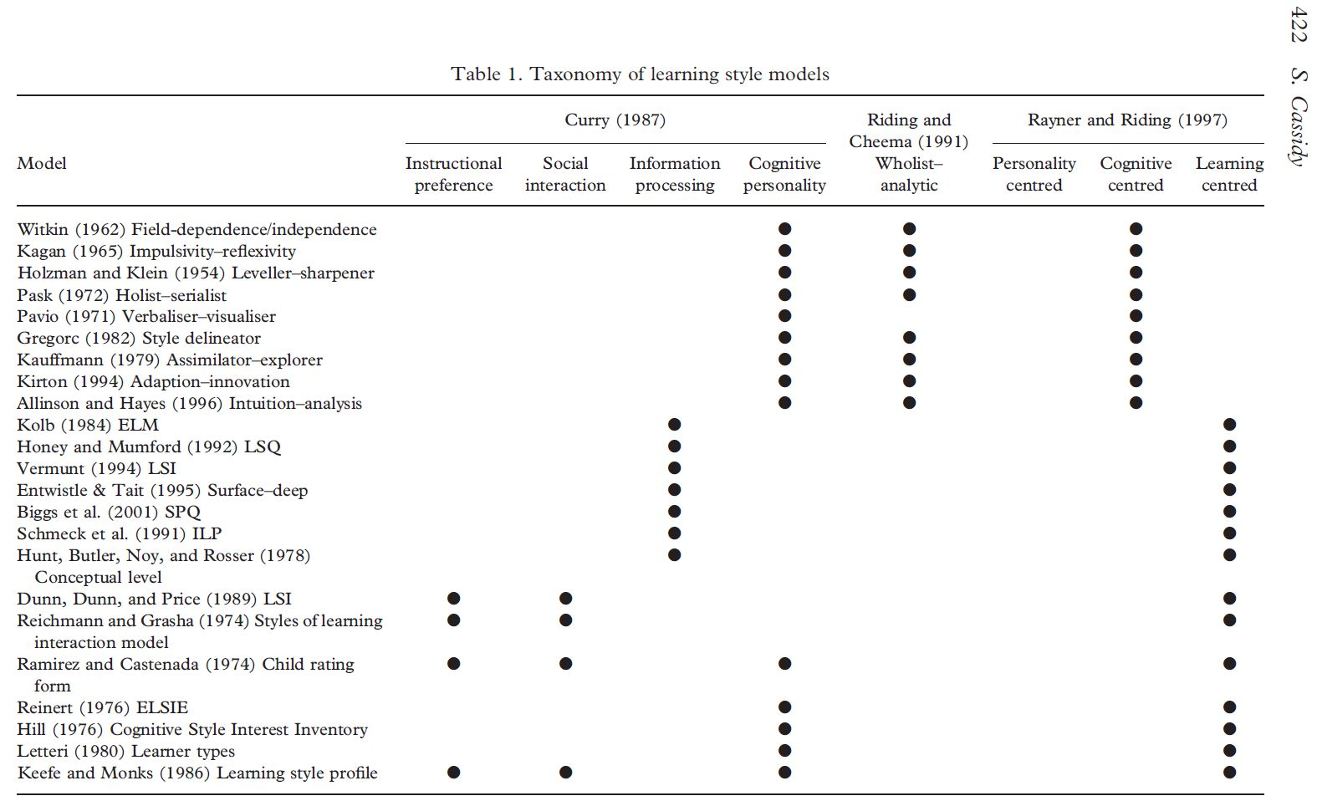
Learning Styles Reconsidered Peter Tagtmeyer Upstate New York Science Librarians 2022 Meeting
Cassidy, S. (2004). Learning Styles: An overview of theories, models, and measures. Educational Psychology, 24(4), 419–444.
Notes:
Cassidy, S. (2004). Learning Styles: An overview of theories, models, and measures. Educational Psychology, 24(4), 419–444.
Crazy wild differentiation, and inherent, persistent issue with styles.

Slide 13
Learning Styles Reconsidered Peter Tagtmeyer Upstate New York Science Librarians 2022 Meeting
One Test to True Them All
Pashler et al. (2008) were commissioned by Psychological Science in the Public Interest to determine if LST were “supported by scientific evidence.”
Posited a fundamental understanding that “instruction should be provided in the mode that matches the learner's style”, the meshing hypothesis.
Proposed a “cross-over interaction” testing method.
The method is taken from another line of education psychology research, study of “Aptitude-Treatment Interactions”. (Cronbach & Snow, 1977)

Slide 14
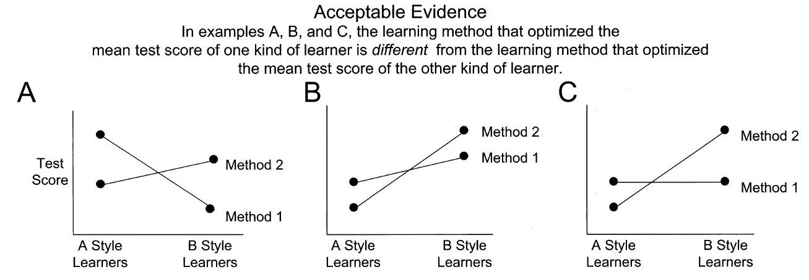
Learning Styles Reconsidered Peter Tagtmeyer Upstate New York Science Librarians 2022 Meeting
Pashler, H. et al. (2008) p.111

Slide 15
Learning Styles Reconsidered Peter Tagtmeyer Upstate New York Science Librarians 2022 Meeting
Seeking Verity
Pashler et al. subsequently found but a single LST investigation that used their crossover interaction research method.
Rohrer & Pashler (2012) again looked for LST studies that employed the crossover interaction method and found 20 with only 3 reporting weakly positive results.
Cuevas (2015) surveyed post 2009 literature. Only 31 studies from around 1400 didn’t use correlational analysis. 16 were omitted for being published in predatory journals. 8 studies demonstrated an interaction effect, 2 of them weakly positive.
Aslaksen and Lorås (2018) identified 1215 works addressing visual-auditory modality based learning styles and found 10 studies that used the crossover interaction method. No significant findings were reported.
Notes:
Cuevas comments on the finding that much LST literature is found in less reputable journals.
Aslaksen and Lorås , publication dates of the selected studies spanned from 2002 to 2016, and none of them were included in Cuevas’s study.
The evidence is fairly comprehensive and clear, why does interest in LST persist?

Slide 16
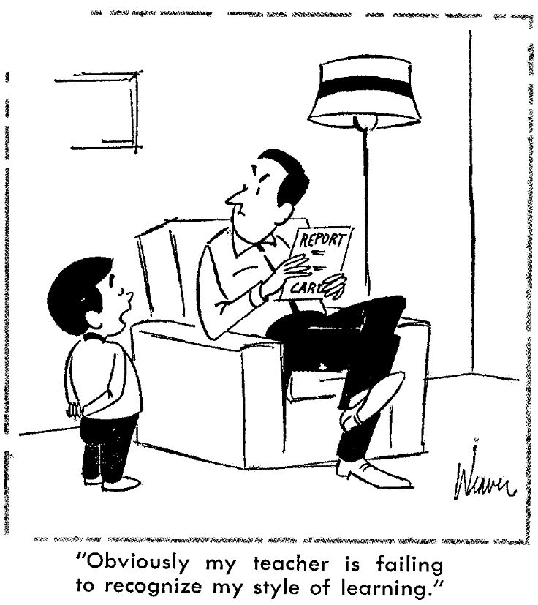
Learning Styles Reconsidered Peter Tagtmeyer Upstate New York Science Librarians 2022 Meeting
Lacking Firm Evidence, Why is LST Still Popular?
Recent measures of LST popularity show little abatement in interest. (Newton & Salvi, 2020; Olsen et al., 2022)
Inherent feel-good, non-culpable rationality
Riessman, F. (1966). Styles of Learning. NEA Journal, 55(3), p.17.
Notes:
Newton & Salvi, 2020 examined survey literature of educators beliefs. a weighted 89.1% of participants agreed with the idea that “individuals learn better when they receive information in their preferred learning style” (2020, p. 5).
Olsen et al., 2022) looked at empirical peer-reviewed K-12 learning styles focused literature. Analysis of 268 articles. “There were 10 (3.72%) articles that questioned learning styles, 0 (0%) articles that opposed learning styles, and 258 (96.27%) articles that promoted learning styles” (p. 48)

Slide 17
Learning Styles Reconsidered Peter Tagtmeyer Upstate New York Science Librarians 2022 Meeting
Lacking Firm Evidence, Why is LST Still Popular?
Sustained, organized institutional promotion:
James Keefe & the National Association of Secondary School Principals (NASSP)
Dunn & Dunn (Academic & Commercial)
D&D National and International Styles Networks
European Learning Styles Information Network
Teacher education and introductory psychology textbooks (Dekker & Kim, 2022; Wininger et al., 2019)
Government and professional organization guidance and regulations (Dunn, et al. 1991; Dekker & Kim, 2022).
Notes:
James W. Keefe, then Director of Research for the National Association of Secondary School Principals (NASSP), formed an organizational task force that developed another LST model and broadcast it through NASSP.
Wininger’s fond 16 of 20 textbooks contained discussion of LST, 5 positive 6 neutral 3 negative.
a good number of both introduction and educational psychology texts indicated teachers should use a variety of instructional methods. Fewer, mostly educational psychology texts, recommended teachers consider individual differences. Fewer still, mostly introduction to education texts, indicated teachers should differentiate instruction based on learning styles.
Dunn invoked the equal protection clause of the constitution for the formation of new regulation legislation in several states.

Slide 18
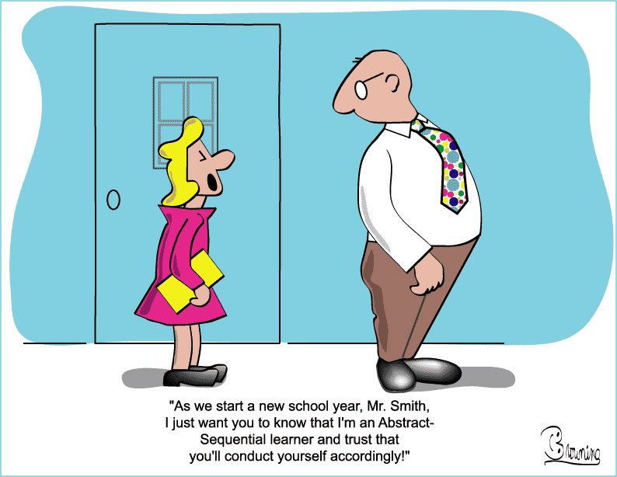
Learning Styles Reconsidered Peter Tagtmeyer Upstate New York Science Librarians 2022 Meeting
What Could Go Wrong?
Time, energy & money lost to accommodation (and not possible in a single session)
Student belief in LST can impair motivation
Greater learning efficacies via multi-modal instruction as suggested by dual-coding and cognitive load theories are un-attainable.
https://serc.carleton.edu/download/images/5929/learning_styles.jpg

Slide 19
Learning Styles Reconsidered Peter Tagtmeyer Upstate New York Science Librarians 2022 Meeting
Alternative Approaches to Improving Learning Efficacies
John Haittie’s meta-analytic study of teaching & learning literature (Hattie. 2009)
Sweller’s cognitive load theory (Artino, 2008; Sweller et al., 2019)
Related approaches, Mayer’s multimedia learning and Paivio’s dual-coding theory.
Notes:
Systematic reviews are all the rage in the medico literature, Hattie seemingly adopted this approach early on.

Slide 20
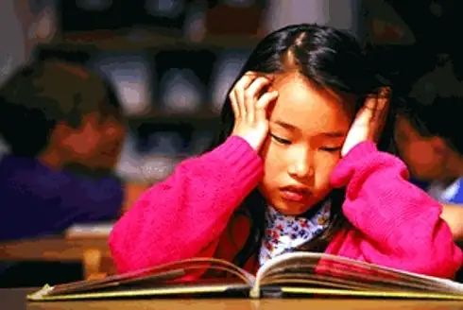
Learning Styles Reconsidered Peter Tagtmeyer Upstate New York Science Librarians 2022 Meeting
Thank you
A nasal learner struggles with an odorless textbook.
https://www.theonion.com/parents-of-nasal-learners-demand-odor-based-curriculum-1819565536

Slide 21
Learning Styles Reconsidered Peter Tagtmeyer Upstate New York Science Librarians 2022 Meeting
Bibliography
https://bit.ly/3TlIrcC

Slide 22
Learning Styles Reconsidered Peter Tagtmeyer Upstate New York Science Librarians 2022 Meeting
Footnotes

