Slide 1
Connecting with departments through impact study: Nature Index analysis for the University of Rochester
Jieer Chen, Data Analyst
jieer.chen@rochester.edu
Sarah Siddiqui, STEM Librarian
ssiddiqui@library.rochester.edu
Notes:
Sarah
Good morning everyone. We are excited to be here today. My name is SS and I'm....joined by JC....
Our presentation today is going to about our "quest" to build on relationships with academic departments in the area of research impact. For subject liaisons, our discussions tend to center more around collections, reference and teaching support but as we know, bibliometrics are a growing area of strength in which libraries can support our researchers. With the example of the Nature Index, today we will be describing how we got the opportunity to learn moreabout our researchers and connect with stakeholders across the university to move forward in our pursuit.

Slide 2
Agenda
Nature Index
Nature Index
Data in Nature Index
Nature Index Project
Project Scope
Project Phases
Dashboard Insights
Feedback and Next Steps
Stakeholder Feedback
Learning and Next Steps
Notes:
Sarah
I'll quickly go over our plan for the next 15-20 minutes (with time for questions at the end). We will briefly explain what the Nature Index is and the kind of data it provides. Then we'll go into how we used the index and performed analyses that describe the University of Rochester's research activity. Finally we will look at the feedback we received from various stakeholders and the lessons we learned.

Slide 3
I. Nature Index | Definition & Application
The Nature Index is primarily a free database of author affiliation information that reveals global publication and collaboration patterns.
It captures all author affiliation information of primary research articles published within a group of selected journals (n=82).
It stores whole article counts (Count) and fractional article counts (Share) for each article.
Nature Index releases a set of country- and institutional-level tables based on counts of high-quality research outputs in the previous calendar year.
Fields of Research: Chemistry, Life Sciences, Physical Sciences, Earth & Environmental Sciences.
Using the Nature Index
Source: Nature Index
Notes:
Jieer
Nature Index is a database that tracks the scientific output of institutions and countries since its introduction in 2016.
It captures all author affiliation information of primary research articles published in 82 high quality nature science journals, chosen by a group of independent researchers
It tracks the contribution to those research articles by using whole article counts and fractional counts of article publication at the institutional and national level and as such, it is an indicator of global high-quality research output and collaboration.
Each year, Nature Index ranks the leading institutions and countries by the number of primary research articles published in leading journals.
The rankings can be order by either Count or Share metric,
And can be categorized by four individual fields of research, which are Chemistry, Life Sciences, Physics, and earth environmental science, with different institutions leading in each.
------------------------------------------------------------------------------------------------------------------------------------------------------
Reference:
https://www.natureindex.com/using-the-index
Last year, when Sarah and I were tasked to look into the nature index, the first group of questions we asked were
What is Nature Index?
and how it is used?
An independent advisory panel including 58 actively publishing scientists from across the natural science disciplinary spectrum was convened to consider the journals to be included in the Nature Index.
The Count and Share metrics are called Nature Index metrics.
For count, A country or an institution is given a Count of 1 for each article that has at least one author from that country/region or institution.
For share, If authors from several institutions and/or countries are involved in a scientific article, it is divided accordingly, assuming that all researchers were equally involved in the article.

Slide 4
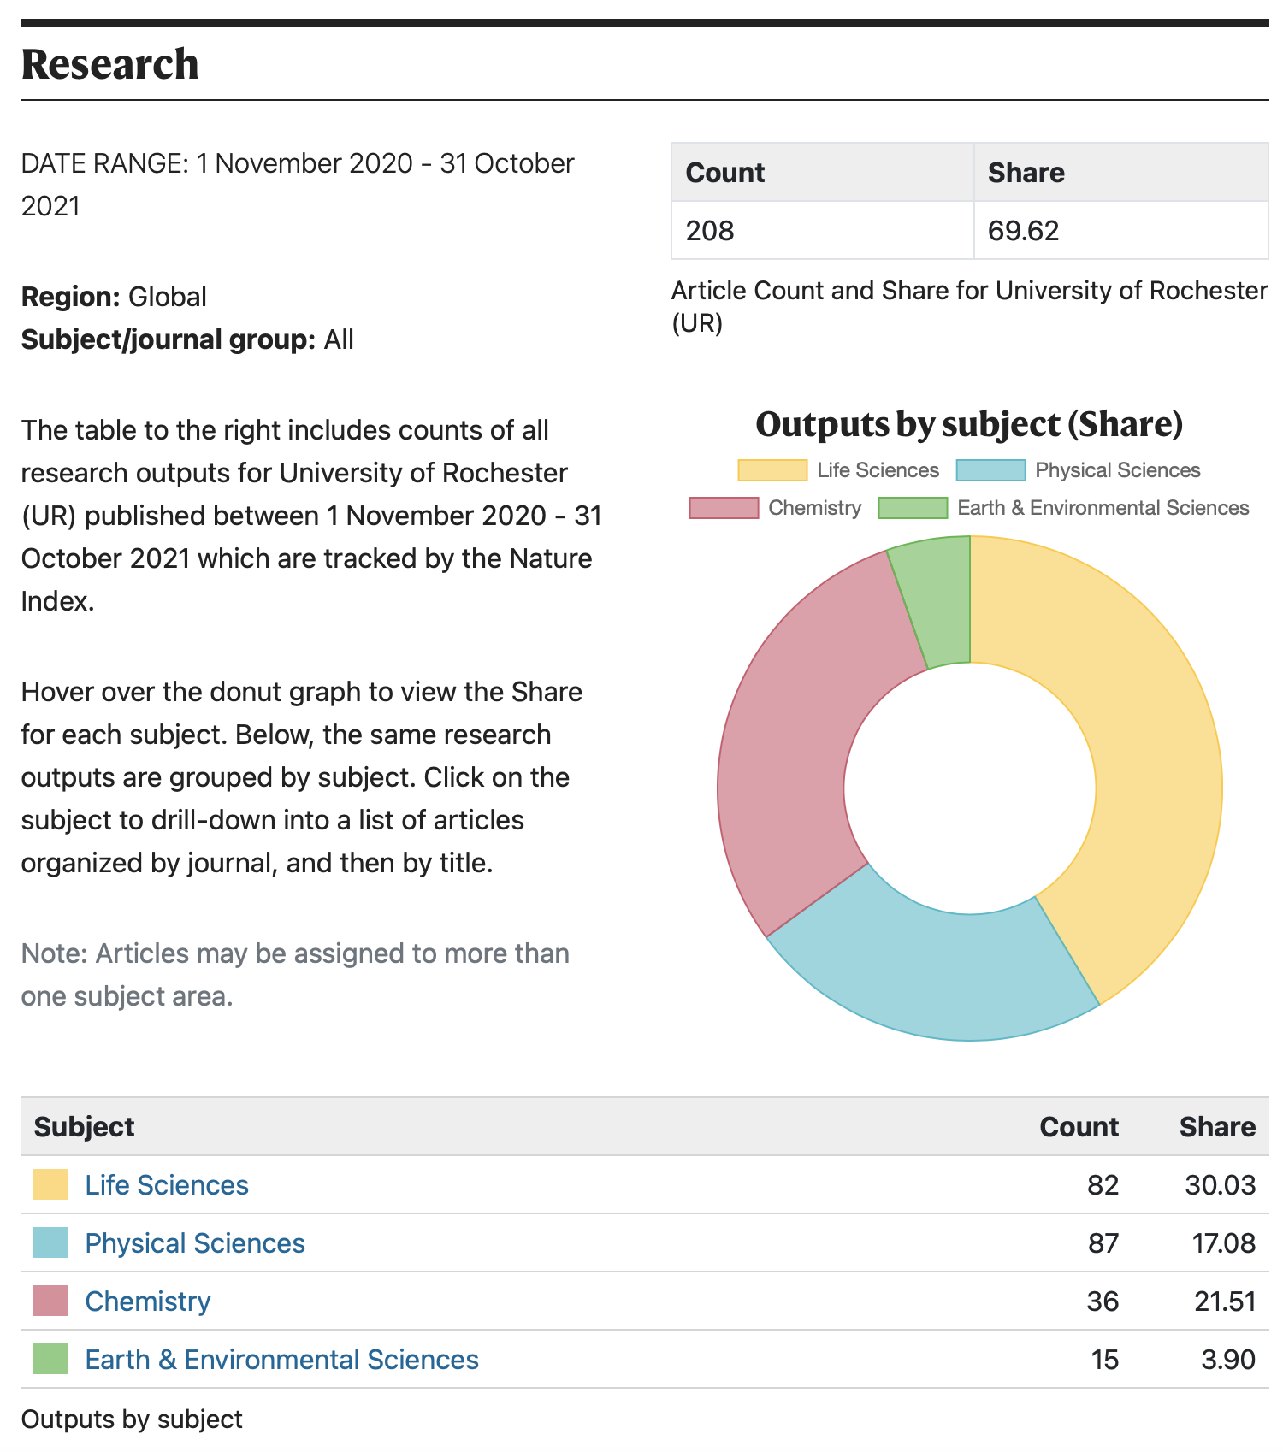
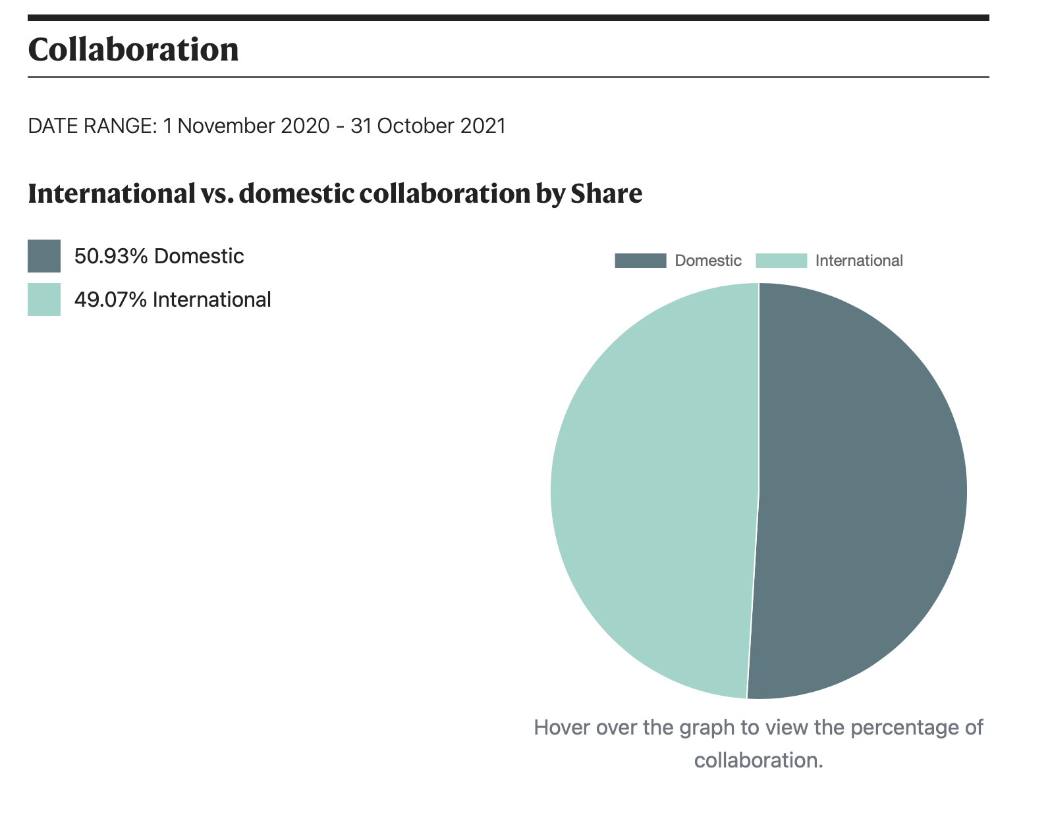
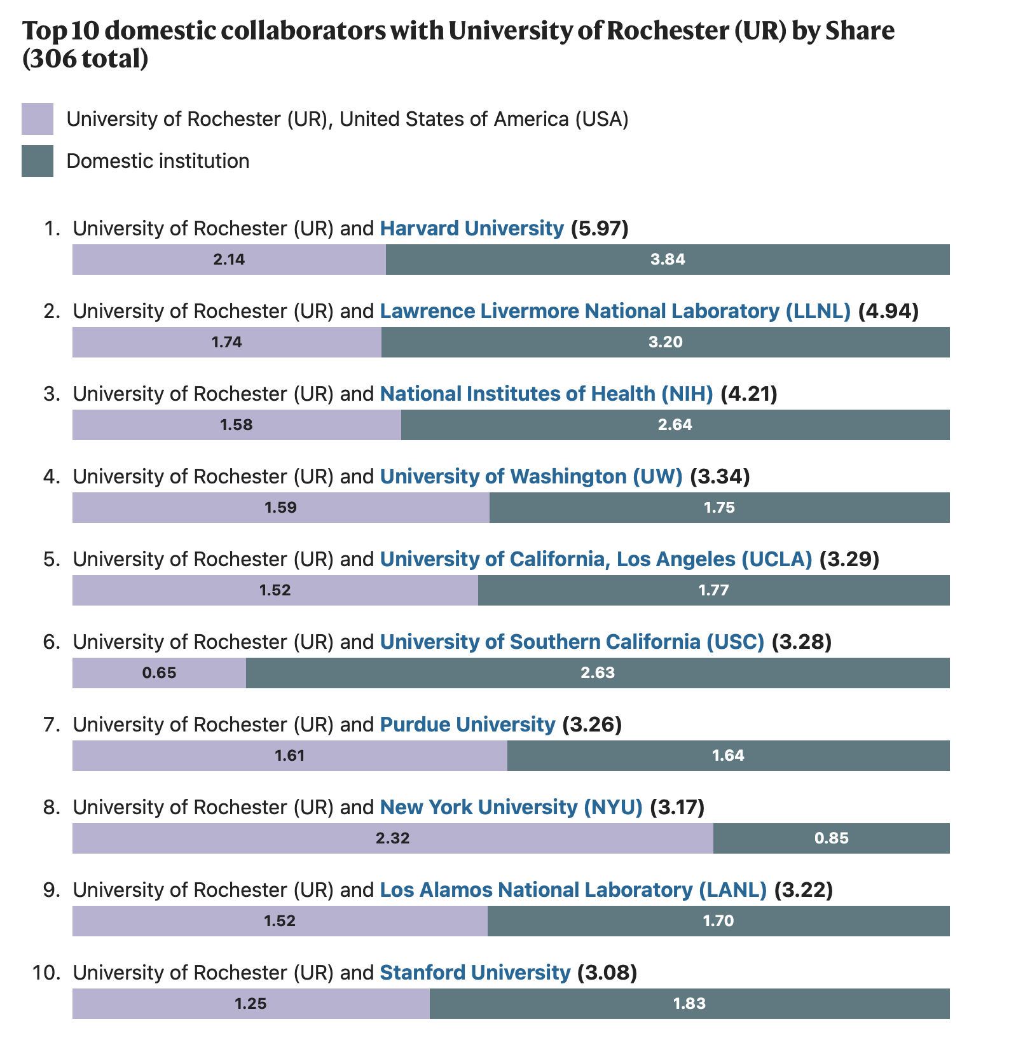
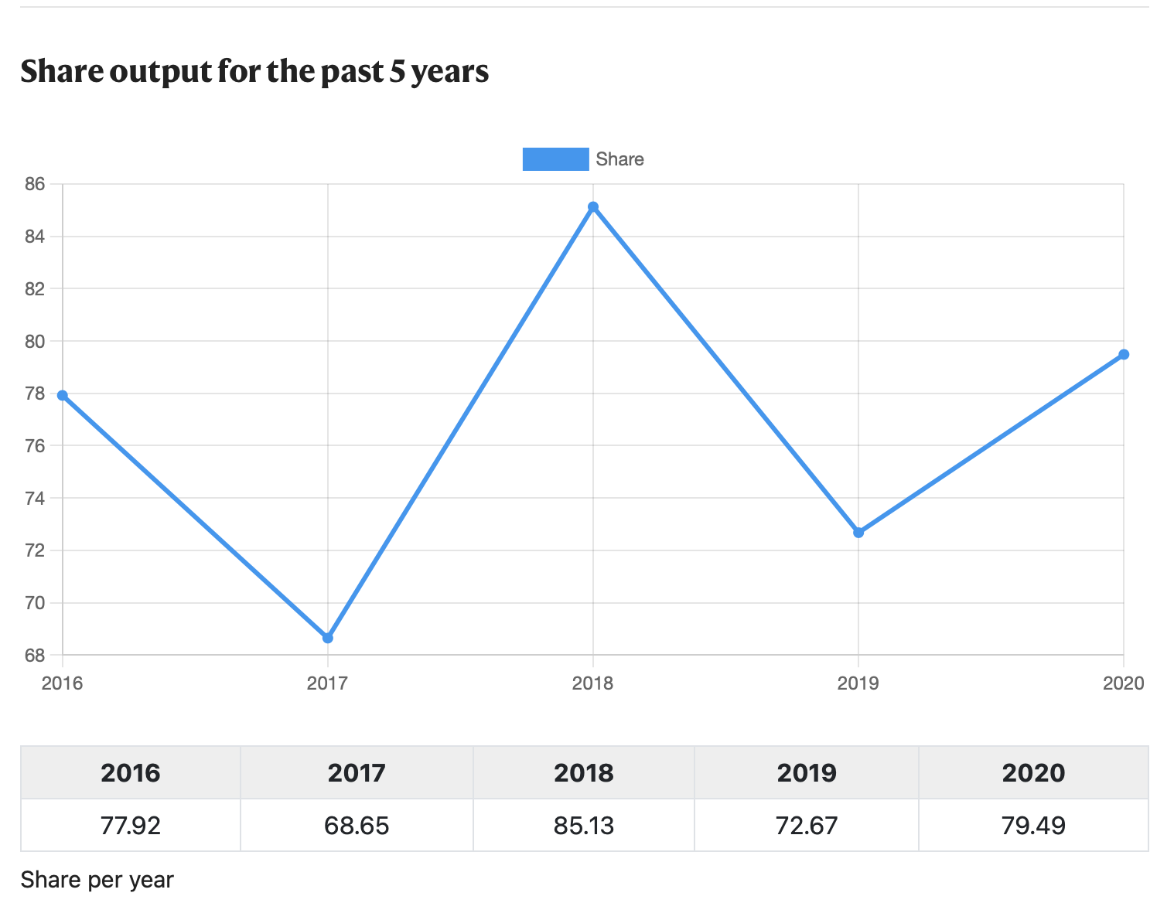
I. Nature Index | Data in Nature Index
Data in the Naure Index:
Updated periodically.
Available for only a rolling 12-month period.
Article-level information is available.
Profile Page of the University of Rochester:
Data Range: Nov 2020 – Oct 2021
Articles can be displayed by journals and then articles.
Data could be incomplete:
A time lag between when your article is published and when it is added to the Nature Index.
Articles may be missed due to technical issues.
Nature Index Profile Page of University of Rochester ()
Source: Nature Index
Notes:
Jieer
(1)
Data in the Nature Index are updated regularly,
And are made available for a given rolling 12-month period.
The nature index website provides article-level information in a institution or a country's profile page.
(2) Take the profile page of the University of Rochester as an example.
The first table includes counts of all research outputs tracked by the Nature Index for University of Rochester (UR) published between November 2020 and October 2021 .
In the second table, the same research outputs are grouped by subject. You can click on the subject to drill-down into a list of articles organized by journal, and then by title.
(3) Through our assessment of the metric, we learned that the data available in the website can be incomplete. There could be a time lag between when your article is published and when it is added to the Nature Index. Sometimes articles may be missed due to technical issues.
-------------------------------------------------------------------------------------
Reference:
https://www.natureindex.com/using-the-index
The next questions we had in mind are:
what data is available in the Nature Index website?
Is the data accurate enough for us to use the Nature Index as an indicator of global high-quality research output and collaboration?

Slide 5
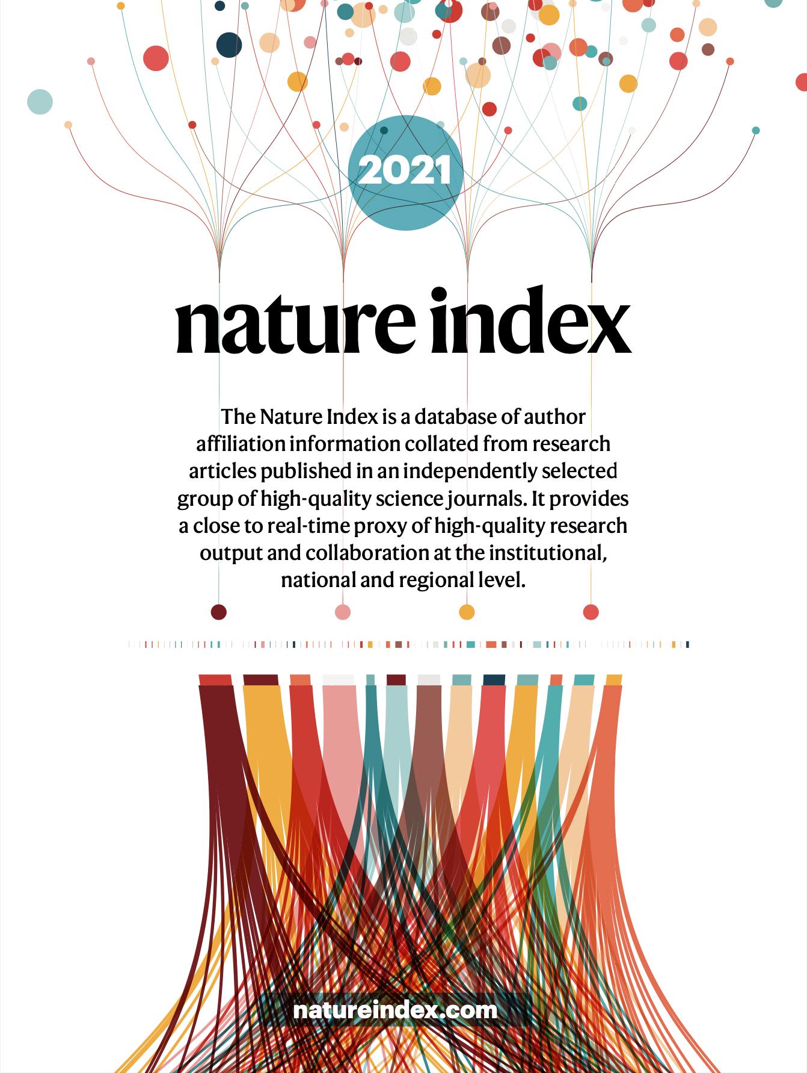
Nature Index Project
Nature Index
Nature Index
Data in Nature Index
Nature Index Project
Project Scope
Project Phases
Dashboard Insights
Feedback and Next Steps
Stakeholder Feedbacks
Learning and Next Steps
Notes:
Jieer
After learning the basics of nature index, we proceed to work on the Nature Index Project. In this part, we'll talk about
the scope of our project,
the three phases our project went through,
and the kind of insights we get from our data dashboards and analysis.

Slide 6
II. NI Project | Project Scope
Goal: Understand how the University of Rochester is represented in high quality research journals.
Journals
Publications
How does the number of papers change over time?
Researchers
Open Access
Funders and Research Organizations
What are the journals selected by Nature Index?
Which journals are our researchers publishing in?
How many publications does UofR have in the selected journals?
Who are the authors of those articles?
Are they primary authors?
Do the selected journals provide open access options?
Who and where are the funders?
Who and where are the collaborating research orgs, in terms of authorship?
What types of open access articles do we have?
Notes:
Jieer
When defining the scope of the project, we started with defining our project goals.
created a list of specific project goals.
Our general goal is to understand how the University of Rochester is represented in high quality research journals.
As for the specific project goals, We aim to answer the list of questions listed here.
Journals: What are the selected journals and which journals published our researchers' primary articles?
Publications: How many publications does UR have? What are the number of publications by year?
Researchers: Which UR researchers published in these journals? Are they primary authors?
Open Access: Are the selected journal open access journals? Are the journal articles open access?
Funder and Research Organizations: Which funding agencies and research organizations can we identify from the articles?

Slide 7
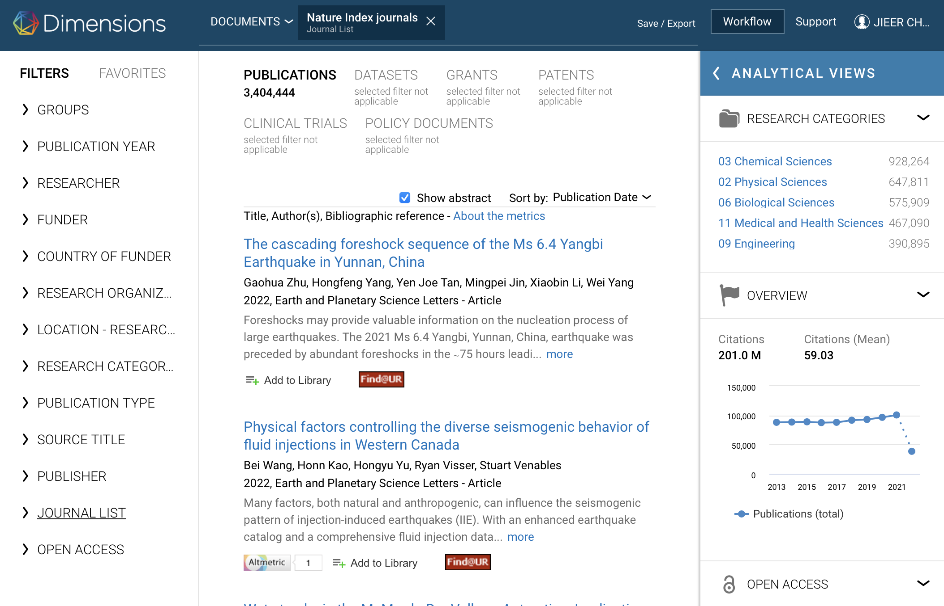
II. NI Project | Project Scope
Pilot Project
Field of Research: Earth and Environmental Sciences (EES)
Data Sources and Information
Scopus (CY2011 – Aug CY2021): Publications, Open Access, Authors. Query by journal title
Dimensions (CY2011 – CY2020): Funder, Research Organizations, Geolocation. Searched using NI filter
The "Nature Index journals" filter under "Journal List" in Dimensions
Source: Dimensions
Notes:
Jieer
We decided to start small and begin with only one subject . We chose earth and environmental sciences because it has a relatively short journal list, and UoR has a very active Earth and Environmental Sciences department.
After comparing data from Scopus, Dimensions, and Web of Science, we chose to collect data from Scopus and Dimensions in the past 11 or 10 years.
1. The Scopus data provides information on publications, open access, and authors information.
2. While the Dimensions provides additional information on Funder, Research Organizations, and geolocation information.
The data collection process in Dimensions is relatively easy compared to that in Scopus because there is a "Nature Index Journals" filter in dimensions that helps reduce the data cleaning work.
Next, Sarah will talk to you about the three phases of our project.
--------
Note for myself:
Dimensions (CY2011-CY2020):
When sharing the initial analysis from Scopus with our collogues, one of the collogues suggests us not to use data in 2021 given that the data in 2021 is still growing.
So for Dimensions, we only collected data between 2011 and 2020.
Review:
How did I collect the data from Dimensions
At the end of the project, we plan to
1. share a list of UR authors and their departments with the EES department head.
2. verify the libraries' access to the high qualify EES journals selected by the Nature Index
3. and have an understanding on the output level, open access trends, funding and Interntional collaboration of the EES publications from UoR.

Slide 8
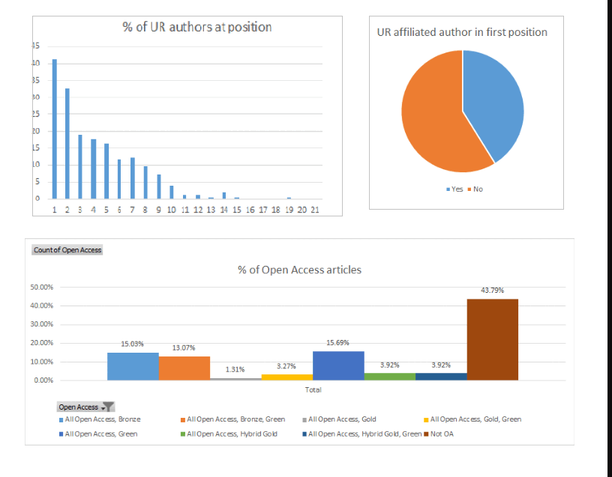
II. NI Project | Project Phase 1
Analysis
Start with Scopus Data
Spreadsheet Analysis
Google doc Report
Not very interactive & Too much information
Communication
EES Department Chair
Email conversations
Introduction to Nature Index
Timeline
3 months (Aug ‘21 – Oct ‘21)
Graphics & Tables from the Google Doc Report
Source: RCL NI Project
Notes:
Sarah
The project had 3 phases which I will now describe. We first started with the data in Scopus. Since there was no special NI filter, this required a lot of preprocessing to remove articles not affiliated to the UofR, some of which was done with OpenRefine. Majority of the analysis at this stage was done in Excel, creating charts and pivot tables depicted on the right. We shared all the information as a report in a Google Doc with accompanying text explaining the process. We also sent preliminary emails to the EES department chair to gauge his interest in the output. Much of this work was done in 3 months at the beginning of Fall 2021. One of the things we realized was that while a report format can be useful for supplemental information, it is not as interactive which led us to the next phase.

Slide 9
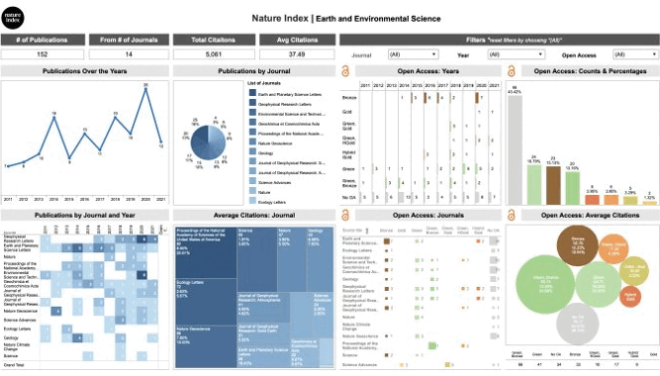
II. NI Project | Project Phase 2
Analysis
Scopus Data & Dimensions Data
Spreadsheet Analysis
Translated into Tableau dashboards
Commnication
STEM Librarians: prepared slides for a deep dive into the dashboard
EES Department Chair: Share dashboard with faculty via email
Timeline:
3 months (Oct ‘21 – Dec ‘21)
Initial Dashboards
Source: RCL NI Project
Notes:
Sarah
Around this time, we also looked at the data in Dimensions using the Nature Index filter. As mentioned earlier, the Scopus data was used to dive into questions pertaining to the journal articles, researchers and open access, and the Dimensions data was helpful for funding information. The initial analysis was again done in Excel, but the charts were then transferred into a Tableau dashboard which was much more interactive and allows the users to see corresponding trends. For instance we could see the number of publications over the years in a specific title while also noting how many of them were open access and the type such as green, gold, etc. We also prepared slides detailing our findings and went over them in a meeting with the other STEM Librarians, and emailed a link to the dashboard to the EES Chair. This phase took place in the second half of the fall semester.

Slide 10
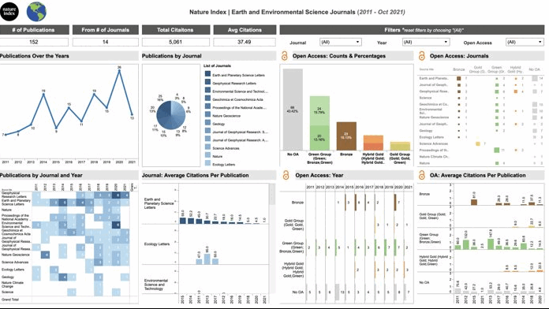
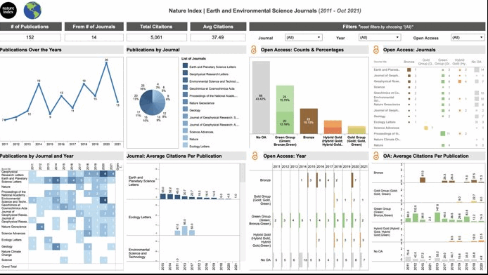
II. NI Project | Project Phase 3
Analysis
Modified dashboards based on feedback, e.g. merged some OA categories in Scopus data
Communication
Library Leadership and University Institutional Research: prepared slides for a deep dive into the dashboard
EES Department Chair: Dashboard deep dive over Zoom
Timeline:
2 months (Feb ‘22 – Mar ‘22)
Finalized Dashboard Design
Source: RCL NI Project
Notes:
Sarah
The 3rd phase of the project involved making some modifications to the dashboard based on the feedback we received. I'll talk more about that towards the end, but one suggestion was to simplify the charts. Scopus data contains additional categories of open access based on combinations, for example green + gold is separate from just green and gold. To simplify our analysis we merged these so we there were only the four broad categories. We also added charts showing the average citations received by an article, also allowing users to see the relationship between the various types of open access articles and their citations.
We also made some changes to the funding charts so it's visually easier to see which funding organizations have contributed to UR research output.
Following all the modifications, we presented our findings to the senior leadership at the library and university and also did a deep dive into the dashboard for the EES chair. Both of these were over Zoom and were done during the spring semester.
Next, Jieer is going to share some specifics from our findings..

Slide 11
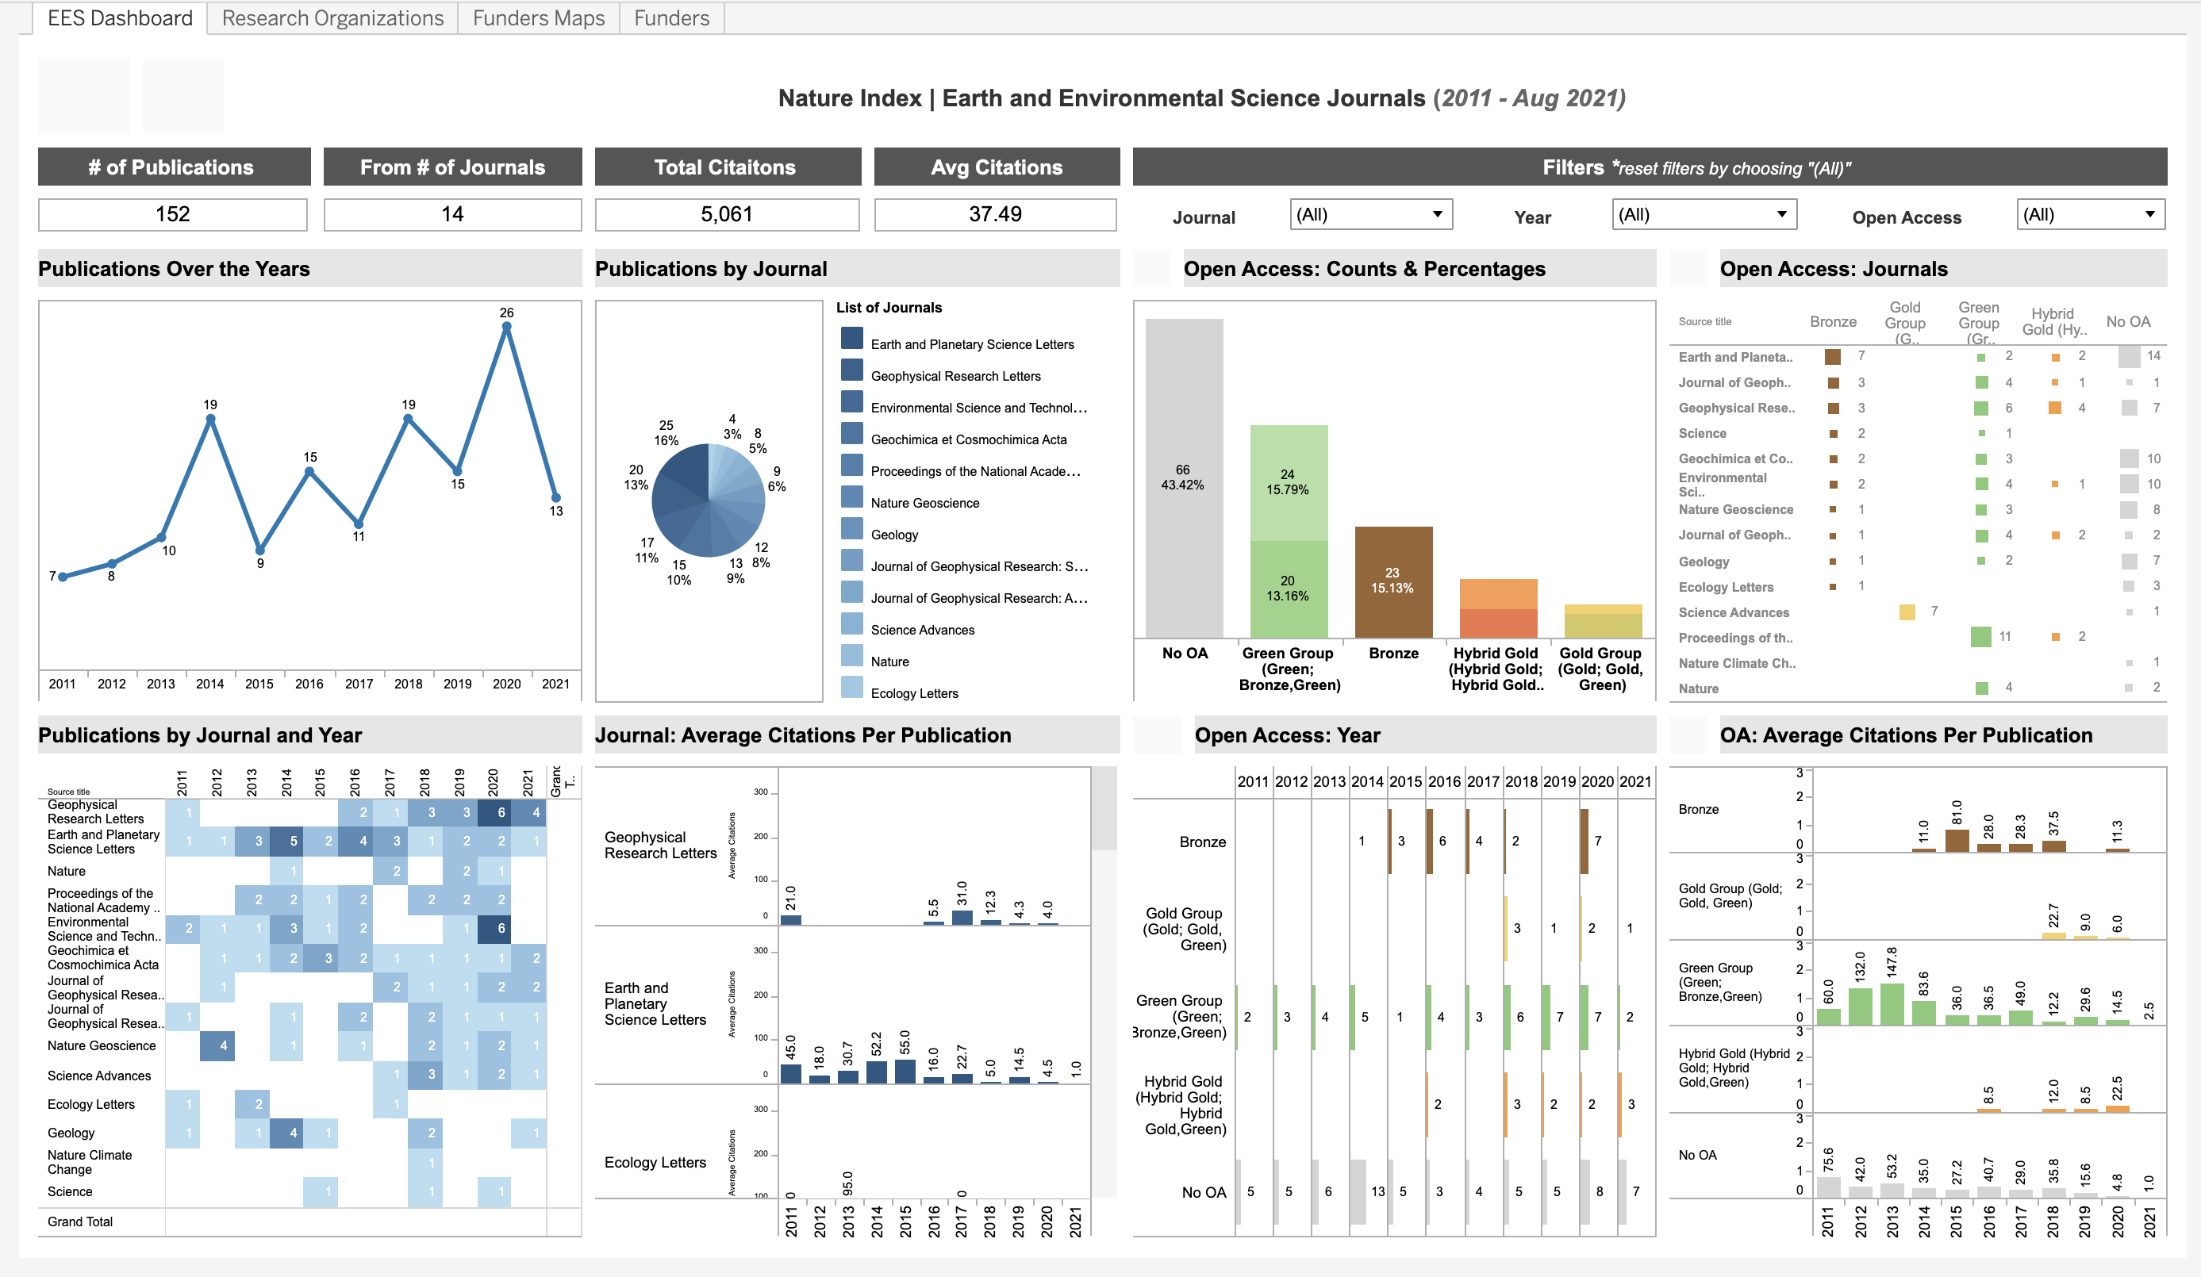
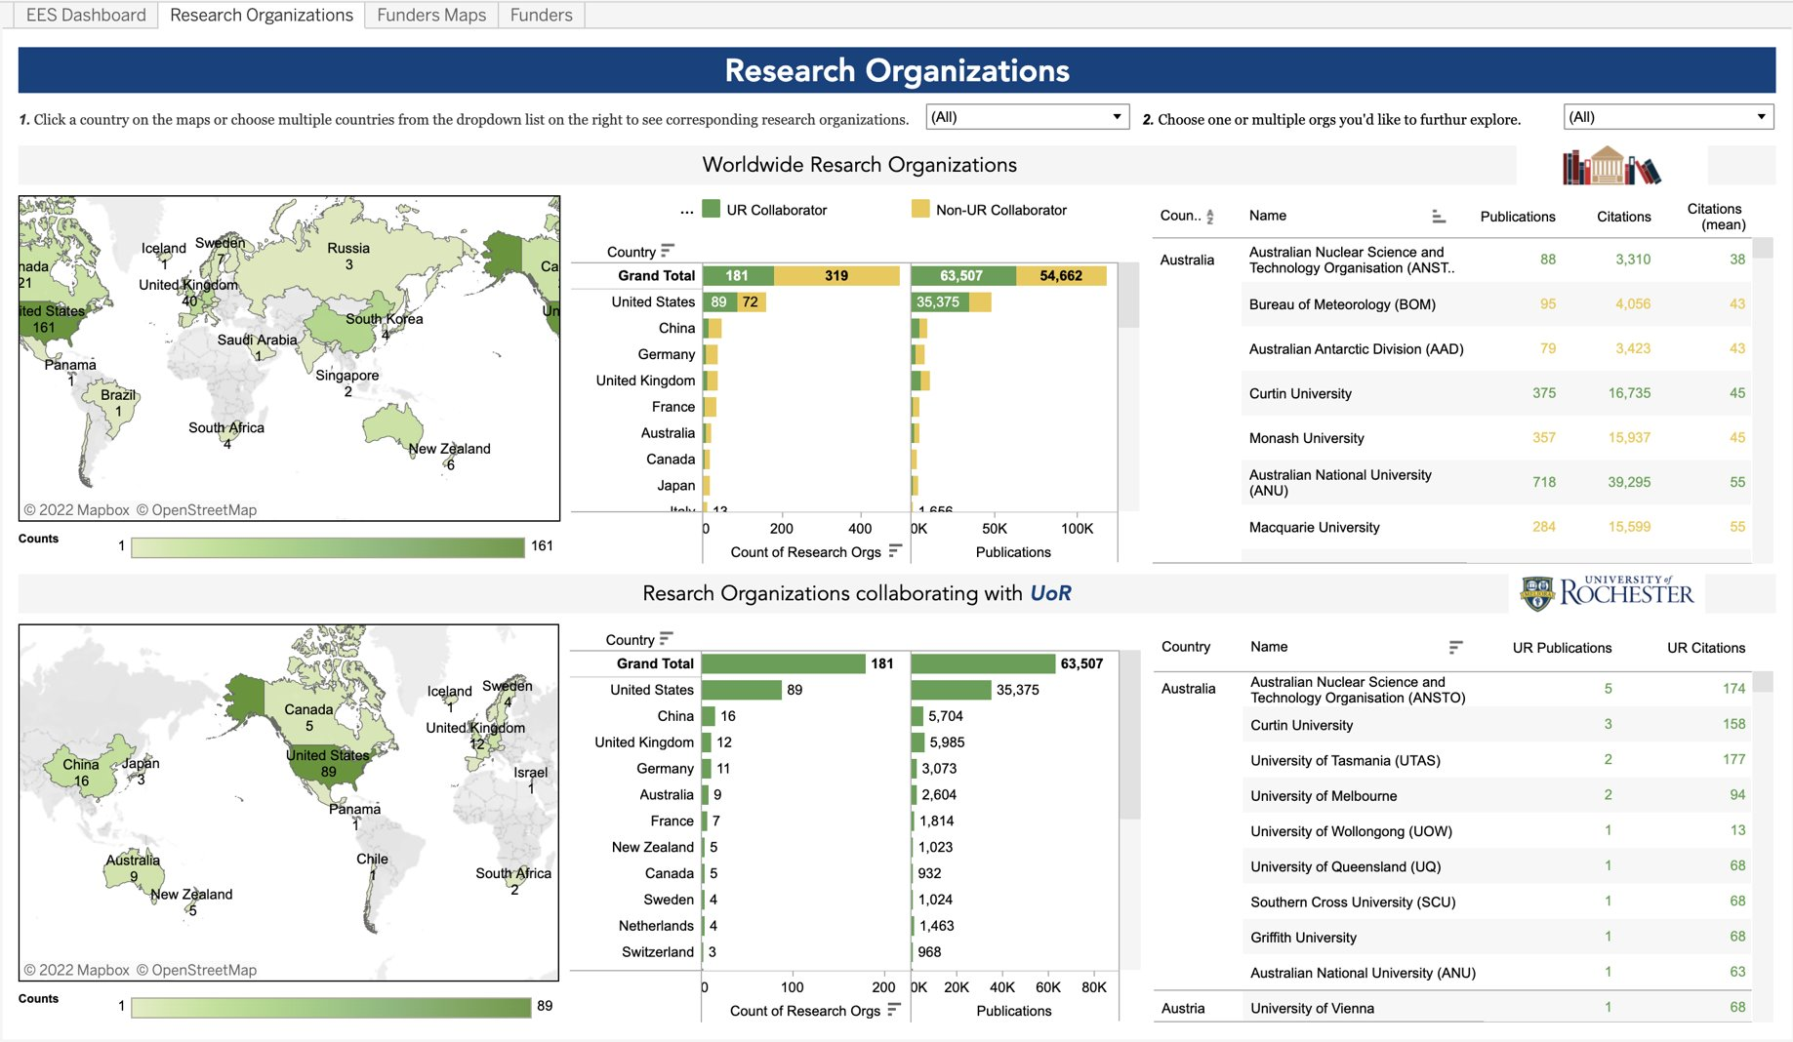
II. NI Project | Dashboards & Insights
Notes:
(Jieer) Thank you Sarah. Let's take a closer look at the dashboards, which answer most of the questions we asked at the begining.
The first dashboard provides information on publications, journals, citations, and open access.
For publications, you can find
- the total number of UofR's articles in Nature Index's selected EES journal between 2011 and Aug 2021.
- the number of articles by year, and then by both year and journal.
For journals, you can see
- the number of journals which our researchers published in,
- the name of those journals & the number of publications by journals
- and the average citations per journal per year
For open access, the four graphs and charts on the rights tells
- the their popularity of each open access type
- the trends of open access publishing over the years
- the type of open access options we are seeing from the journals
- and whether we are seeing high citations for certain type of open access articles
The second dashboard reveals information on Research Organization. The dashboard is divided into two parts,
The first parts provides information on research organization of all EES publications tracked by the Nature Index.
The second parts provides information on research organization for only EES publications that are affiliated with UofR.
The dashboard is designed to help us
understand UofR's international collaboration
identify the research organizations we worked with
find potential new researcher partners
For instance, the table on the top right shows a list of research organizations from different countries, and can be order by their number of publications, citations, and average citations per publication. The color tells us if our researchers have work with certain research organizations or not. If it is yellow, then no. Users can use this table to identify research organization that has high research output or research impact and that they haven't work with yet. We also have an identical dashboard that provide information on funders to help find new funding opportunities.
Besides summarizing the finds from our data dashboards,
- we performed additional analysis to identify top journals, open access type, funders, and reasrch orgnaizations in terms of total publications and total citations.
- we also mapped out the broad subject area of our publications and created a list of UoR researchers with their department information for the EES deparment head.
- we also verified our libraries' subscription to the EES Journals selected by Nature Index so to make sure that our reasrch community has access to them.
The dashboards and insights were presented to our three group of stakeholder

Slide 12
Feedback and Future Plans
Nature Index
Nature Index
Data in Nature Index
Nature Index Project
Project Scope
Project Phases
Dashboard Insights
Feedback and Future Plans
Stakeholder Feedbacks
Learning and Next Steps
Notes:
Sarah
In the last section of our presentation, I'll be sharing the feedback we received from the various stakeholders and what our next steps will be

Slide 13
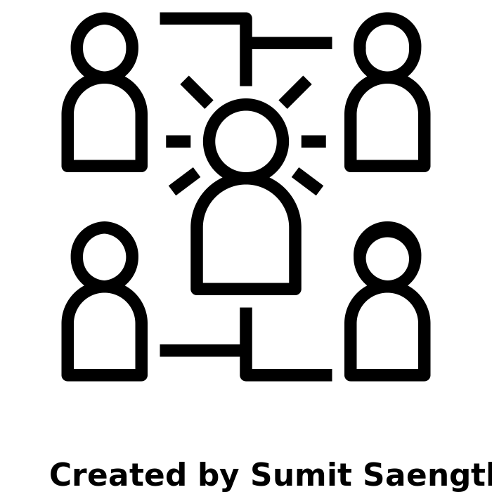
III. Feedback | STEM Librarians
Helpful to know where our researchers publish
Which journal is getting the most citations
Does this align with our internal usage data
Is Open Access being embraced by my department
Trend in different types of Open Access
Skepticism/nervousness around funding data
Possible sensitivity around interpretation of our intent
With multiple researchers, cannot identify who received the grants
Not very useful if researchers aren't eligible for a grant, e.g., federal grants in other countries
Helpful for pursuing transformative agreements
Artist: Sumit Saengthong
Source: Noun Project
Notes:
Sarah
The first group we spoke to were the other STEM liaisons in the department. They were interested in replicating the analyses for their subject areas, to know where our researchers are publishing and what journals get the most citations. The library collects and receives data about journal usage from various vendors, they thought it would be helpful to compare if that usage aligns with the publishing activity.
Further, as you all might have heard, a lot of publishers are reaching out to libraries with transformative agreements. The librarians wanted to know if there is a growth in types of OA in their areas. For EES, we found a growth in gold open access over the years. A lot of these journals have pretty high article processing charges. It will be helpful to know how researchers are currently paying for these, perhaps the APC is hindering more people from publishing in these journals. Learning more about this would help us in having more meaningful conversations with publishers.
When it came to the funding analysis, there was some nervousness about how our work would be perceived: the depts may wonder what is the library's intent in studying the grants. There were also doubts about the nature of the data for collaborative works. For instance, if an article has co-authors from, say, Iceland and it shows a grant from there, it is possible that only certain authors used that award and UofR's researchers never saw the money, which cannot be captured in the metadata. In the same vein, this information may not be very helpful if researchers are not eligible for the grant. Going back to the Iceland example, it could be a federal grant that only citizens are eligible for. In that scenario, the information is not very actionable.

Slide 14
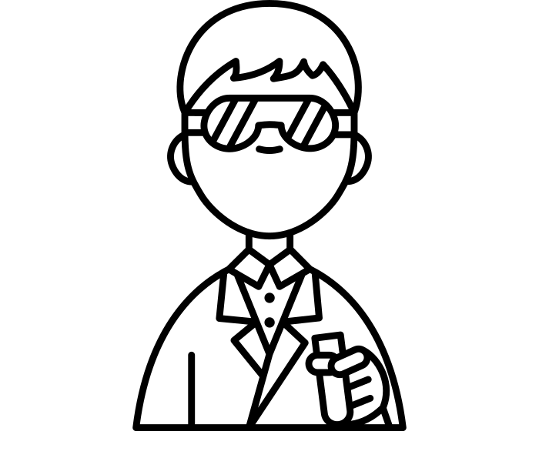
III. Feedback | Academic Department Chair
Feedback on the dashboards
Future developments
Comparing the department's performance in Nature Index with other metrics. E.g., we rank much higher in Academic Analytics
A normalized comparison with other UR departments, also comparing with other universities
Asked to walk through the dashboard
List of journals in Nature Index is good but doesn't cover 100% of the "top" journals (also subjective)
Useful to show publication growth to senior leadership, with new faculty joining over the past few years
Interested in the growth in Open Access publishing
Artist: Amethyst Studio
Source: Noun Project
Notes:
Sarah
Next we spoke to the EES chair. As mentioned, we had emailed him a link to the dashboard, however he wanted us to walk him through the different pieces the first time.
Also, prior to our conversations, he had not heard about Nature Index and was curious about it's importance and how it compares to other metrics. We asked about the list of journals included, and he said it's a pretty good list but doesn't necessarily cover 100% of the top journals in the field. He also recognized that the list of top journals is subjective and another faculty even in the same department may have a different opinion.
He was also interested in sharing the results with senior leadership at the university. There have been new faculty hires in the department over the past few years, and the growth in research shows that they are having a positive impact in our output which is great.
He was particularly interested in the data around open access publishing. The dept chairs have access to toolkits like Academic Analytics which provide high level information about research, but the OA info we shared is unique and not covered in the databases. Sharing this project also sparked conversations about potential transformative agreements, comparing ranking calculations among different metrics and how citations take a while to accumulate which can impact results over time.
He also had ideas for future directions in the project, such as comparing how the department performs in NI with other metrics that measure impact differently. He was also interested in a comparison with other departments at the university, after normalizing the data since the EES dept is relatively smaller in size. It would also be nice to compare with EES departments at other academic institutions.

Slide 15
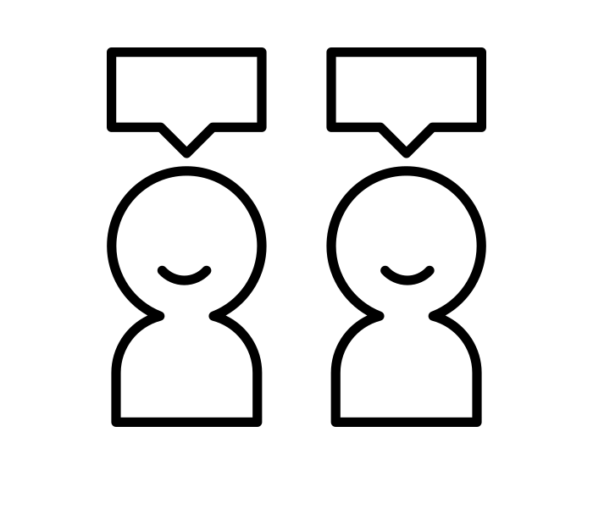
III. Feedback | Library & University Leadership
Feedback on the dashboards
Future developments
Comprehensive dashboards that can answer a good set of questions for different audience groups
Proactively choosing the data we want to show, also consider department chairs' feedback
Might create some noise due to discrepancies between data in dashboards and other tools/sources
Good to show department chair multiple data sources
Suggestions on the subjects to work on, the academic department chairs to work with, and the units to collaborate with
Ideas on revealing trends of "Share" metric and repeating co-authorship and collaborating research organization
Artist: Made X Made
Source: Noun Project
Notes:
Sarah
Finally, we spoke with the library's associate dean and the university's assistant VP for analytics, who were also the sponsors for the project. We received a lot of helpful feedback from them. They thought it's good to share the different analyses with the department chair. But the caveat is that sometimes the data from different sources can have discrepancies, so there's potential for noise or confusion there. They also had ideas about the Share metric in Nature Index, and studying the trends for repeating author collaborations, which we could use in future.
Moving forward they recommended creating comprehensive dashboards that address distinct questions for different stakeholder groups. We also need to consider the intended audience for the work, think about whether the dashboards should be shared only with department chairs or all faculty or anyone who expresses interest. And we want to be proactive in the type of data we are sharing, keeping in mind the chair's feedback. For example if we were to expand the list of journals, how do we choose what titles are included? Think about if there's specific information the research office wants, and so on.
When it comes to the metric itself, Jieer and I heard that there might be some changes in how NI will calculate some of the variables in future. Since the analysis took us significant time, we want to see how the metric changes over time before committing to analyzing UofR's performance on an annual basis.
Lastly, they also had recommendations about which subjects to analyze in future, depending on which chairs are more likely to interested, etc.

Slide 16
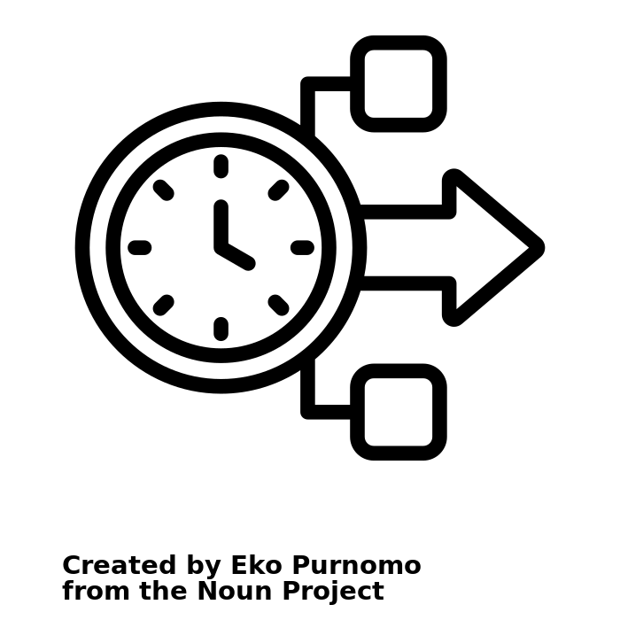
III. Future Plans
Short-term Goals
Content: identify repeating co-authors and their affiliation
Content: add the trend of the Nature Index metric "Share" to the dashboard
Journal List: expand the journal list to include other high quality EES journals suggested by the EES department head
Identify the next subject area to work on and the department: Chemical Engineering, Life sciences
Long-term Goals
Collaboration: identify potential collaborators to work on the dashboards
Journal List: Nature Index, UofR researchers commonly publishing and citing, Journals where others citing us in
Artist: Eko Purnomo​
Source: Noun Project
Notes:
Jieer Chen
To sum up, based on the various feedback we’ve received,
In the short-term, we plan to make the dashboard a little more comprehensive
- by adding the "Share" metric from the Nature Index to the dashboard
- and by expanding the journal list to include other EES journals suggested by the ESS department head
- Meanwhile, we’ll be in discussions with other STEM librarians to explore the probabilities of building dashboards for another subject area, potentially chemical engineering or Life Sciences.
In the long run, we plan to
- help identifying repeating co-authors and their affiliation through our dashboards
- and further expand the journal list to include journals our researcher are publishing and citing, and journals where others citing us in
- Lastly, we'd love to engage other units in the library or other university departments in the conversation and event invite them to work on the dashboards together
* reproducibility & documentation & responsible use of metrics.
-----
Adjusted Share accounts for the small annual variation in the total number of articles in the Nature Index journals. It is arrived at by calculating the percentage difference in the total number of articles in the Index in a given year relative to the number of articles in a base year and adjusting Share values to the base year levels.
The bilateral collaboration score (CS) between two institutions A+B is the sum of each of their Shares on the papers to which both have contributed. A bilateral collaboration can be between any two institutions or countries/territories co-authoring at least one article in the journals tracked by the Nature Index.

Slide 17
Thank you! Contact us for questions
Jieer Chen, Data Analyst
jieer.chen@rochester.edu
Sarah Siddiqui, STEM Librarian
ssiddiqui@library.rochester.edu
Notes:
Jieer:
That was a long presentation. I hope you found it valuable and know that we really appreciate you listening.
Please don't hesitate to reach out to us if you have any questions or would like to connect with us. Thank you.

Slide 18
Appendix
Nature Index
Article & Journals
Count & Share
Nature Index Assessment
Nature Index Project
Author Positions
Funders & Citations

Slide 19
II. NI Project | Dashboards & Insights
Research Category, Funder, Research Organization
​
Publications from EES are mapped to 6 broad categories.
Over half of UR funders (37) are from United States.
At research organization level, the number of collaborative publications ranges from 1 to 11.
The categories are Earth, Environmental, Physical, Chemical, Biology, Engineering.
UR has 73 funders from 15 countries of its EES publications.
The top three countries with most funders are United States(37), Australia(7), and China(6).
UR collaborated with 271 research organizations from 39 countries.
The rest of 12 countries have 3 or less funders.
Top 3 (highest average citations): University of Iceland, Stanford University, The Ohio State University.
Top 3 (most publications): Oregon State University (OSU), University of California, San Diego (USCD), Peking University (PKU), China
Among EES, many publications are under Earth Sciences. Outside of EES, most of them are related to Biological Sciences.
Depth of International Collaboration: 178 research organizations worked with UR on only one publication. 21 countries have only one organization collaborating with UR.
New Funding and Collaboration Opportunities: Identified 428 funders that funded non-UR EES publications and 319 research organizations that had no collaboration with UR.
Notes:
Jieer
The slides summarizes the information on research category, funders, and research organizations.
We tried to understand the depth of our international collaboration by looking the number of collaborated publications and the number of collaborated research organizations in a country. We give a high-level summary on the number of funders and researchers organizations didn't appear the publications affiliated with UoR.
On the right side, we identified
- the board subject areas our publications are mapped to.
- the country where our majority of funders located at, and the top three countries we are seeing the most funders.
- similarly, we identified the top 3 research organizations in terms of the number of publication and the number of average citations per paper.
Transite:
Next, Sarah will be sharing the qualitative insights we get from stakeholders.

Slide 20
II. NI Project | Dashboards & Insights
Number of publications published in journals by year ranges from 0 to 6.
Top 4 journals in terms of citations accounts for 21% of total papers and 43% of total citations
86 authors affiliated with the University of Rochester had publications in NI journals.
66 papers (or 43.42%) are not open access while 86 papers (or 56.5%) are OA of some kind.
Citations from Green and Bronze accounts for 56.92% of citations.
Majority were from EES, with several authors from the departments of Biology, Chemistry, Physics & Astronomy, Mechanical Engineering, Medicine, Public Health Sciences, etc.
Scopus has multiple OA categories, we combined them into 4 broad categories.
Green OA is the most common, followed by Bronze, Hybrid Gold, and lastly Gold.
63 papers (41% of total) had a first author and likely corresponding author from the University of Rochester. 48 papers (31.5% of total papers) had a UR author in the last position.
Top 4 journals in terms of number of publications account for 50% of total papers
Publications, Open Access, Scholars​
Number of publications published in journals by year range from 0 to 6.
Scopus has multiple OA categories. We combined them into 4 broad categories.
Majority of them are from EES, with several from Biology, Chemistry, Physics & Astronomy, Mechanical Engineering, Medicine, Public Health Science, etc.
Top 4 journals in terms of number of publications account for 50% of total papers.
66 papers are not open access while 86 papers are OA of some kind.
Green OA is the most common, followed by Bronze, Hybrid Gold, and lastly Gold.
86 authors affiliated with University of Rochester had publications in NI EES journals.
Citations from Green and Bronze accounts for 56.92% of citations..
63 papers had a first author and likely corresponding author from the University of Rochester. 48 papers had a UR author in the last position
Top 4 journals in terms of citations accounts for 21% of total papers and 43% of total citations.
UR has 152 papers published in 14 (out of 16) Nature Index EES journals between CY2011- August CY2021.
Yearly output ranges from 7 to 26 (highest in 2020).
An average of 13.8 papers per year and 36.8 citations per paper.
No publications in Water Research or Nature Communications (EES Category).
Notes:
Jieer
This slide and the following slide shows the specific information we were able to get from our data dashboards and additional analysis. We thought to share these with you to help you understand what kind of qualitative insights we are getting from this project, and you might get if you were to perform the same kind of analysis. Please keep in mind that the numbers are not important and could look very different for your schools.
The left side shows the statistics about publication and citations.
- The total number of publications,
- range of publications from year to year,
- the average number of paper and citations per paper,
- and the journals which UoR doesn't have publications.
On the right side, you can see that
- for journals, we identified the top 4 journals in terms of number of publications and in terms of citation the their aggregated percentage.
- for open access, we identified the portion of open access articles and the most popular open access type among our users, and the type of open access we are seeing the most citations from.
- for author affiliation, we looked into the departments of our UoR researchers and the number of UoR researchers in the first and the last position.

Slide 21
Nature Index Methodology
Articles:
Only primary research articles from the selected journals are included in the Nature Index.
Exception: for four large physics journals, only primary articles identified by the journals as having higher importance, more urgency or more interest for the community are included.
Journals:
Selected by a panel of active scientists, independently of Nature Research.
The selection process reflects researchers’ perceptions of journal quality, rather than using quantitative measures such as Impact Factor.
The journals represent less than 4-5% of the journals covering natural sciences in the Web of Science (Clarivate Analytics) but account for close to 30% of total citations to natural science journals.
Primary Research Articles
Primary research articles are also referred to as original research or research articles.
In a primary research article, author(s) present a new set of findings from original research after conducting an original experiment.
Notes:
A primary research article typically contains the following section headings:
"Methods"/"Materials and Methods"/"Experimental Methods"(different journals title this section in different ways)
"Results"
"Discussion"

Slide 22
Nature Index Methodology
Count: a count of one is assigned to an institution or country if one or more authors of the research article are from that institution or country
Share: all authors are considered to have contributed equally to the article. The maximum combined Share for any article is 1.0. For authors who are affiliated with more than one institution, the author’s Share is then split equally between each institution. The total Share for an institution is calculated by summing the Share for individual affiliated authors.
The ratio of Count to Share gives an indication of the degree to which an institution or country collaborates in its research. Broadly speaking, if the Count is a lot higher than the Share it indicates a high degree of external collaboration and dependency on external resources. If the Count is close in value to the Share it indicates limited collaboration with external researchers and a strong dependency on internal resources.

Slide 23
Nature Index Assessment
Limitations of Nature Index:
Metadata: Inconsistent Dates
1. Print/table of contents publish dates are used when available and online publish dates when not.
2. NI: " While we were integrating with Dimensions, we found these dates became inconsistent. We will look to pursue a more consistent policy again this year as we look to improve our article metadata."
Completeness of Data: Missing articles
1. Exists in NI DB, but outside the 12-month window we display on NI.com
2. Articles are missing, but can be added to the database by reaching out to the NI team
Selection Criteria:
1. Comment from EES Chair: List of journals under subject groups is "good" but doesn't cover all major journals in field
2. NI: "We are looking at article-based alternatives in place of journal-based."
Recommendations:
If used as a regular research metrics, be aware of limitations.
Conduct annual audits to make sure all qualified UR publications are added to the NI database. Caveat: cleaning the data and doing the comparison is time consuming.
Notes:
Through research and conversations with NI team, we learnt two limitations of current Nature Index and two initiatives in the horizon.

Slide 24
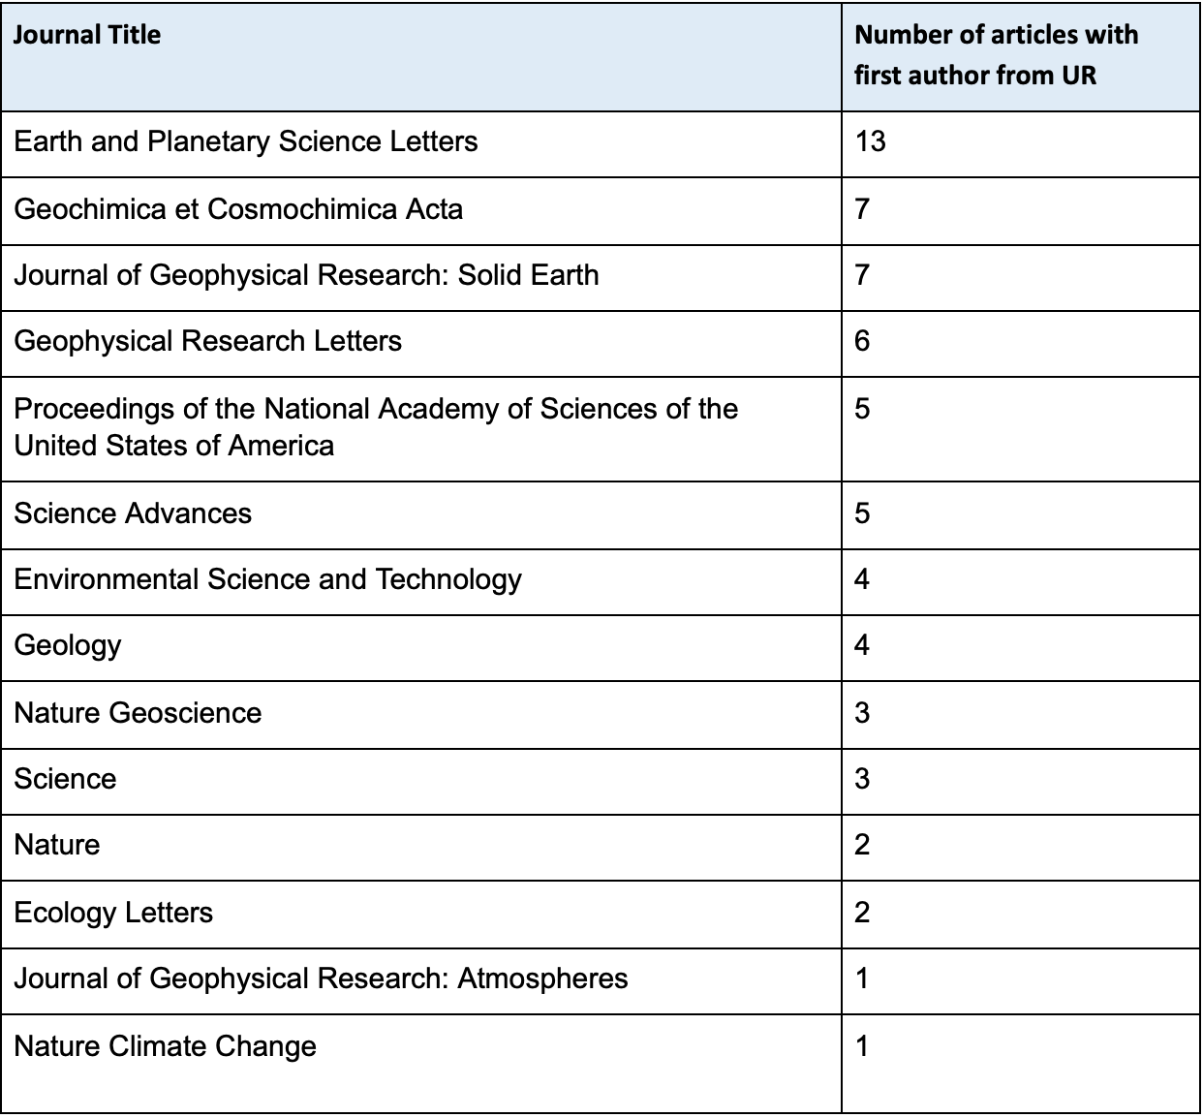
Data Insights | Scholars
Counts of UR authors at first position: 63
Counts of UR authors at last position: 48
Counts of UR authors at both positions : 25
Author Position
First position: 63 papers (41% of total) had a first author and likely corresponding author from the University of Rochester
Last position: 48 papers (31.5% of total papers) had a UR author in the last position.
The table on the right shows the number of articles in each journal that had a UR author in the first position.

Slide 25
Data Insights | Funder & Country
3 funders from China have average citations
National Natural Science Foundation of China (NSFC)
Chinese Academy of Sciences (CAS)
Technology of the People's Republic of China (MOST)
2 funders from the UK has higher than average citations
Royal Society (Royal Society)
Natural Environment Research Council (NERC)
2 funders from New Zealand have over average citations
Ministry of Business, Innovation and Employment (MBIE)
National Institute of Water and Atmospheric Research (NIWA)
2 funders from Denmark have over average citations
Carlsberg Foundation
The Velux Foundations
11 funders from the U.S. have over average citations
Cook Medical (United States)
Scripps (United States)
Environmental Protection Agency (EPA)
National Heart Lung and Blood Institute (NHLBI)
National Human Genome Research Institute (NHGRI)
National Institute of General Medical Sciences (NIGMS)
Howard Hughes Medical Institute (HHMI)
Comer Family Foundation
Gordon and Betty Moore Foundation
Geological Society of America (GSA)
Division of Earth Sciences (NSF EAR)
3 funders from Australia have over average citations
Australian Antarctic Division (AAD)
Australian Nuclear Science and Technology Organization (ANSTO)
Department of Education, Skills and Employment (DET-Au)
1 funder from Germany have over average citations
German Research Foundation (DFG)
1 funder from Iceland have over average citations
The Icelandic Centre for Research (RANNIS)

