Slide 1
Making the future more accessible: Assistive technology at UR and the RRLC
Allegra Tennis (STEM)
Eileen Daly-Boas (Education)
Notes:
A

Slide 2
RRLC technology grant
Goal: increased support and awareness
Build a collection for hands-on experimentation
Intended to be used for educators, not for long-term needs
Notes:
A The goal of this project is to increase awareness and support for assistive technologies among library professionals and their communities. This project will build a unique collection of technology that will provide educators, librarians, and others an opportunity to learn and engage with assistive technology (products, equipment, and systems that enhance learning, working, and daily living for persons with disabilities)

Slide 3
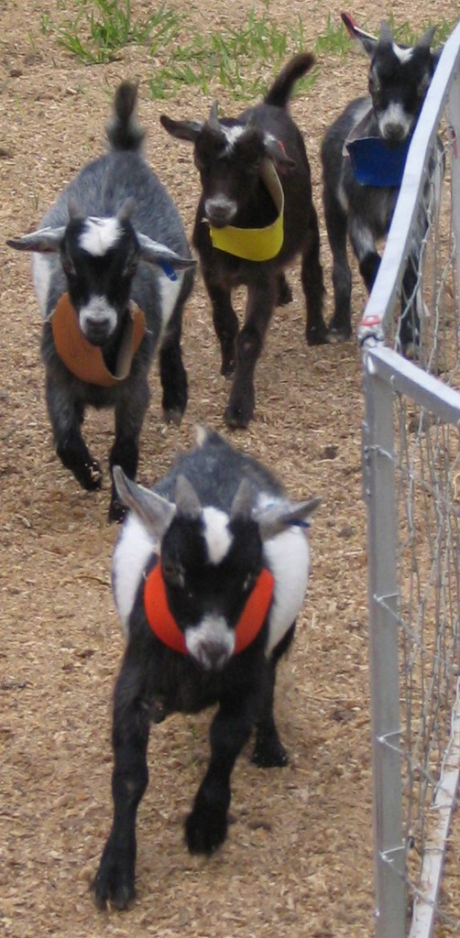
Why a tech "petting zoo?"
Workshops and practice with AT increases the comfort level and confidence of instructors, and leads to more successful implementation. (Schmidt et al., 2017; McNicholl et al., 2019; Jones et al., 2018)
This is a low-cost, low-stress way for instructors and librarians to get to know the technology.
Notes:
E:Multiple studies have shown that without instructor familiarity with Assistive Tech, it's less likely to be transformative. (McNicholl, 2019)

Slide 4
Why the library?
Accessibility in computing (and elsewhere in academia)
Libraries are resources for instruction/education
Rush Rhees Library, Wikimedia Commons
Notes:
E: Accessibility in computing is a problem with increasing awareness. As a resource for instruction, education and access to digital information resources, the library is an excellent partner to tackle this problem. Libraries can provide introductory access and experimentation with tools that increase inclusion in our digitally driven workplace and educational environment.

Slide 5
Xbox Adaptive
Career Exploration In Libraries and Mentoring (CEILAM) undergraduate employment program
Works with simple switches and joystick mouse (also part of collection)
Created by A. Crabtree, 2020 CEILAM student
Notes:
Fortunate enough to work with an undergrad from the CEILAM program at UR in the spring. Was given the flexibility to choose which piece of technology they wanted to focus on, Xbox Adaptiv was chosen. This is the quick start guide they created, converted to a pretty neat video to show their process.
The Xbox Adaptiv is designed to make user input for video games easier for those with physical disabilities. Works with a variety of systems.
Price is not accessible, due to the need for multiple add-ons (like the simple switch and joystick mouse), to make it versatile.
Simple switches are big buttons that require little dexterity to use. They can extend and replace a number of buttons used for gaming.
Joystick mouse selected is also one that requires little dexterity. Ours is not a gaming mouse, but one that can be used with small movements of the palm, nothing more.

Slide 6
Joystick Mouse
Optima joystick mouse
Red and yellow buttons can be programed
Comes with 2 other joystick heads
Small handle
Large cushioned ball
https://www.inclusivetlc.com/images/product/optima-joystick.jpg
Notes:
Joystick mouse selected is also one that requires little dexterity. Ours is not a gaming mouse, but one that can be used with small movements of the palm, nothing more.

Slide 7
Loupedeck+
Makes photo and video editing more accessible
Knobs, dials, and buttons reduce need for shortcuts
https://www.provideocoalition.com/wp-content/uploads/Loupedeck-photo.jpeg
Notes:
The functions you use are all organized by category. So instead of jumping between menus, panels and submenus, they’re all in one place.
Reduces need for memorization and for multiple keys to be pressed at the same time

Slide 8
One-handed keyboard
BeeRaider optimized one-handed keyboard
Works with either hand (or both)
Faster data entry than traditional keyboard
https://www.beeraider.com/wp-content/uploads/2014/10/Optimised-keyboard-mouse-1024x418.jpg
Notes:
Optimized refers to the layout of the keys, which you may notice are not QWERTY. QWERTY not available at the time of purchase, but you are able to reconfigure the keys at will.
These keys optimized for 1 handed, whereas QWERTY optimized for 2.
Much less expensive than dedicated one-handed keyboards, which also only come in right or left handed varieties. This works for either, or for both hands at once.
Allows for faster data entry

Slide 9
Simple/Adaptive switches
Essentially large buttons
Activates assistive technology
Used in conjunction with another device
Photo by A. Tennis
Notes:
A
Simple switches are big buttons that require little dexterity to use. They can extend and replace a number of buttons.
Our collection has 4, in yellow, red, green, and blue

Slide 10
Birds of a feather: Kindle Fire, Chromebook, iPad
Built in capabilities: screen reading, audio assist and captioning, voice control, shortcuts and navigation assist.
Apps, extensions, and interoperability with other assistive technology.
Notes:
E(1.5 min)
Each device already has built in capabilities including: screen reading, screen magnifiers, compatible with braille input/output devices, closed captioning, audio amplification, voice control, color filters.
They all support different apps as well – we're focusing on apps designed to help students with a variety of physical, behavioral and learning needs.

Slide 11
Kindle Fire, Chromebook, iPad
Assistance for a variety of challenges:
Vision
Hearing
Mobility
Communication
Learning and behavioral disabilities, including reading, spatial reasoning, staying on-task

Slide 12
Original plans vs COVID-19 plans
ILL circulation vs digital "hands-on" sessions
Physical vs digital promotional materials and user quick-start guides
Showcase in professional development settings vs online only workshops and conferences
Notes:
A
The pandemic has affected the feasibility of our original deliverables.

Slide 13
What's next?
Continued Collaboration with RRLC towards expanding a tech collection
Feedback will inform future RRLC workshops
Creation of a shared bibliography of current research on Assistive Technology in Education using Zotero
Notes:
E
Working with RRLC to continue to improve upon and support this collection and the needs of its users. Use data gathered from this to build upon and expand A tech collection according to feedback from users, inform future RRLC workshops, etc. Development of a Zotero group bibliography on Assistive Tech in Education and Libraries.

Slide 14
Photo credits
"Goat Race" by SeeMidTN.com (aka Brent) https://www.flickr.com/photos/brent_nashville/220827242/in/photolist-kvNff-5bPJC5-jTU8s
iPad: https://static.vecteezy.com/system/resources/previews/000/010/121/original/vector-ipad.jpg
Loupedeck: http://media.gadgetsin.com/2016/11/loupedeck_photo_editing_console_for_lightroom_2.jpg
Xbox Adaptive: https://3.bp.blogspot.com/-HULjBlbDEIM/Wv0w0Za7u2I/AAAAAAAAKPI/q9oyyG16Da4B0RqZRgwj7fKuCwuwkj2iQCLcBGAs/s1600/Adaptive-xbox-controller-HTNovo.png

