Slide 1
Scatter Plots and Trendlines: Meaningfully assessing long-term LibGuides usage
Roman Koshykar, RIT Libraries
Upstate New York Science Librarians Conference
October 9, 2020

Slide 2
DISCLAIMER
I am not a “math person”

Slide 3
Background

Slide 4
Use of LibGuides at RIT Libraries
Initially purchased SpringShare LibGuides in 2011
  Branded as InfoGuides
  Homegrown Drupal-based guide publishing prior to 2011
Migrated to LibGuides 2.0 CMS in summer 2015
  Major content review
  Something of a “reset” for published guides
  Continued publishing on this platform since 2015

Slide 5
Problem Statement

Slide 6
Assessing guide use over the long term
Each calendar year, I export and save use stats for all my published guides
But how can I assess the changes in usage patterns over a four to five year period?
There are patterns there – But…
  Could not derive a meaningful chart by plotting yearly averages
  Data was too noisy for a meaningful trend chart of all guides across all months

Slide 7
Solution

Slide 8
The aforementioned scatter plots and trendlines!
Enter monthly use stats for each guide being assessed in its own Excel sheet
  Guides weren’t all published at once, so I could look at each one’s use pattern on its own for its entire life up to now
Insert scatter chart created from this data
  Plot months on X axis and number of views per month on Y axis
  Chart now resembles a set of dots or points
Add linear trendline and display equation on chart
  Chart now includes a sloped line showing the trend in Y/X (i.e., monthly guide views over time)
  Also includes a mathematical equation in the format y=mx+b
  Where “m” is the slope of the trendline, which gives you the positive or negative change over time of guide views!
  Slope values can be used to compare guides to each other
  See example on following slide:

Slide 9
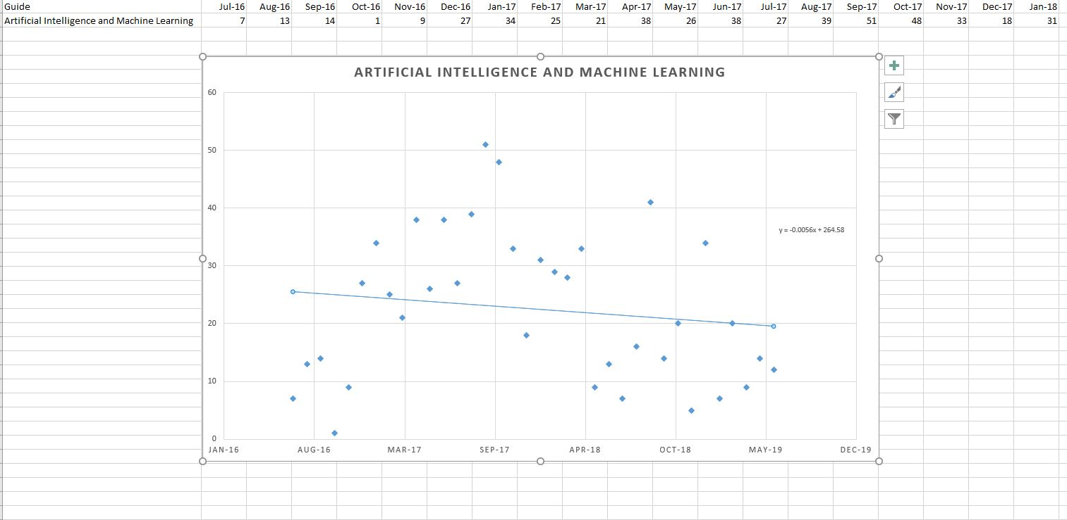

Slide 10
Results

Slide 11
First review – subject guides
10 guides on how to research various subjects in computing
  Review conducted in July 2019
  Covering August 2015 (or month of publication) to June 2019
Average slope = -0.0165
  Meaning: overall, use of subject guides declined slightly on average during this four year period
  Only one guide’s chart had positive slope (increase in use over time)

Slide 12
Second review – “non-subject” guides
7 guides on some other library topic (citation tools, database access instructions, etc.)
  Review conducted in June 2020
  Covering August 2015 (or month of publication) to May 2020
Average slope = +0.0964
  Meaning: overall, use of these guides increased appreciably during this five year period
  Two guides’ charts had negative slope (decrease in use over time)
  One guide’s chart had off-the-chart positive slope (big increase in use over time…)

Slide 13
Analysis

Slide 14
Mostly steady state, but some jump out
For most of my subject guides, use has decreased over time
  But not enough to really indicate that something needs to be overhauled
  Very difficult, if not impossible, to determine the cause
For one non-subject guide (EndNote), use decreased over time
  Use increased over time for Mendeley and Zotero guides
  Likely indicating that EndNote is not being used as much as newer systems
For Zotero guide, use increased significantly
  Calculated slope was +0.6787, by far the largest change in either direction
  New question: can I deduce why?

Slide 15
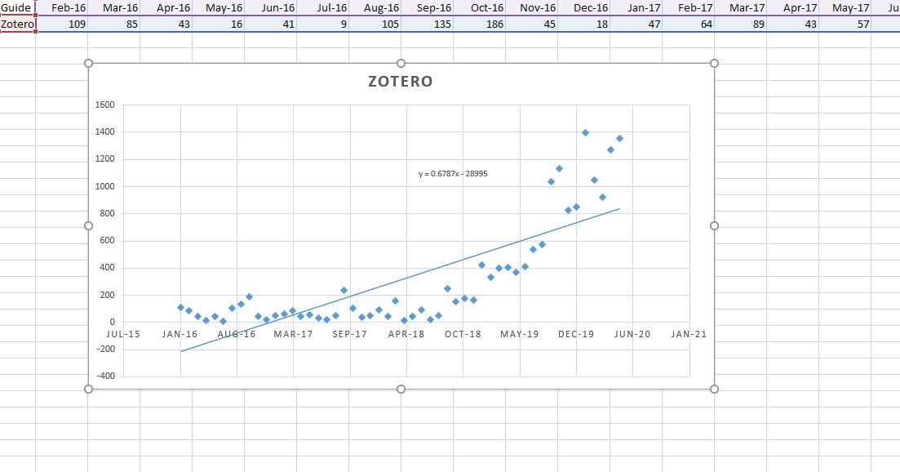
Something happened
In the summer of 2019…

Slide 16
Delving deeper into Zotero guide usage
LibGuides allows you to report on page views within an individual guide
Ran Page Views Report for Zotero guide
  Shorter sample – 8/1/2020 through 9/15/2020
  1825 total views
  1492 (82%) were for one of 13 active guide pages!
  “Install Zotero for iPad”

Slide 17
Further down the rabbit hole
LibGuides logs the Referrer URLs for page views
  Where did the user find your guide page?
Almost all of the 1492 views for Install Zotero for iPad page were from Google searches
Search Google for “install zotero for ipad”
  #1 search result as of 9/15/2020
  Probably has been since sometime in summer 2019?

Slide 18
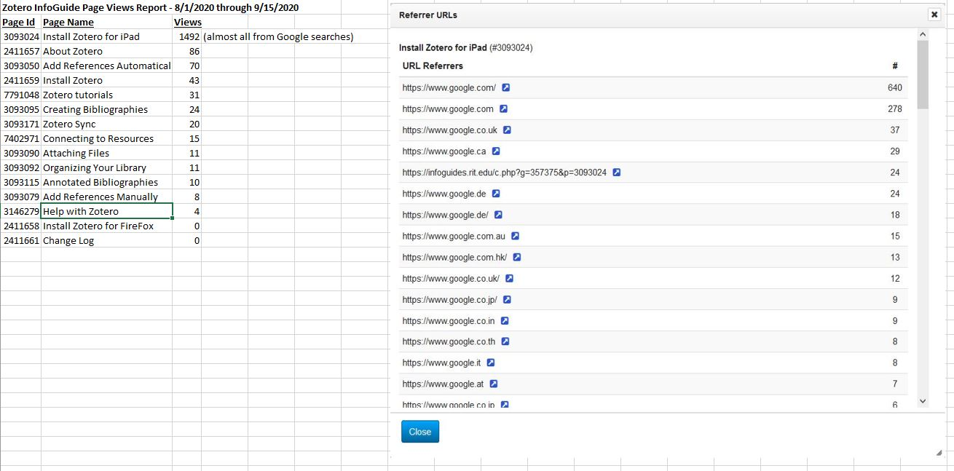

Slide 19
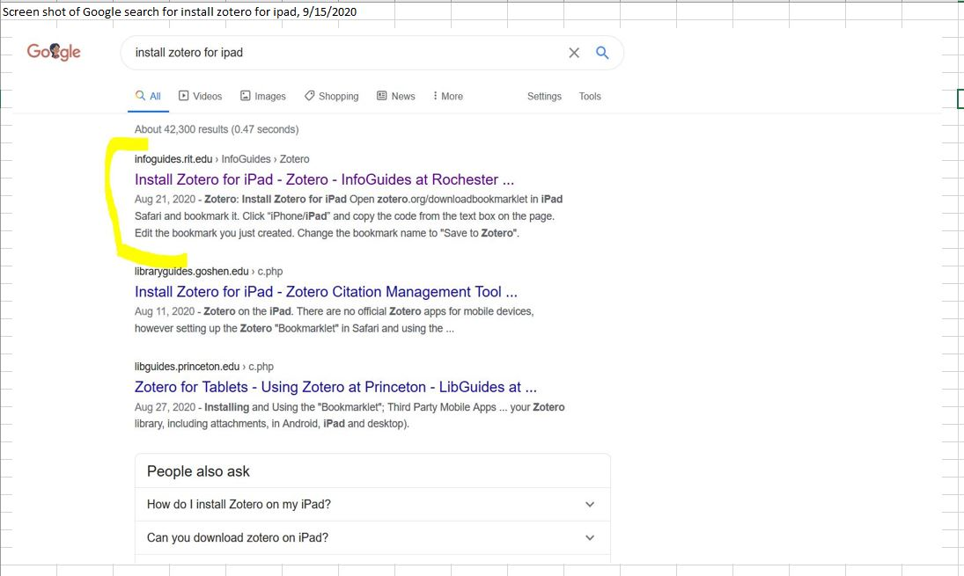

Slide 20
Thank You!

