Slide 1
How to Flourish in Scientific Publishing? Ask a Librarian
Jill Powell, Leah McEwen, Jeremy Cusker, Henrik Spoon Cornell University Library
Oct 18, 2019
Notes:
Jill to introduce with this slide.
Initially called Scitech Immersion changed title with Jose’s help.
Jan 2019 workshop for grads, postdocs

Slide 2
Research from Start to Publish: A 2-Day Workshop
Outline
Programming - (Leah)
Logistics and Participation - (Jill)
Marketing - (Henrik)
Feedback - (Jeremy)
Notes:
Programming - show sessions, speakers and content (Leah)
Logistics - how to organize the program; the guide, task list, planning meetings, food (Jill)
Participation and Outreach - summarize figures, departments represented (Henrik)
Speaker recruitment and interactivity
Library Communications involvement - Posters, Twitter, Chronicle
Feedback - can show slides with feedback snippets (Jeremy)
what went well
what we should do better

Slide 3
Programming
Research from Start to Publish
Focus on scientific communication
Many points in the research cycle
Survey of expertise across campus
tiny.cc/scitech
Also: http://guides.library.cornell.edu/empsworkshop
Program, registration, resources, evaluation
Notes:
Some commonalities across scholarly communication, some commonalities across scientific research
Some contextual distinctions in these subjects
17 speakers and 11 sessions over 2 days

Slide 4
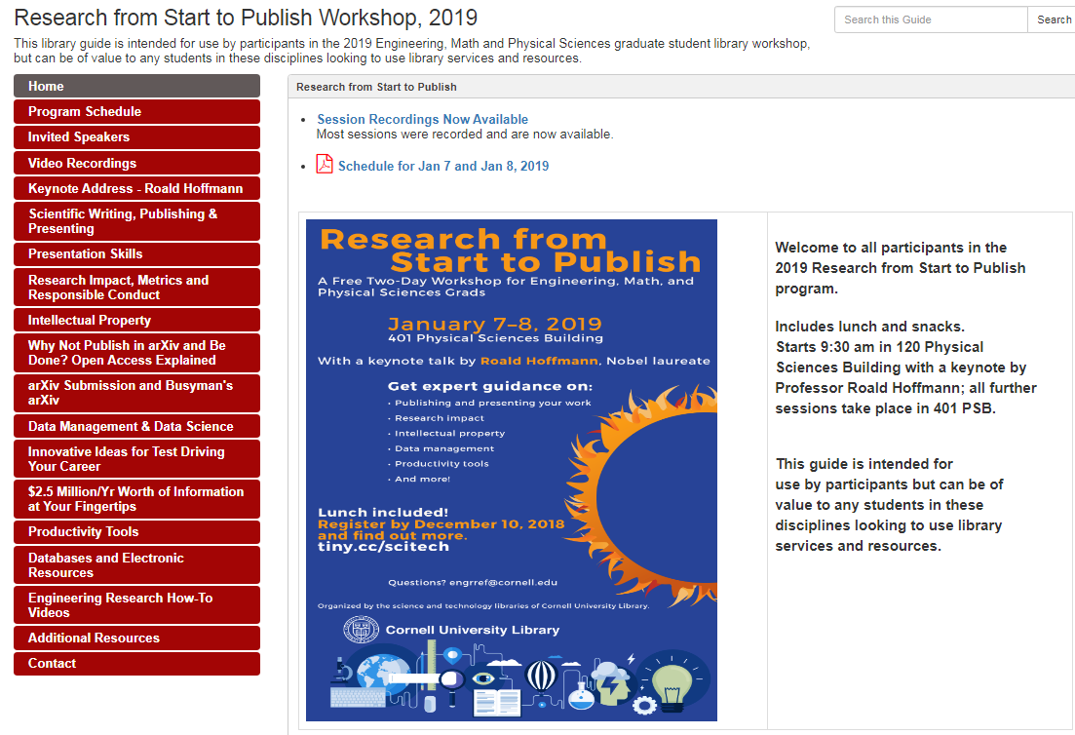

Slide 5
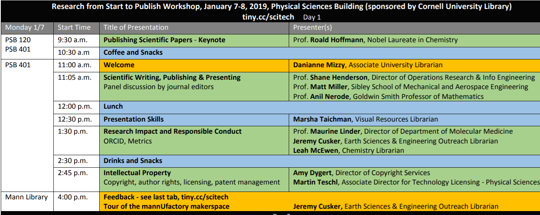
Day 1
Notes:
Rationale for order of speakers – high-profile speakers at beginning to bring in people and set inspiring tone
Keynote, Journal editors panel very popular.
Day 1 generally more cognitive, high level and ethical considerations of scientific communication

Slide 6
Day 2
Notes:
Day 2 generally more practical, smorgasbord of examples of challenges and resources for communication

Slide 7
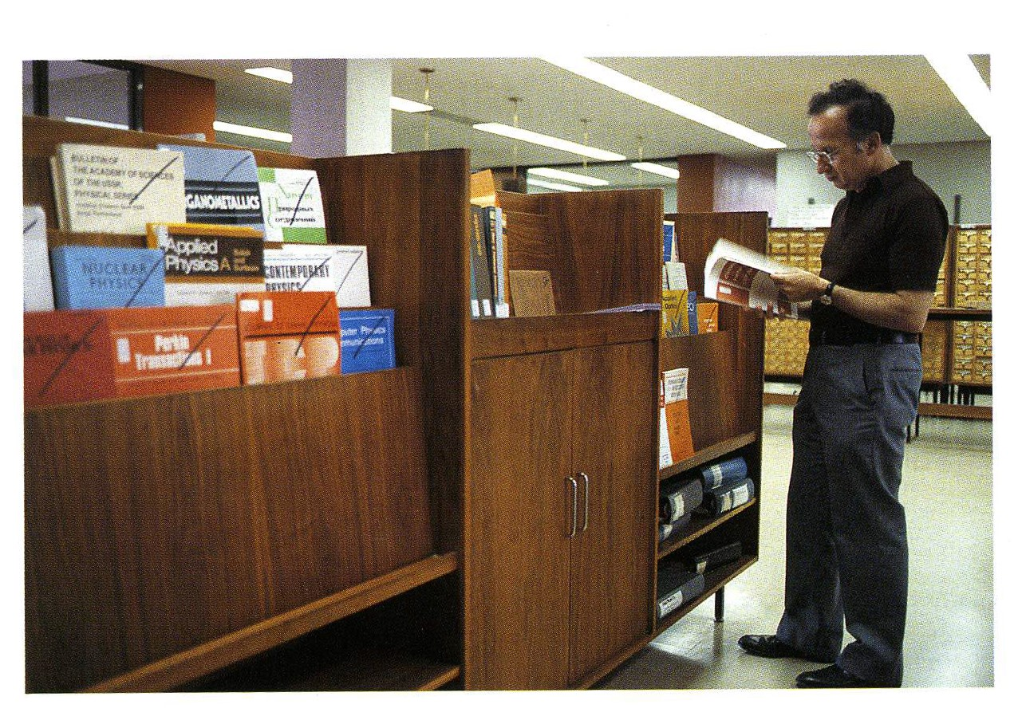
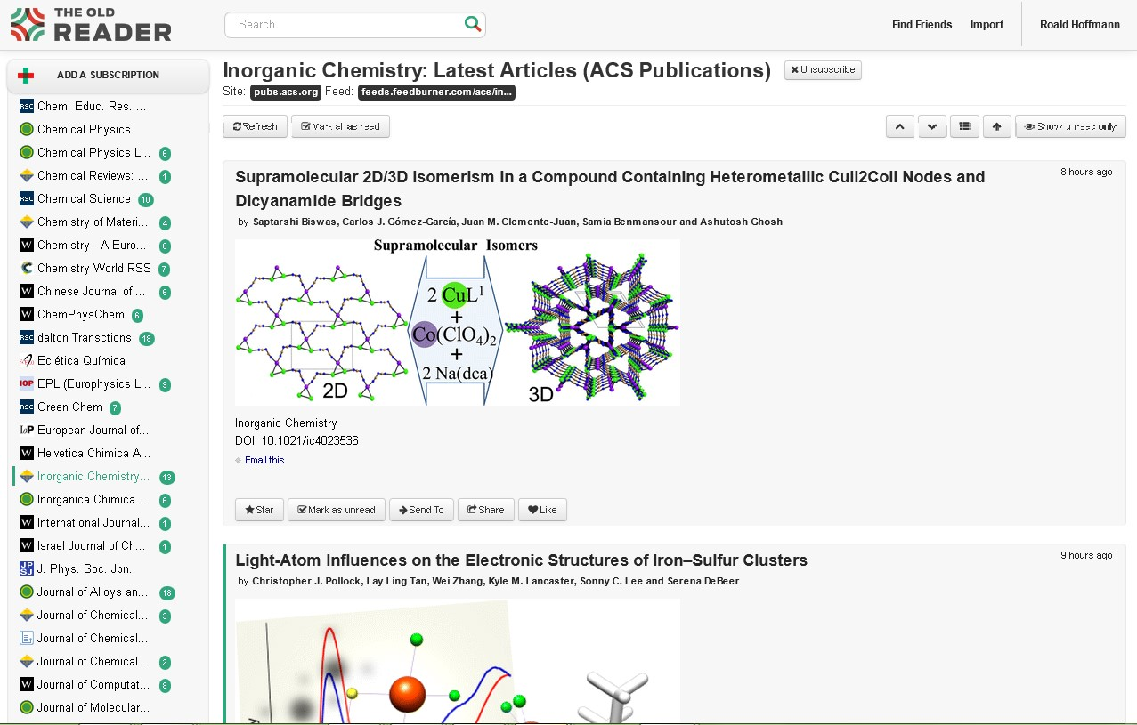
http://news.cornell.edu/stories/2019/01/how-do-you-flourish-scientific-publishing-ask-librarian
Notes:
Picture of Roald Hoffmann in Cornell Chronicle (Jan 2019); PSL library in 1970 and his “Old Reader” today to monitor journals.
He scans 100 journals, 2,000 article titles per week, takes 3 hours. Reads 30 abstracts, reads fully 5 articles.
“You can still get a Nobel prize if you don’t publish in Science and Nature.”
“Science and Nature give preference to articles that are newsworthy over good science.”
Jose Beduya – acknowledge him for picture, interviews

Slide 8
Logistics
Meeting Tools
LibGuide, Box, Zoom, Google Drive
Speaker Recruitment
Registration – accept more since 22% no shows
Food planning
Technical issues
Multiple rooms, decision on offering Zoom
Notes:
Saved on lots of emails by using centralized tools. Box worked better than confluence. Google Docs and Google Sheets.
* librarian speakers readily accepted invitations; difficulty recruiting faculty speakers
* Registration – 22% no shows, accepted more and created waiting list. Main concern was food/costs, we had 2 sandwiches left for 50 people. Room had 52 who could fit comfortably. Capped at 60, had a lot of speakers to feed too.
* Food –used Wegman’s catering for lunch; Manndible café for coffee / tea
Bought fruit, granola bars, water at cheaper store for break food – kudos to Natalie Sheridan
* Technical issues – multiple rooms reserved. One designated overflow room, but couldn’t get audio working.
*Sean and Matt Ryan said technology not the best. Keynote turned his mic off, best to have Sean setup as Webinar so he can mute everyone. Zoom instructions – gave to waitlisters
Thank you – gift cards

Slide 9
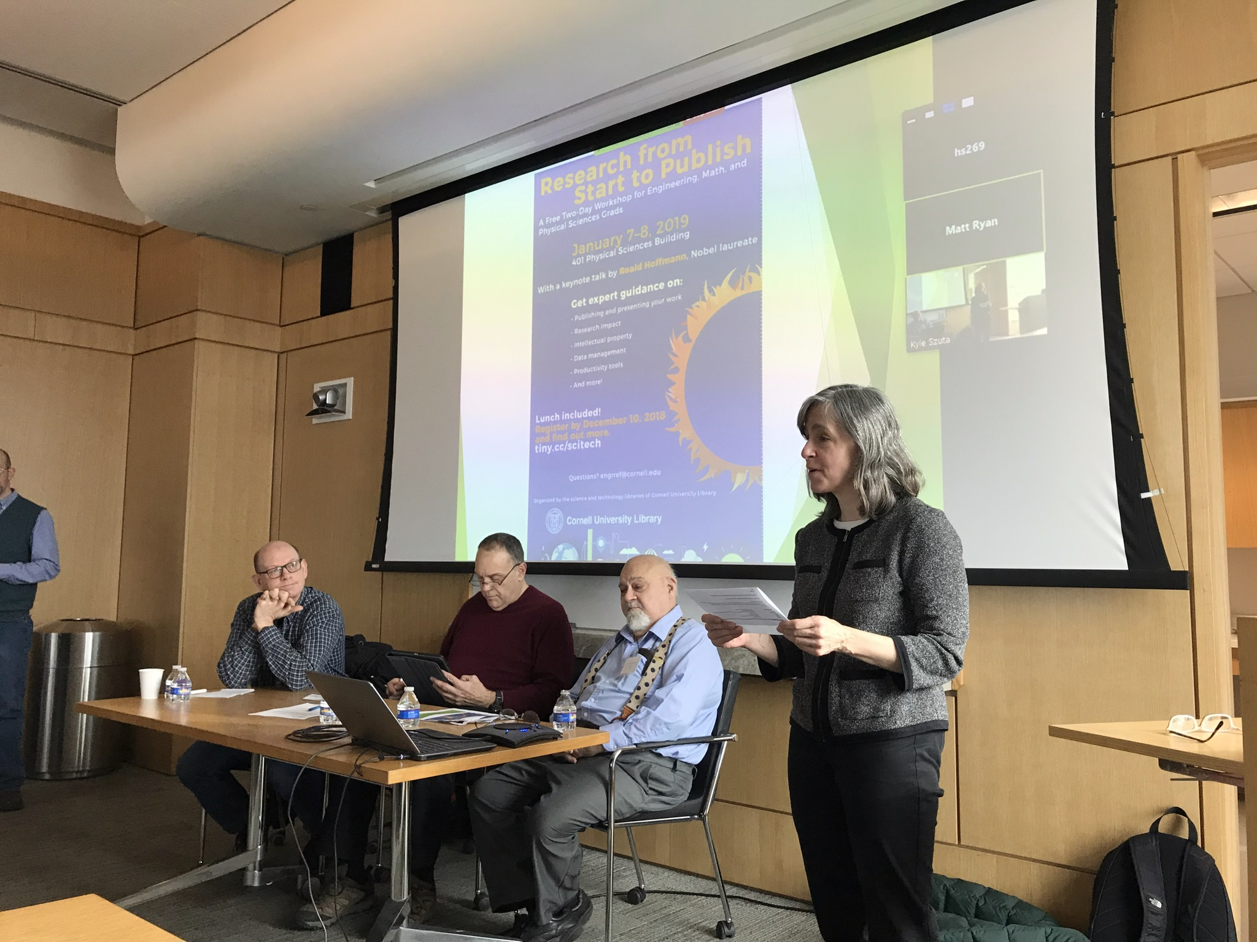
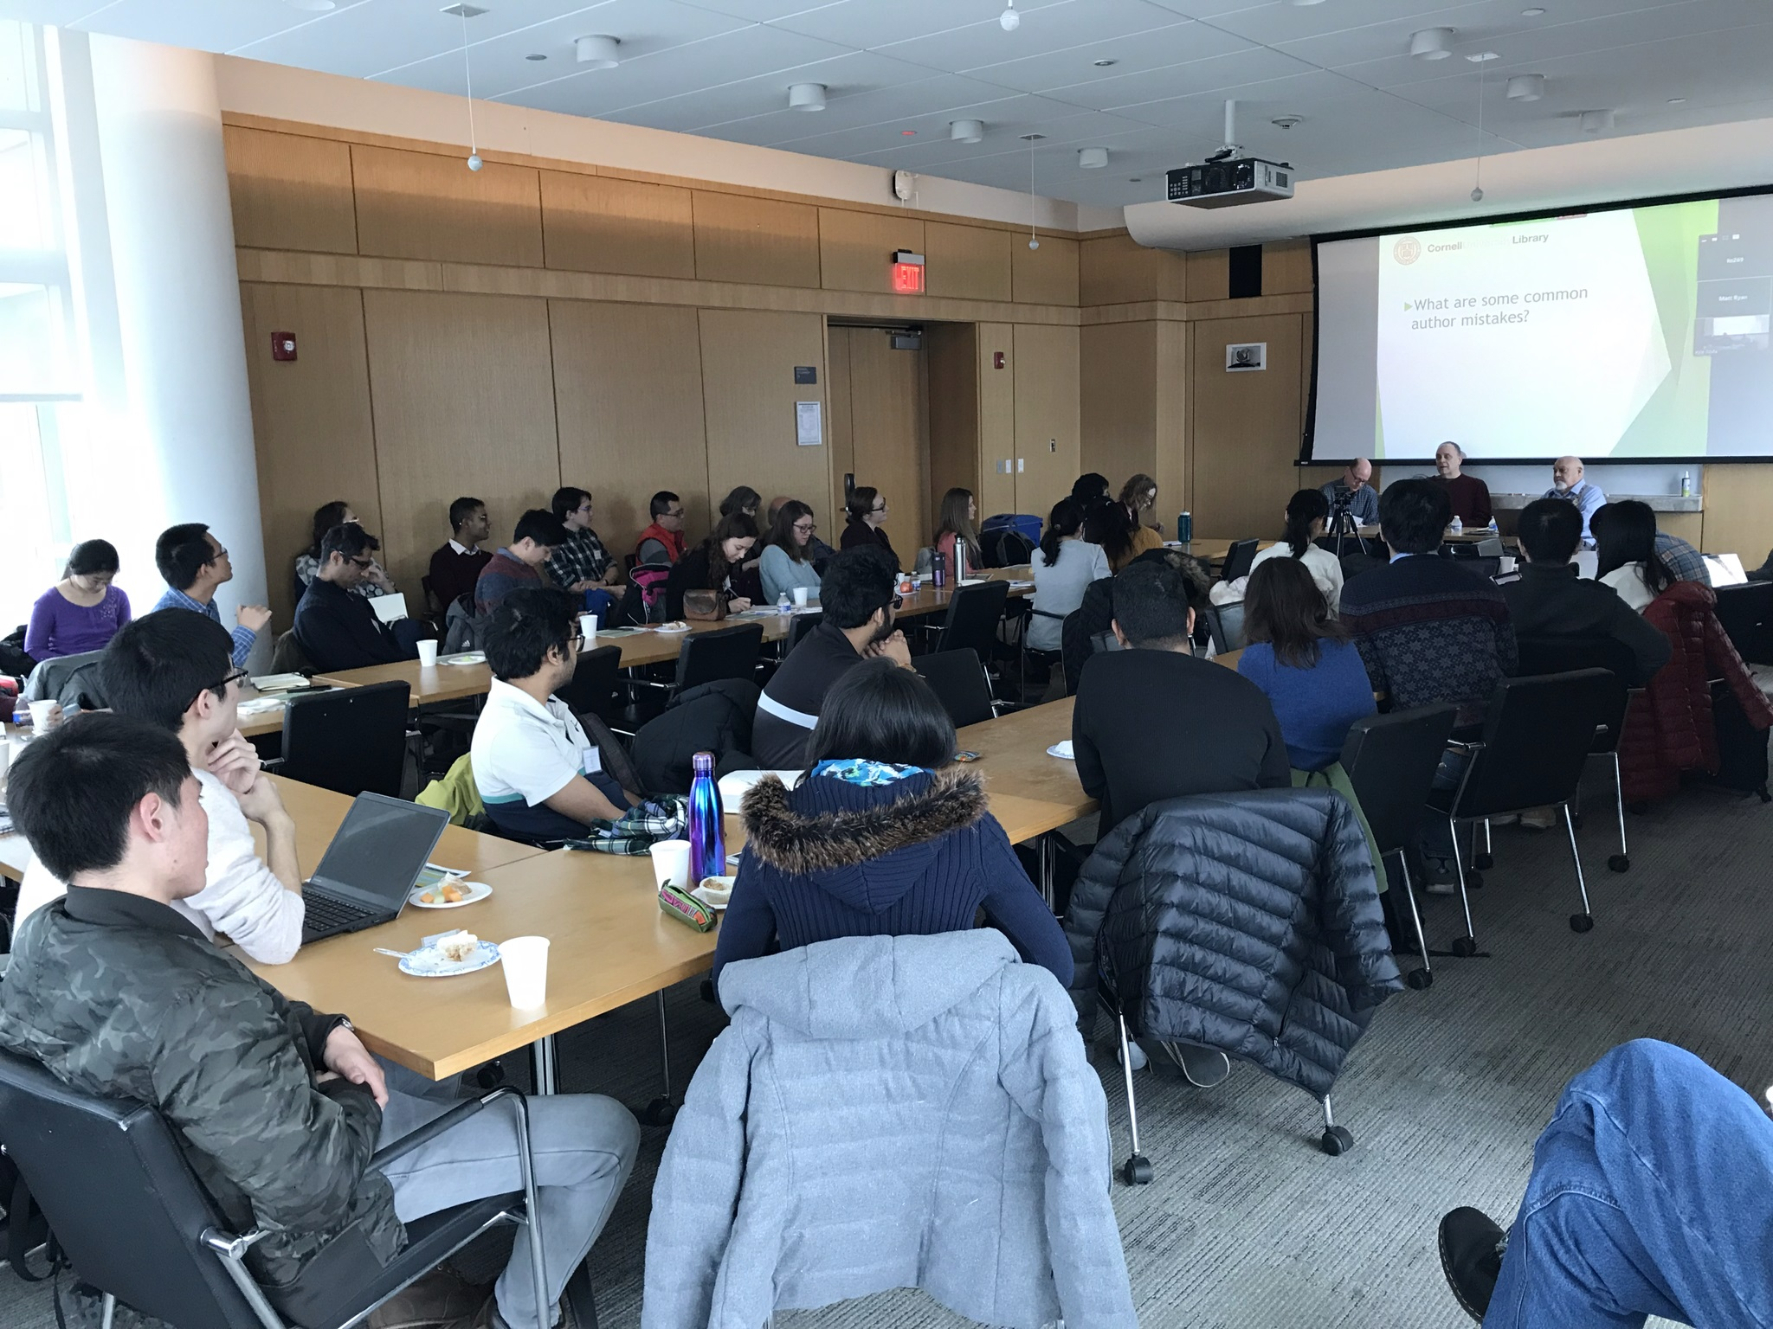
Participation
138 at keynote; (offered Zoom and recordings)
50 at sessions day 1; 34 day 2 (22% no show rate)
16 departments
Astronomy - 1 | Mech & Aero Engr – 2
Biological Engineering, Microbiology – 9 | Natural Resources - 1
Biomedical Engineering - 5 | Nutrition - 1
Chemistry - 8 | Operations Research - 2
Design & Environ Analysis – 1 | Physics - 5
Food Science - 3 | Statistics - 1
 | Systems - 1
Applied Engineering Physics – 8 Materials Science - 7
Notes:
17 speakers, 11 sessions; strong attendance, really helped to do for multiple departments
Next time might organize just faculty journal editors panel with some librarian talk and food and open it up to all science depts.
No shows – 5 dropped out officially, 5 more didn’t show up from above list.

Slide 10
Marketing
A good workshop title is crucial ! Thanks Jose Beduya!
Working title: "Sci-tech Immersion"
Final title: "Research from Start to Publish"
Notes:
Sizes of posters
Twitter, chronicle article – Library Communications
E-Lists – BEST, grad students, dept e-lists

Slide 11
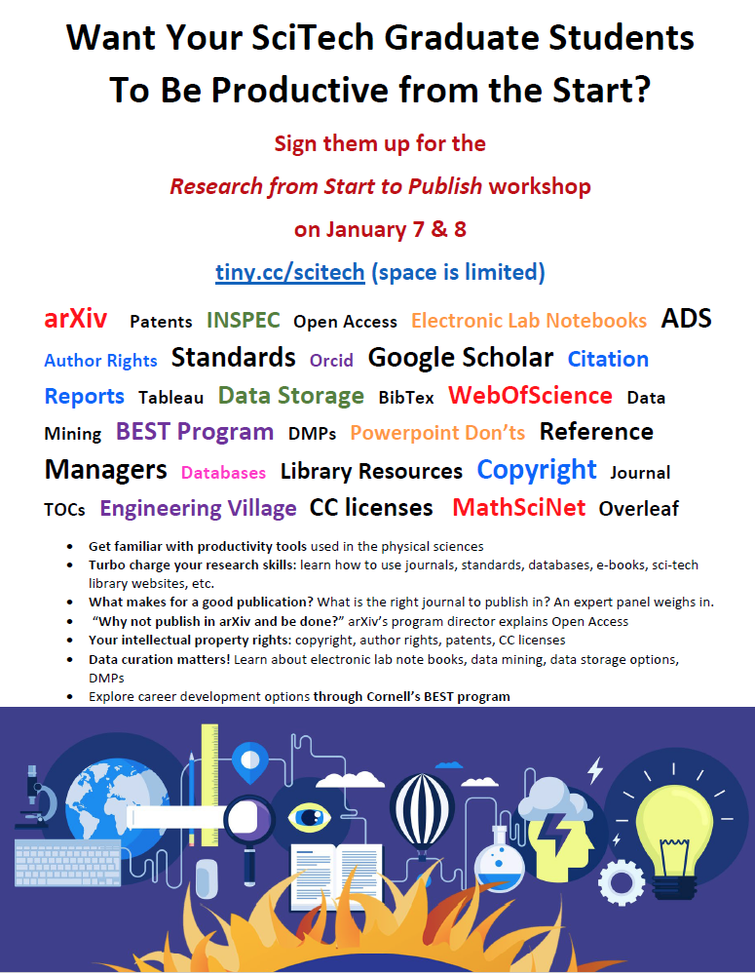
Marketing via advisors
"The faculty knows what is best for their students"
We put fliers in mail boxes of physics faculty.
Still only 5 physics grads signed up
Ask faculty to recommend workshop to their graduate students
Notes:
Sizes of posters
Twitter, chronicle article – Library Communications
E-Lists – BEST, grad students, dept e-lists

Slide 12
Feedback – Generalized conclusions
Compress program (One day rather than two for busy students?)
Heterogeneous audience = not every topic relevant to every participant
How to coordinate across speakers to avoid excessive overlap in some topics?
Promotion through the BEST Program = good source of attendees
In general: People liked the program.

Slide 13
Future Program Ideas
Journal editors panel, regular event?
Cross-disciplinary
Graduate school collaboration
Collaborate with other immersion programs?
Notes:
Offer journal editors panel to all CU, expect Mann library patrons as well as PSL, ENGr, Math to attend.
Comparisons with Humanities, social sciences immersion.
Ongoing challenge of meeting everyone’s research needs.

Slide 15
Acknowledgements:
Natalie Sheridan, José Beduya, Sean Taylor, Matt Ryan, Danianne Mizzy, Tracy Davenport, Carla DeMello
Questions?
Tiny.cc/scitech
Jill Powell, Leah McEwen, Jeremy Cusker, Henrik Spoon

