Slide 1
ILS Migration for a Small Library: Our Experience
Doyin Adenuga,
Electronic Resources Librarian (MLIS)
Michael Green,
Circulation Coordinator and Interlibrary Loan Specialist
(LIS Grad Student, University at Buffalo)

Slide 2
About Us
Small, private, liberal arts college - WNY
ILS
VTLS (1984)
Symphony (2005)
WMS (2019)
Why the migration?

Slide 3
Data to Migrate
Symphony/Sirsi WMS/OCLC
Bibliographic Record
001 – 999
Bibliographic Record
Local
Bibliographic Record
001 - 999
590
690
590
690
Holding Record
Local Holding Record
866
994
866
994
Data not attached to an Item not migrated

Slide 4
Pre-Cleanup
Tried to make Holding records migratable
Reduced locations: 60 to 36
Circulation table

Slide 5
Post-Cleanup
Error files
bibliographic record
Item/circulation statistics
loans status
Holding records issues

Slide 6
Migration
Small staff – big goals!
(AKA: How to do many different things very quickly.)
Collaboration
Structure
Proactivity
Coffee

Slide 7
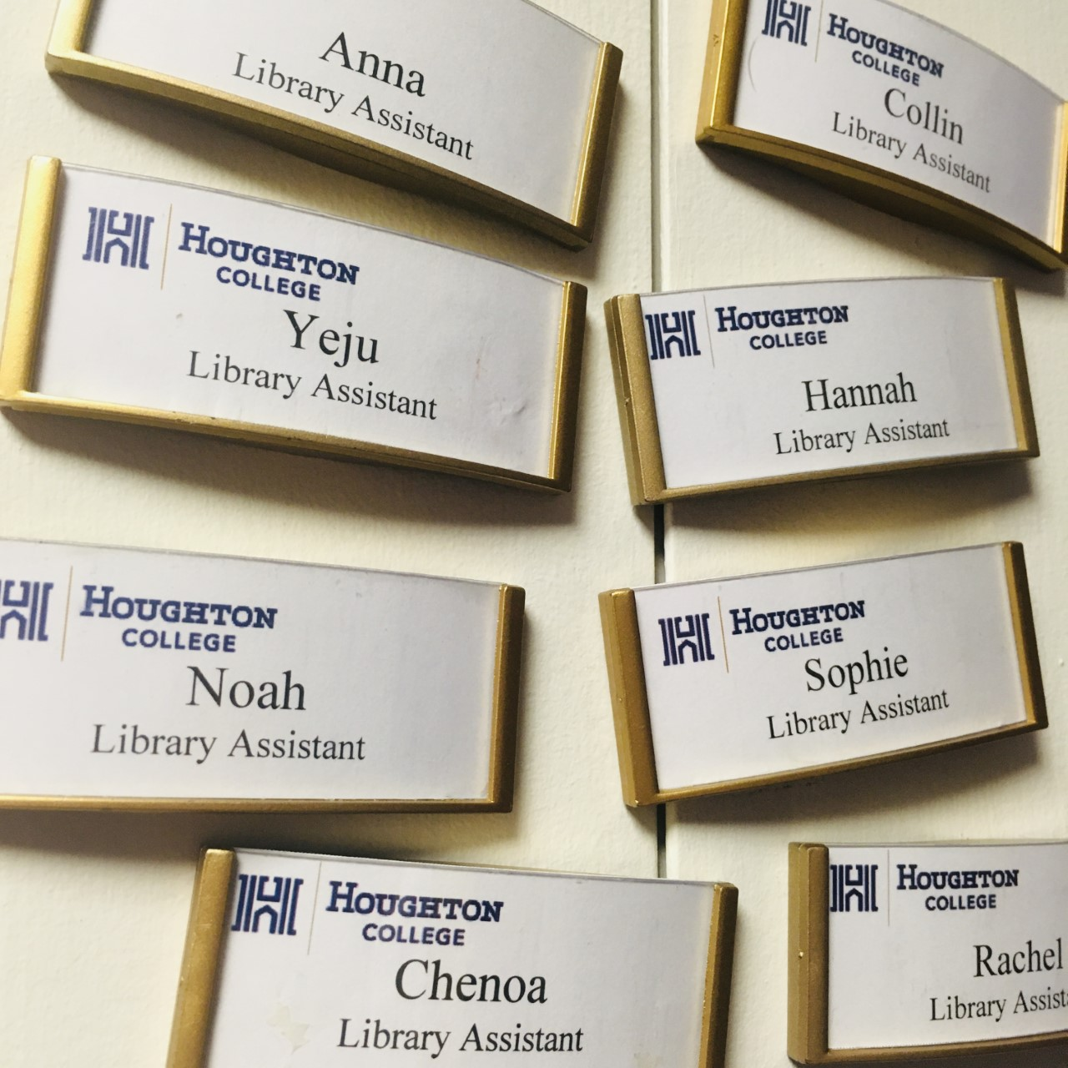
Onstage Changes
Student workers
Reduced training time
Reduced perplexing situations
Improved student worker
experience

Slide 8
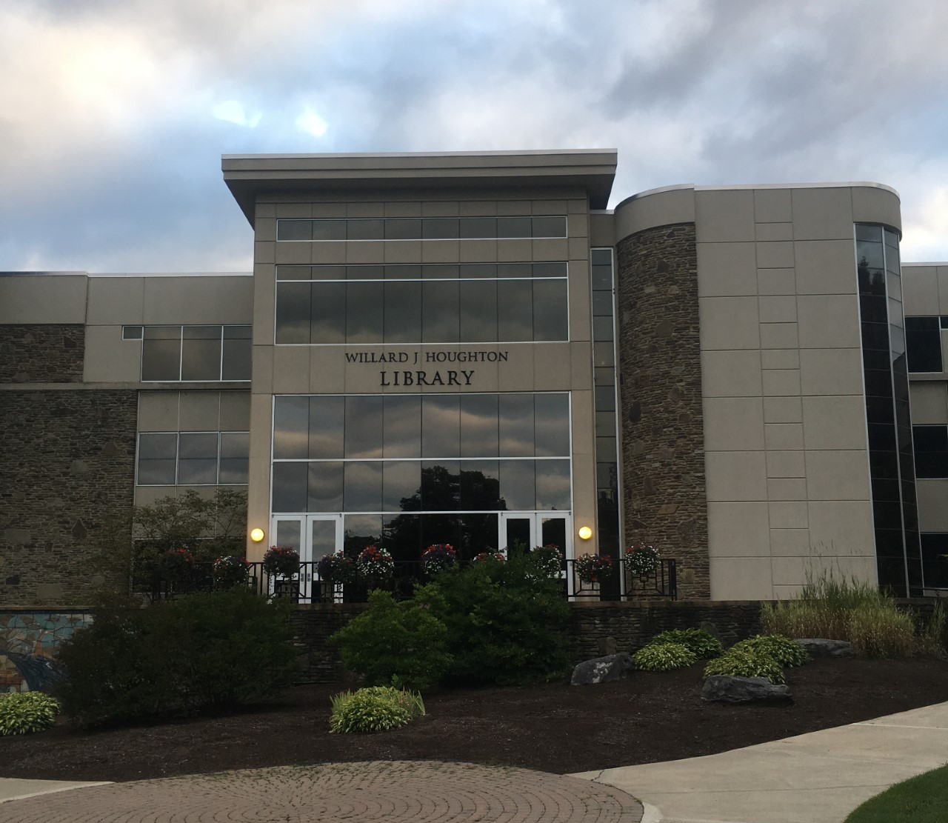
User Experience
Easier to access services
Better, more productive interactions with users
Increased user satisfaction

Slide 9
Thank You & ?

