Slide 1
24/7 access at the Upstate Health Sciences Library
Rebecca Kindon, MSLIS, AHIP Associate Librarian Assistant Director for Customer Services Upstate Health Sciences Library

Slide 2
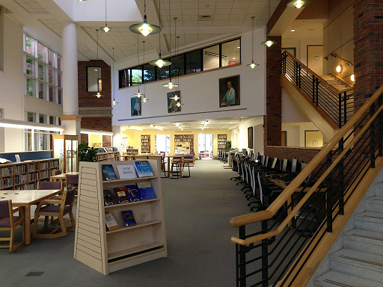
Brief introduction to the Health Sciences Library:
HSL serves our four colleges & three hospitals
Currently open and staffed an average of 104 hours per week:
Monday – Thursday 7:30 am – 12:00 am
Friday 7:30 am – 10:00 pm
Saturday 10:00 am – 9:00 pm
Sunday 10:00 am – 12:00 am
HSL is open 361 days a year

Slide 3
Our history with 24/7 access:
After-hours (24/7) access has been the #1 service request for over a decade.
Costs and staffing were always the unsurmountable obstacle.
Inquiry to AAHSL revealed that several of our peer institutions were providing unstaffed access via card swipe.
We have card swipe access….

Slide 4
Steps towards providing unstaffed access via card swipe:
Get permission from Upstate Legal Counsel to offer unstaffed access via proximity reader at entrance
Ask our students if they would like this level of access
Draft statement of responsibilities & staff procedures
Work with IMT to access proximity readers at HSL
Develop a brief orientation for individuals – quiz included!
Announce and roll out service…

Slide 5
Results to date:
310 students have registered for after-hours access
Early morning (before 10am) on weekends is the most popular
No instances of theft or destruction of property
Only a handful of procedural infractions, e.g., students forgetting to sign out at departure.

Slide 6
Thank you!

