Slide 1
LibQuest
A Web-App for Exploring the Library
Abby Juda
Ithaca College Library
Notes:
With thanks to Ron Gilmour, Kelly Hallisy, Dan Taylor

Slide 2
Why LibQuest?
Notes:
Scavenger hunts chaotic, easy to cheat, don’t always take into account changing resources
Library tours – a little boring, and we’re a small library

Slide 3
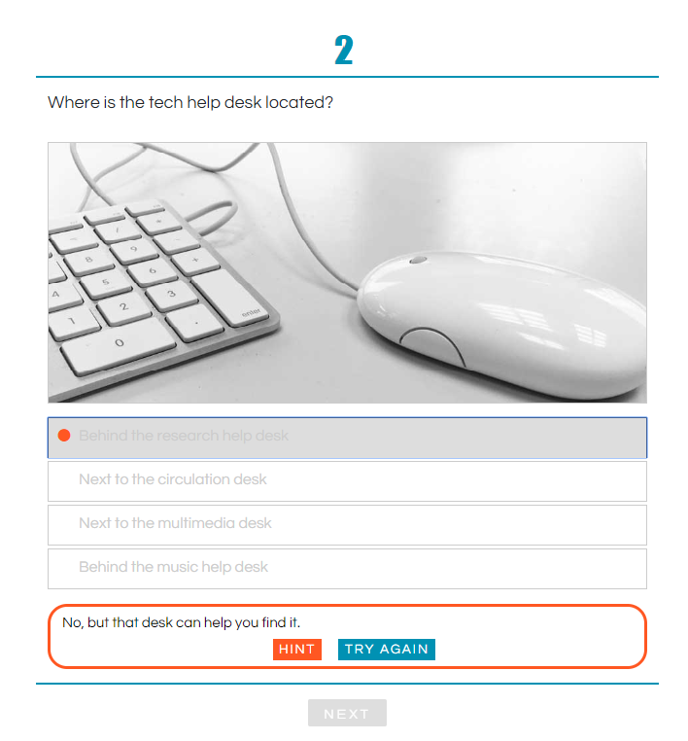
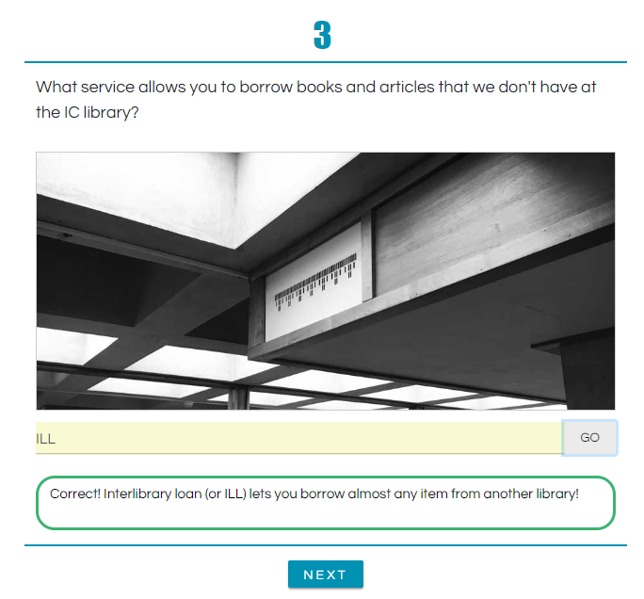
Notes:
LQ is semi-randomized, mobile friendly, forces students to get the right answer before they move on. Answers are saved (anonymously) so we can see where students are having trouble. Easily updatable.

Slide 4
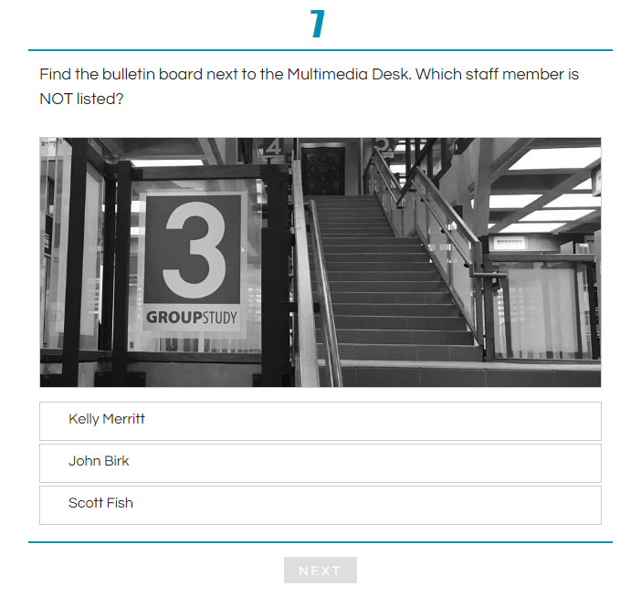
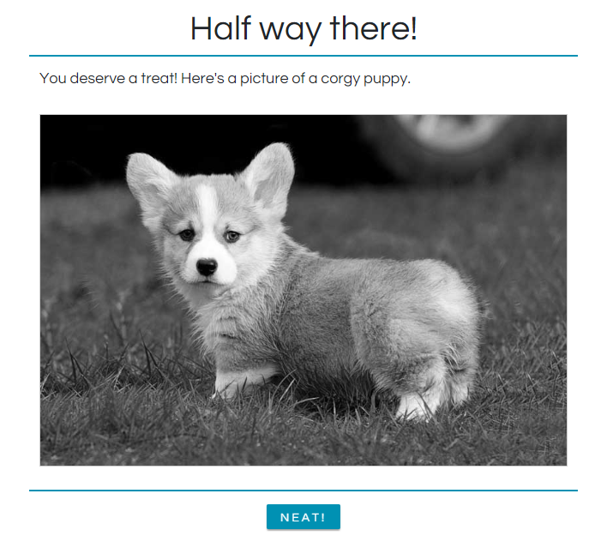
Notes:
Fun, encouraging, gets them into the physical space of the library. Could click through these questions, but there are several

Slide 5
What’s Next for LibQuest?
?
Notes:
We’ve got a framework for anything now. Angular framework for front end, JSON file for questions.

Slide 6
Thanks!
Try LibQuest at library.ithaca.edu/LQ
Get the code at GitHub https://github.com/rgilmour70/angular-quiz

