Slide 1
Summer Research Students
One Scholarly Publishing Program to Serve Them All?
Michelle Price, MLS, MA
Lavery Library, St. John Fisher College
November 2, 2018
Upstate New York Science Librarians 2018 Meeting

Slide 2
Summer Research @ St. John Fisher college Undergraduate Students
Independent research with a Faculty Member Sponsor
Common, competitive application for all majors
New Center for Student Research & Creative Work serves as an umbrella for all research students
10 week online Scholarly Publishing Module, voluntary (run by Science Librarian)
Notes:
Credit and/or Stipent.

Slide 3
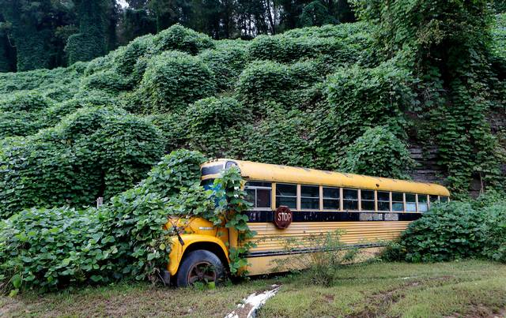
History of Summer Research @ fisher
 | Summer 2016 Science Fellows | Summer 2017 Science Fellows | Summer 2018 Fellows & Community Engagement
Faculty Participants | Biology Chemistry | Biology Chemistry Nursing | Biology, Chemistry, Nursing, Data Science, Pharmaceutical Chemistry, Physics, English, Psychology, History, Philosophy Media and Communication
Library Focus | Advanced Research & Scholarly Publishing | Scholarly Publishing | Scholarly Publishing

Slide 4
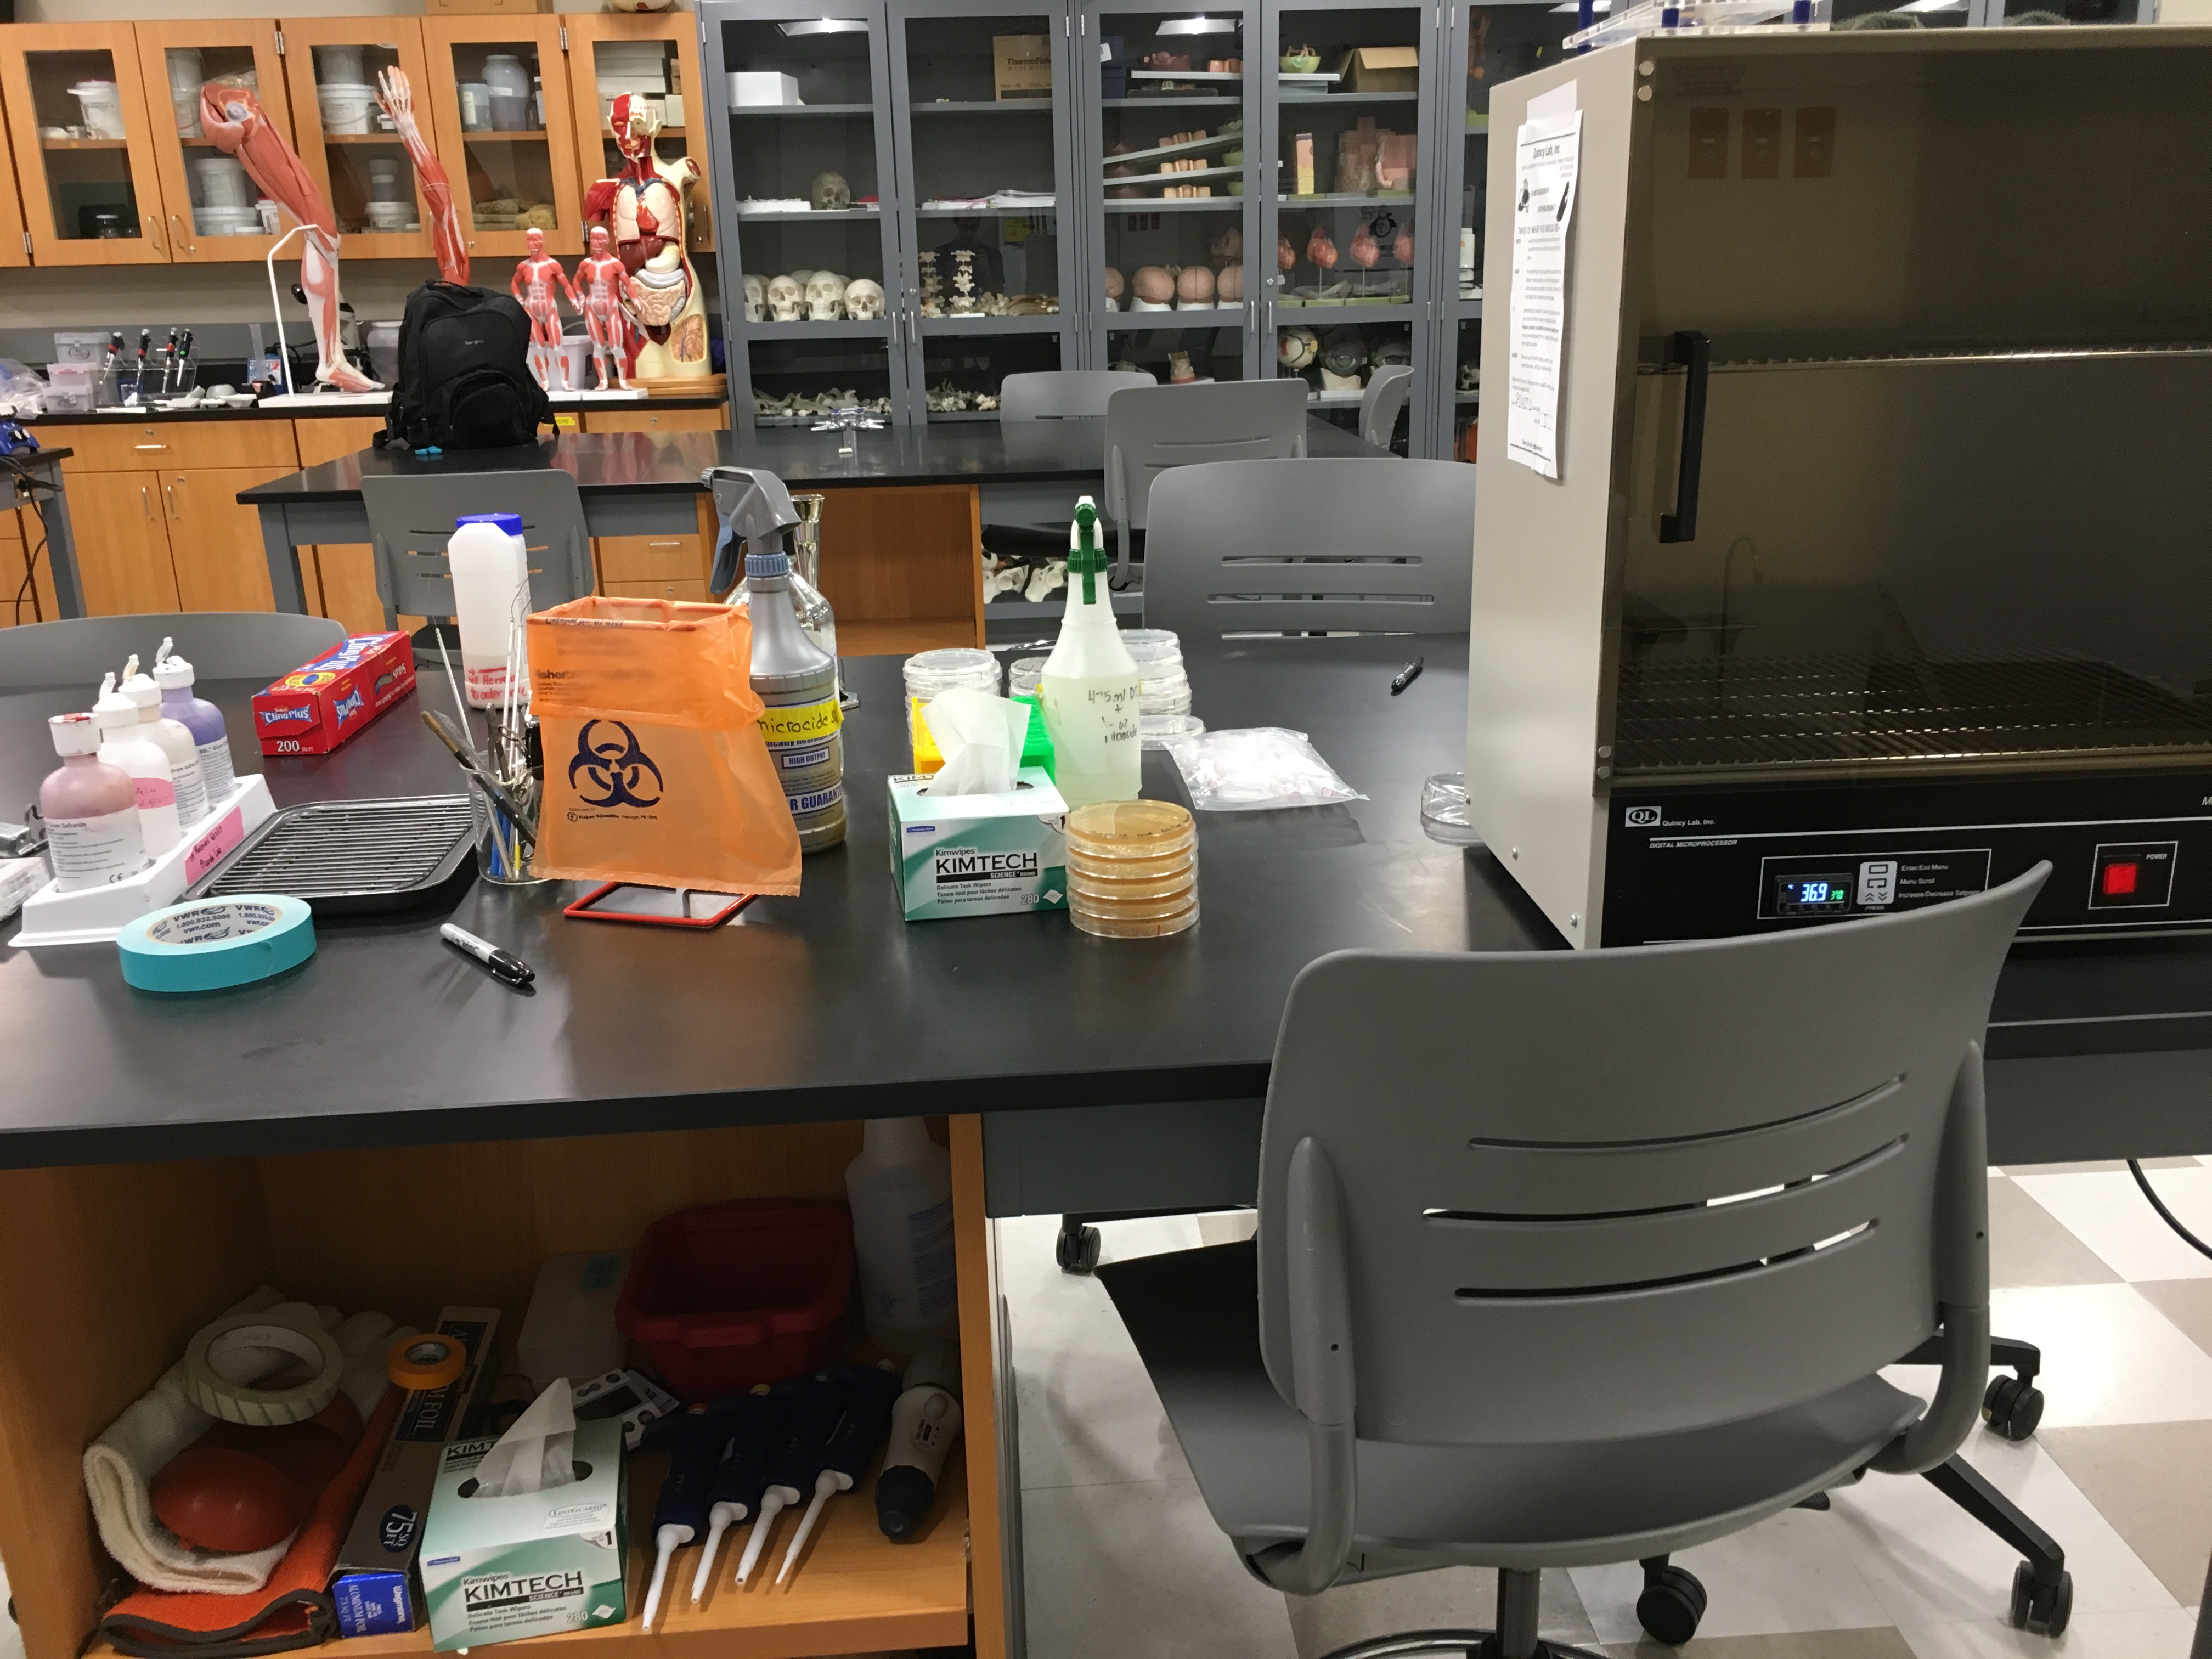
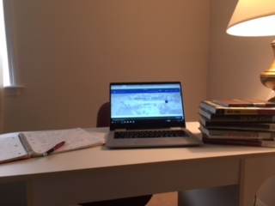
Updates to Activities Inclusive but Sustainable
Platform | Switched to an Organization in Blackboard. Used Discussion Board with subscribe option.
Week 1 Introductions | Your Lab Space
Week 2 Database Advanced Searching | Added Academic Search Complete
Week 8 Undergraduate Research Journals | Added Academic Leadership Journal in Student Research
Week 10 Final Reflection | Modified Quality Improvement Project option to include Clinical Practice or Industry

Slide 5
Challenges
Timing: Late notice, quick turn around for summer
Platform: Discussion board vs email
Student Participation: Voluntary vs Mandatory
Quantity of Students: Maximum participation, 17 students in a summer
Trust: Low completion rates in the Humanities & Social Sciences
Librarian Participation: Little to no uptake. Director observed.
Content: Inclusive enough? What modifications to make?

