Slide 1
Outreach to Science Faculty and Students Through Research Exhibitions
Tina Chan and Chris Hebblethwaite
SUNY Oswego
Upstate New York Science Librarians Meeting
October 25, 2013

Slide 2
How It Started
Library’s gallery exhibition space near the front entrance and in our café
Traditional use of exhibition space
Looking for new content to display, Diversify disciplines
Display research posters in the library to showcase student-faculty research
Call for research posters sent to science faculty
Six faculty submitted 13 student-faculty research posters
Notes:
Tina: Penfield Library at SUNY Oswego has a gallery exhibit space near the front entrance that is used to showcase student-faculty research and art class projects. I ask art faculty if they want to show their students’ work for a month or two, but sometimes they approach me. In the fall 2012, I was looking for work to exhibit and I remember being in the science building and seeing research posters on the corridor walls. Since mainly science students, faculty, and staff are in the science building, I thought that bringing the research posters to the library would be a wonderful way to showcase student-faculty research to a broader population. After all, the library is the perfect place to exhibit this work as it is a central location for research and study. As Chris and I are both science librarians at Oswego, I asked Chris what he thought of showing the research posters in the library.
Chris: As a science librarian and Coordinator of our Learning Commons, I thought this was a great idea. A common features of a Learning or Information Commons is a display of student scholarship and creative works. The intention is to create an atmosphere that inspires learning and creativity. My thought was that displaying these posters would show students what their peers have accomplished and help build excitement about what they themselves can achieve. Posters about student research are already generated for a variety of venues on campus. Our seniors are required to do capstone research projects and need to present their research at an event we call Quest. Quest is a one day symposium that occurs each spring that is dedicated to sharing the scholarly and creative pursuits of faculty, staff and students at SUNY Oswego.
Tina: So, a call for research posters was sent to science faculty asking if they would like to feature their student-faculty research posters in the library. Six faculty submitted 13 student-faculty research posters, which were exhibited in the library’s gallery exhibit space and inside the library cafe. Some submitted more than one. We didn’t specify a limit because we weren’t sure how many we would get, but we made sure everyone who wanted to submit a research poster had the opportunity to do so.

Slide 3
Research Titles
The Relationship Between Vegetation Composition and Oviposition Behavior of the Bog Buckmoth, A Rare Inhabitant of New York Peatlands
Remediation of Toxic Metal Contaminated Soil: Long-term Effectiveness of Fishbone Apatite Amendment
Extractions and Characterization of Lipids From Food Samples
Metal Toxicity in Children: Apolipoprotein E and Lead
Gastric Bioavailability of Toxic Metals in Contaminated Soil Four Years After the Amendment with Fishbone Apatite
Inhibition Testing of Pseudomonas Spp. "K/W" Against Pythium aphanidermatum PA5 on Cucumis sativus
The Effects of Instar and Caterpillar Group Size on Prediation of Hemileuca Sp.
Effects of EDTA on Trypsin's Activity and MALDI TOF
Assessing the Presence of Methicillin-Resistant Staphylococcus aureus (MRSA) in Human and Canine Nasal Passages
Mechanically Damaged Baby Greens and the Effect on Escherichia Coli O157-H7 Growth
Degradation of Polycyclic Aromatic Hydrocarbons in Contaminated Soil Amended with Fishbone Apatite and Iron (III) Oxide
Community-Oriented Environmental Research Project: Quality of Well Water vs. Municipal Drinking Water
Extending the Shelf Life of Farm-Fresh Using Novel Energetic Preservation Methods
Notes:
Tina: Most of the research posters were from the biological sciences faculty. Since Chris and I originally didn’t receive many responses, I asked certain biological sciences faculty members individually. After approaching them individually, they gave me their research posters. I hung the research posters, and I spread out the research posters by subject and authors.

Slide 4
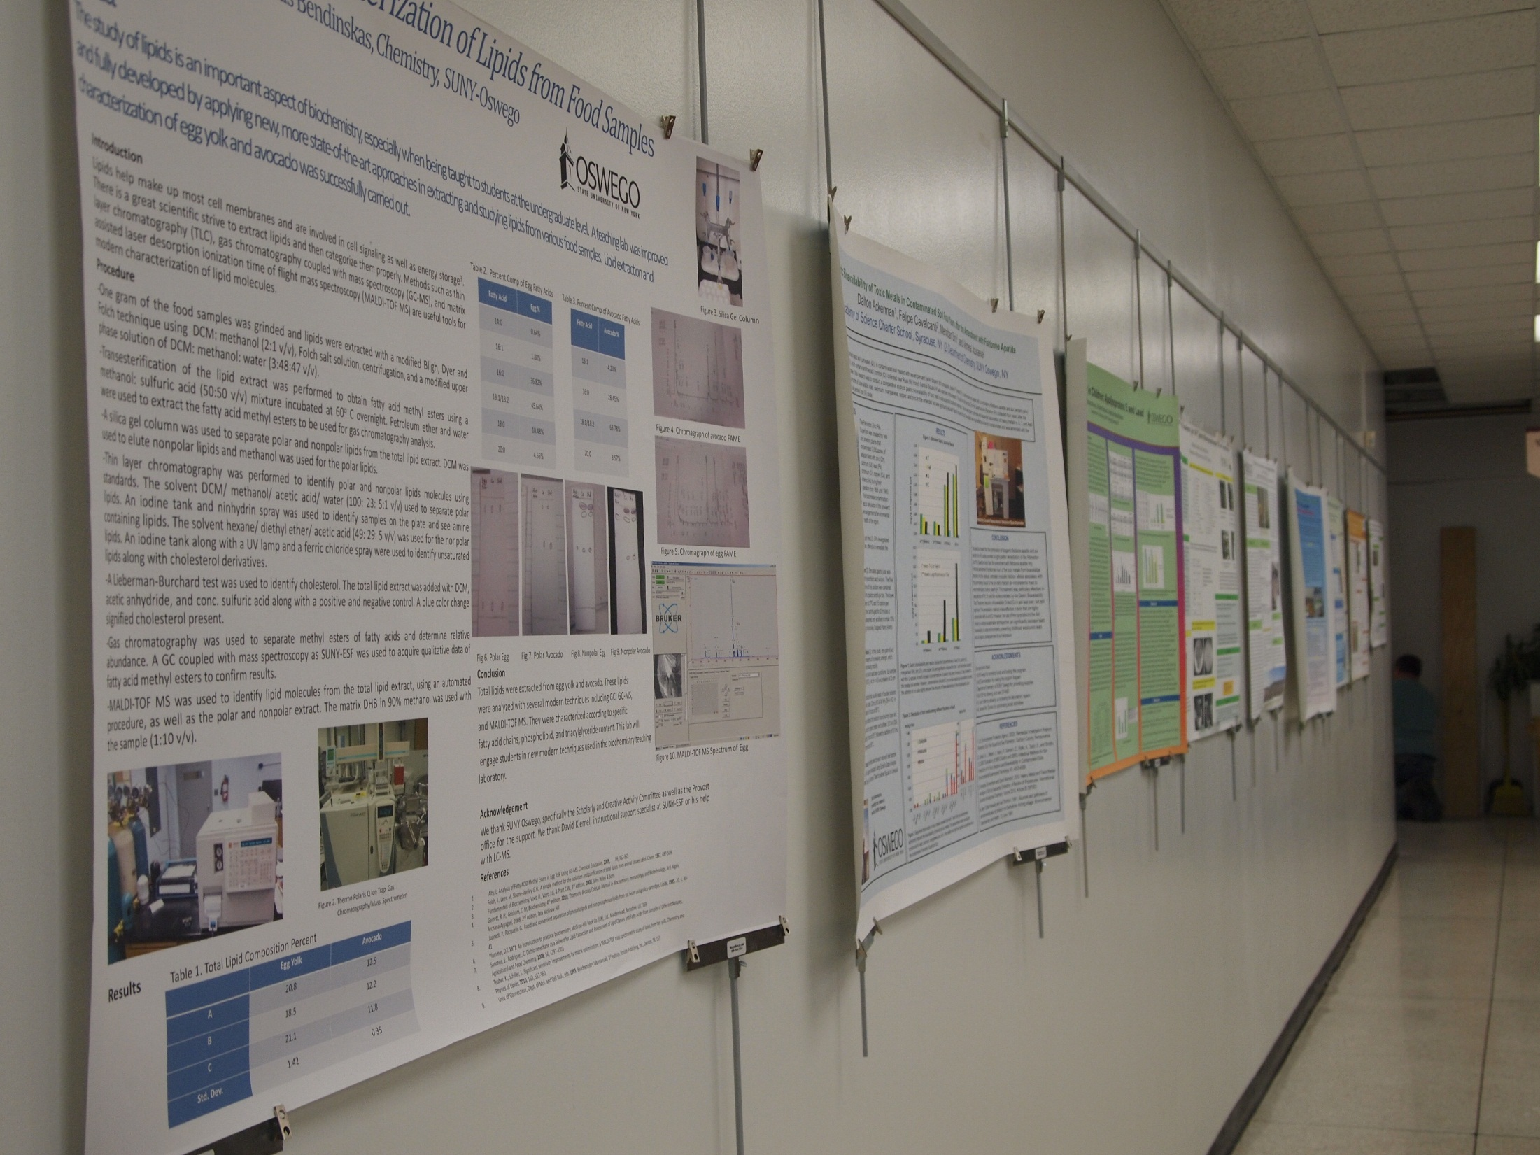
Notes:
Chris: This wall is directly across from our Circulation Desk at our main entrance and is the most visible of the display areas. This aspect gives you a fairly good view of the hanging system we use. It’s called the Walker Display System and was selected by Tina’s predecessor, an Art Librarian who was not only an artist but someone who had experience with designing exhibition space. You can see that there is a rail that is installed permanently across the upper portion of the wall and there are rods that hang from it that can be placed at any location along the rail where they are needed. On the rods you can attach a variety of hooks or clips depending on what you need to hang.

Slide 5
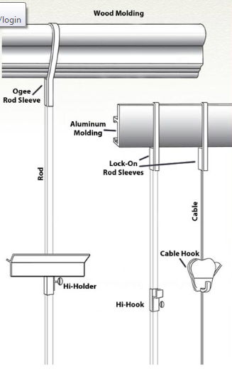
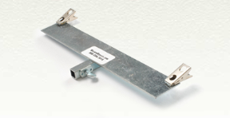
Taken from the Walker Display Inc. website at http://www.walkerdisplay.com/how-it-works.html
Notes:
Chris: These images were taken from the Walker Display Inc. website and show a close-up of the product and how it works. Here is the rail (or molding as they call it) that is installed on the wall and these are the rods or cables you can use to hang from the rail. This is an image of the particular clip Tina used to hang the posters. The double clips make it possible to hang the posters without the need to mount them on a stiff backing.

Slide 6
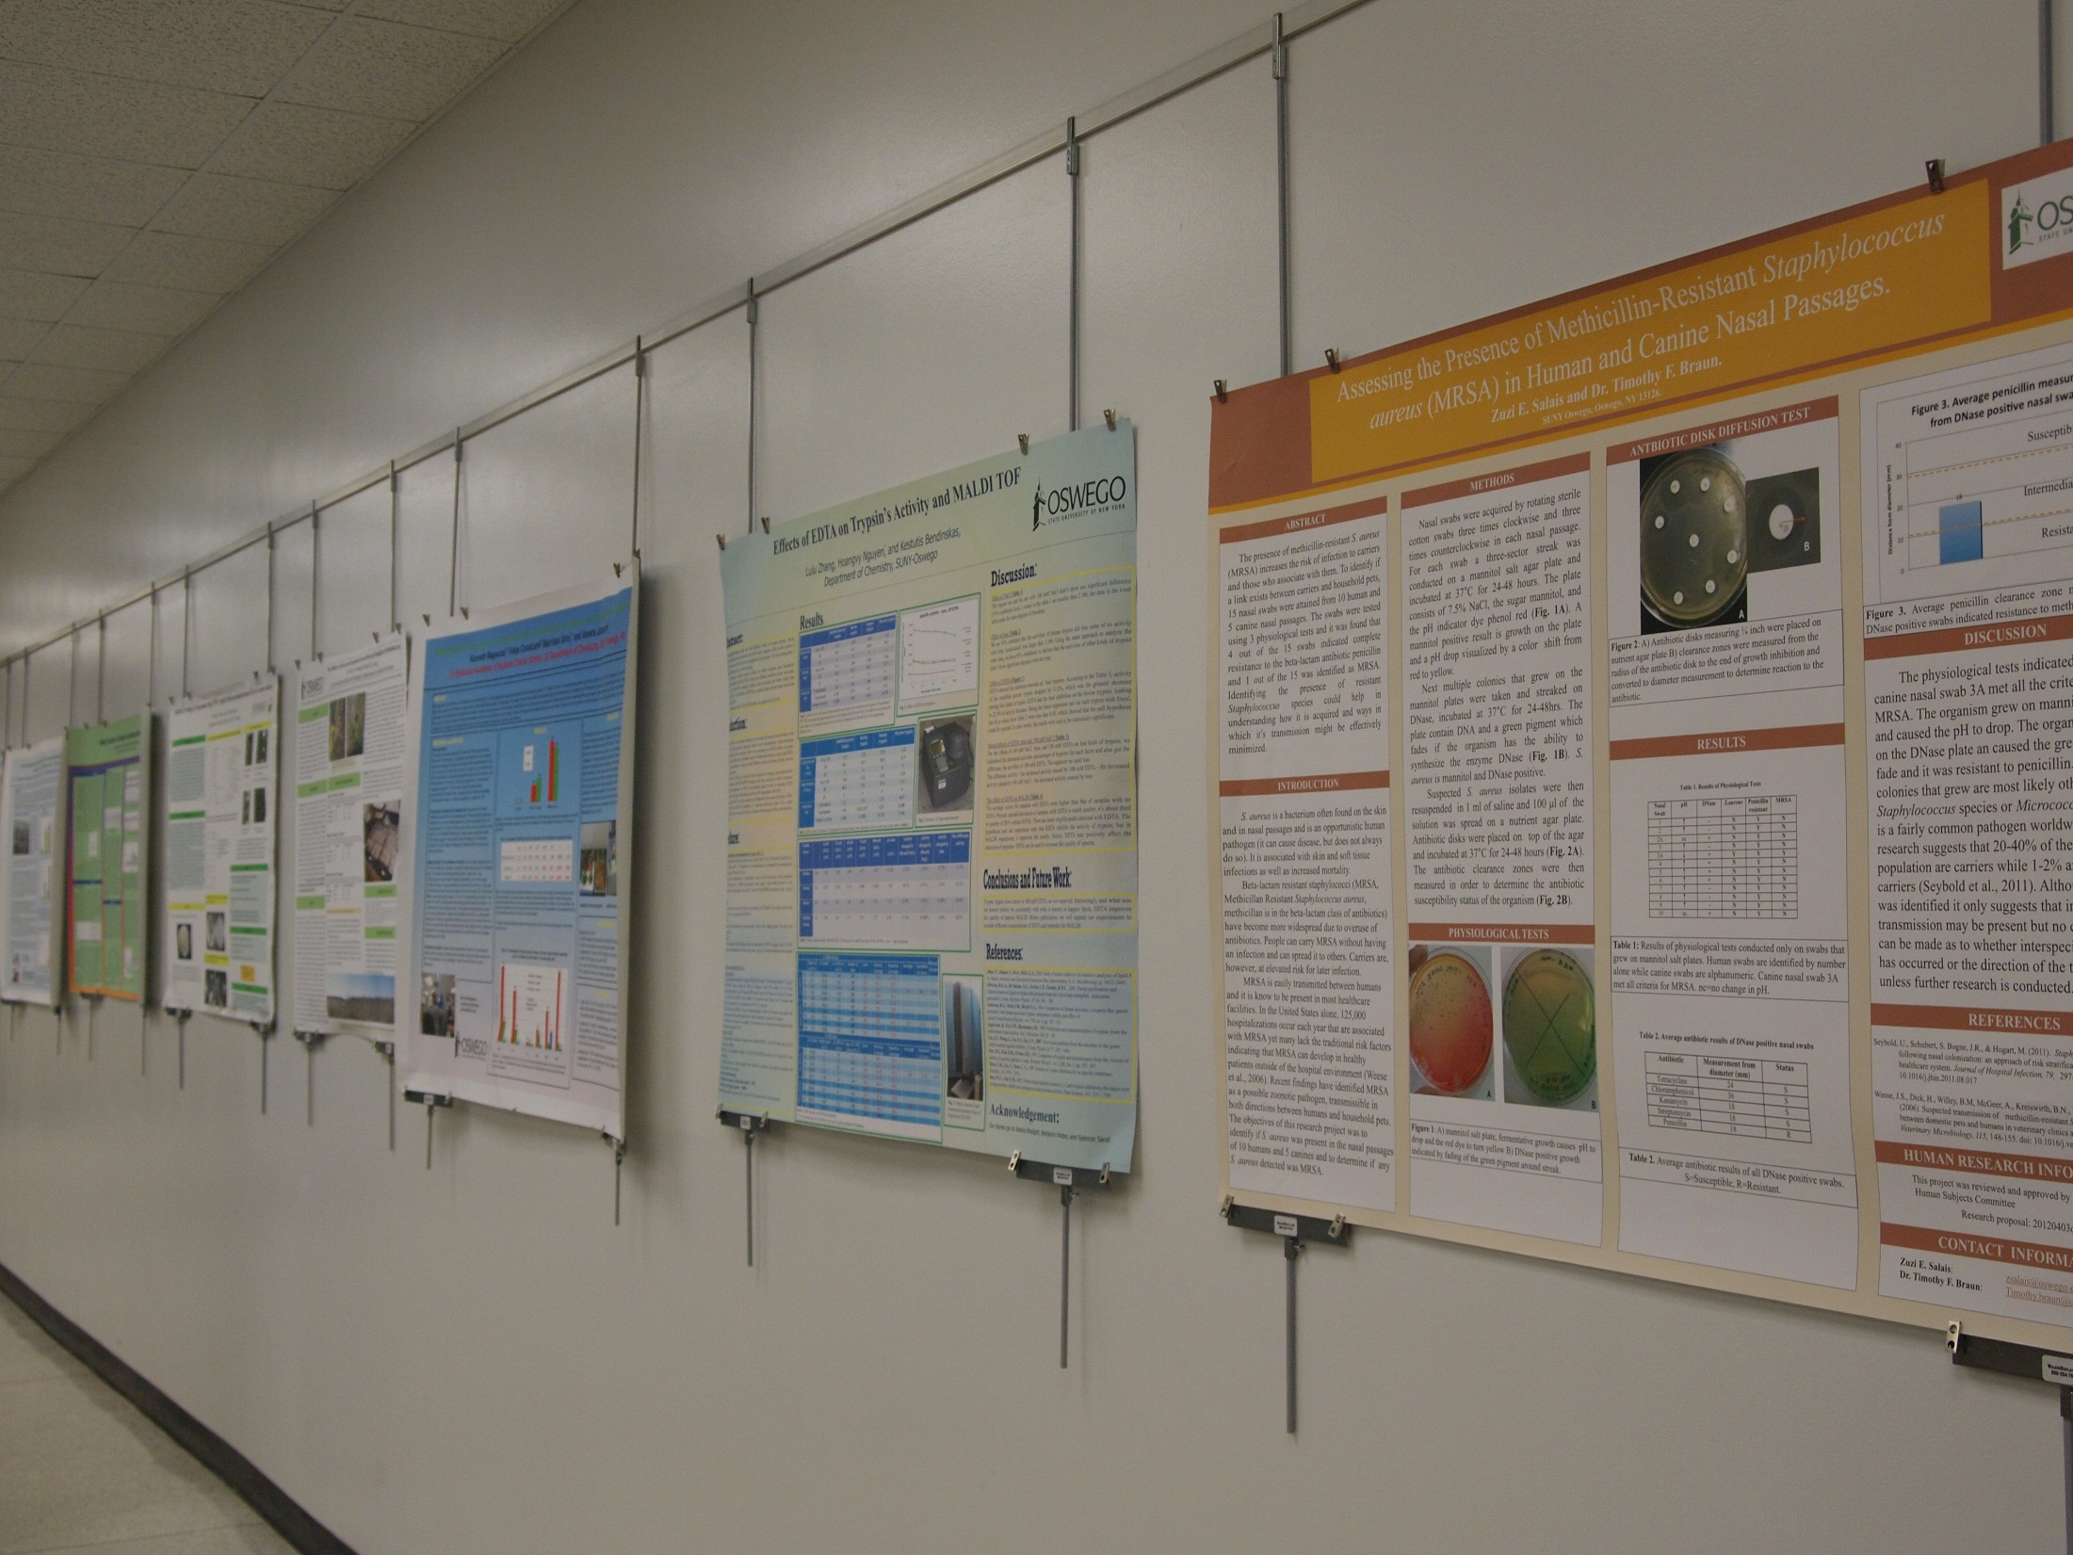
Notes:
Chris: Here is another view of the same wall and you can see how the posters are attached to the rods.
(In case anyone asks, the moldings start at $20 for an 8’ length. Depending on the finish, they can be as high as $30. The clips we used are $7.95 each...$70.00 per 10 pack. There are the items like mounting snaps and end caps for the moldings that you would need.)

Slide 7
What we would do differently
Give faculty more lead time to get us posters
Follow-up our call for posters with more personal invitations
Be more specific in our call for posters regarding size
Assess how faculty and students perceived the value of the display – survey
Notes:
Tina does 1st two and Chris does 2nd two.
We gave faculty 2 weeks to get us posters. Some faculty may need to print a new copy of the poster or may need more time to respond.
Size was not that important. We received posters that were basically the same size with some variation. They were typically the size that they used in their poster sessions. Saying that this is an appropriate size upfront makes the process more efficient.

Slide 8
Thank you!
Tina Chan
tina.chan@oswego.edu
Chris Hebblethwaite
chris.hebblethwaite@oswego.edu
Notes:
Tina: By having research posters displayed in a visible, central, and active location, this provided greater visibility to the broader campus community to view the latest research from students and faculty. By reaching out to science faculty, they were reminded that librarians can help with their library needs, and the library is a place to highlight their and their students’ research.

