Slide 1
“I Want to Do a Systematic Review!”
Chris Fournier, Life Sciences Librarian
ctf43@cornell.edu
Kate Ghezzi-Kopel, Applied Health Sciences Librarian
kwg37@cornell.edu

Slide 2
What is a systematic review?
“…a scientific investigation that focuses on a specific question and uses explicit, pre-specified scientific methods to identify, select, assess, and summarize the findings of similar but separate studies.”
Notes:
Systematic reviews have long been considered the gold standard approach in medicine for synthesizing and critically appraising evidence to inform policy.
Systematic review teams follow a strict protocol to ensure that their methods are transparent, unbiased, and reproducible.

Slide 3
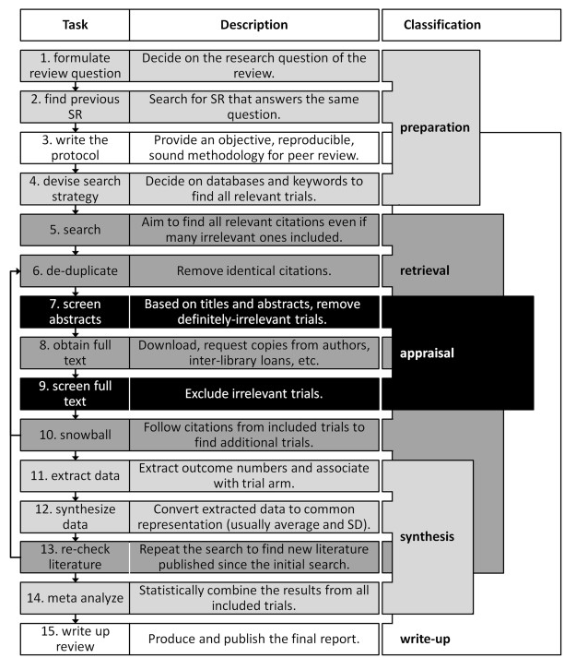
Steps in a traditional systematic review:
Tsafnat G, Glasziou P, Choong MK, Dunn A, Galgani F, Coiera E. Systematic review automation technologies. Syst Rev 2014;3:74. doi:10.1186/2046-4053-3-74
Notes:
The methodology is rigorous and complex, as illustrated here.
SRs require literature searching expertise and advanced information management skills – as such they make use of classic library skills
Health sciences libraries are increasingly offering systematic review support services, and librarians on these teams are trained to shepherd researchers through the process.

Slide 4
Systematic reviews are common practice in clinical environments
In interdisciplinary contexts, the conversation changes
Notes:
SRs lend themselves readily to the clinical medicine disciplines
But in an environment like ours, systematic reviews can take on a variety of unfamiliar characteristics (that we were not necessarily prepared for in our training, which is often geared toward medical librarians)

Slide 5
Systematic Review Questions in Clinical Medicine:
vs. Systematic Review Questions in…
Education
Natural Resources
Agriculture
Communication Studies
Nutritional Studies
?
Notes:
In Clinical Medicine: Readily lends to the SR methodology, clearly defined PICO clinical question, many existing RCTs to examine
In Other Disciplines: Different databases, less base knowledge of the methodology, more instruction required up front
We can’t think of other disciplines as being monolithic in their needs, it varies by discipline, as does the jargon
Even in Nutrition, a more clinical discipline than some others we work with, their understanding and execution of systematic reviews is different than ours.
Whereas medical librarians can often dive right into the SR process with their teams, we must adapt our services to see eye-to-eye with those who request assistance.

Slide 6
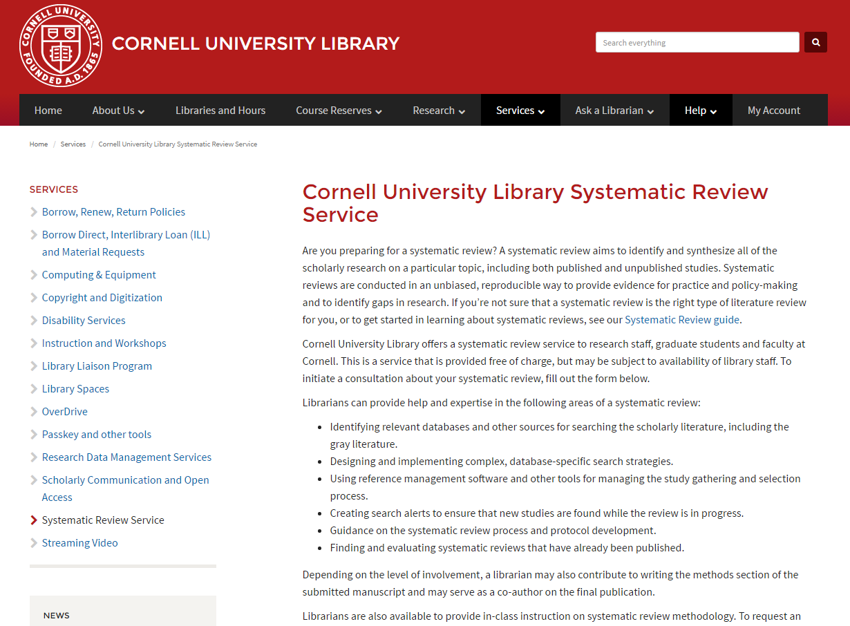
https://www.library.cornell.edu/services/systematic-review
Notes:
Since January of 2016 we’ve offered a formal service with a dedicated email inbox
WCMC already provides one
Designed to meet the noticeable increase in SR-related research support requests
As of yet we haven’t identified other non-medical/health sciences libraries that provide a formal service

Slide 7
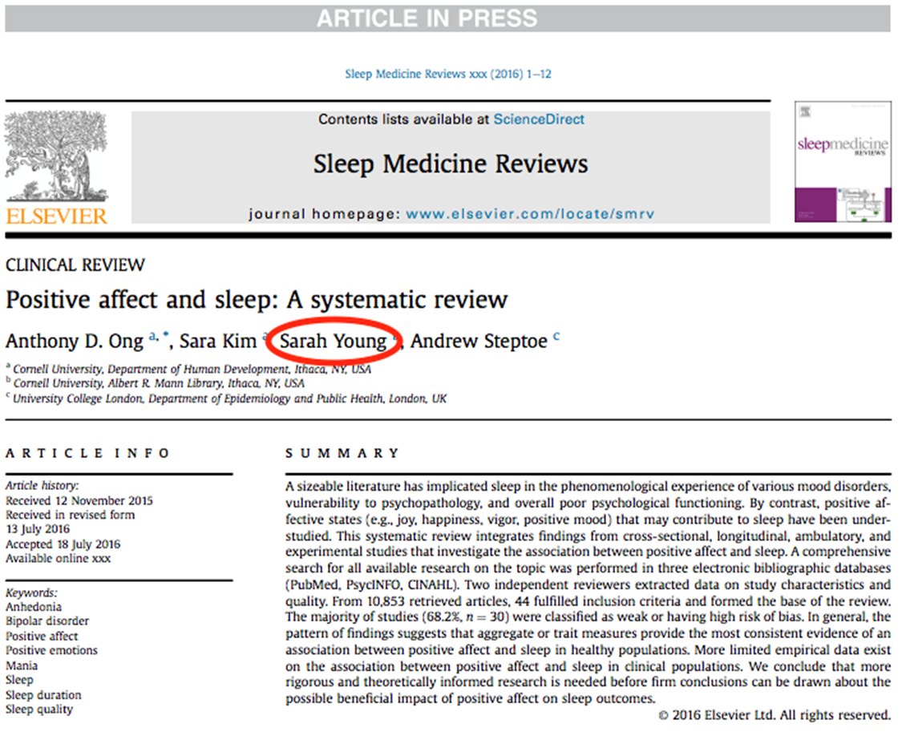
Notes:
Some SRs that we collaborate on are more traditional and our collaboration parallels the steps in the standard methodology.
Our former colleague collaborated on this SR from our Human Development department
Two different levels of involvement are offered… L1: basic consultation and episodic check ins, L2: full support start to finish and authorship on publication

Slide 8
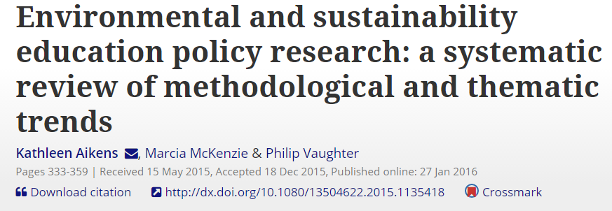
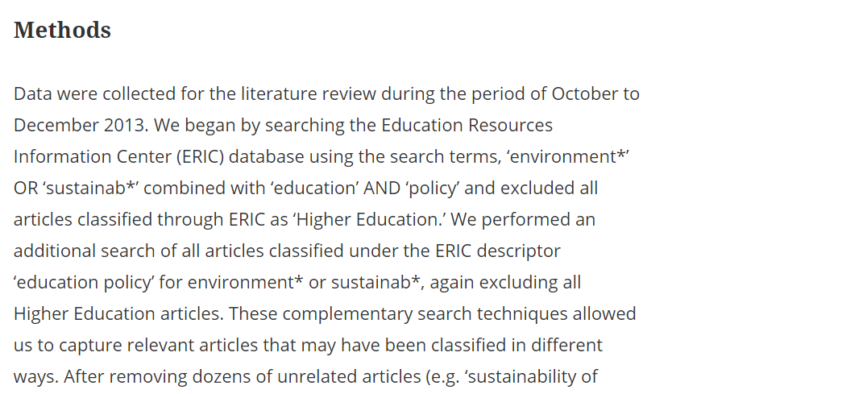
Notes:
Example of a published SR in Natural Resources with simplistic search strategy

Slide 9
(((("Environmental Education" OR "Nature Education" OR "Environmental Educator" OR "Experiential Learning" OR "Ecological Literacy" OR Ecoliteracy OR ESD OR "Education for Sustainable Development" OR "Conservation Education" OR "Citizen Science" OR "Community-based education" OR "Place Based Education") OR ("Educación Ambiental" OR "educación en la naturaleza" OR "Educador Ambiental" OR "aprendizaje experiencial" OR "Alfabetización Ecológica" OR "Educación para el desarrollo sostenible" OR "educación para la conservación" OR "educación para la sustentabilidad" OR "Ciencia Ciudadana" OR "ciencia participativa" OR "educación basada en la comunidad") OR ("Educação Ambiental" OR "educação pela natureza" OR "Educador Ambiental" OR "aprendizagem experiencial" OR "Alfabetização Ecológica" OR "Educação para o Desenvolvimento Sustentável" OR "educação para a conservação" OR "educação para a sustentabilidade" OR "Ciência cidadã" OR "ciência participativa" OR "educação baseada na comunidade") OR ("éducation à l’environnement" OR "éducation environnementale"OR "education à la nature" OR "Apprentissage expérientiel" OR "alphabétisation écologique" OR "éducation en vue du développement durable" OR "éducation pour le développement durable" OR "éducation à la conservation" OR "sciences citoyennes" OR "éducation communautaire" OR "éducation axée sur les lieux"))))
AND
(((("Latin America*" OR "Central America*" OR "South America*" OR Caribbean OR "Antigua & Barbuda" OR Argentin* OR Aruba OR Bahamas OR Barbad* OR Belize OR Bolivi* OR Brazil OR Cayman Islands OR Chile OR Colombia OR "Costa Rica" OR Cuba OR Dominica or "Dominican Republic" OR E*uador OR "El Salvador" OR "French Guiana" OR Grenad* OR Guadeloupe OR Guatemala OR Gu*ana OR Haiti OR Honduras OR Jamaica OR Martinique OR Mexico OR Nicaragua OR Panama OR Paragua* OR Peru OR "Puerto Rico" OR "Saint Barthelemy" OR "St. Kitts & Nevis" OR "St. Lucia" OR "St. Martin" OR "St. Vincent and the Grenadines" OR Surinam* OR "Trinidad * T obago" OR "Turks & Caicos" OR "Urugua*" OR Venezuela OR "Virgin Islands") OR ("América Central" OR "América d* Su*" OR Sudamérica OR Suramérica OR Caribe OR "Antigua y Barbuda" OR Belice OR Br*sil OR "Islas Caimán" OR República Dominicana OR "Gu*ana Francesa" OR Martinica OR Perú OR "San Cristóbal y Nieves" OR "Santa Lucía" OR "San Martín" OR "San Vicente y las Granadinas" OR "Trinidad y Tobago" OR "Islas Turcas y Caicos" OR "Islas Vírgenes") OR ("São Cristóvão e Nevis" OR "São Martinho" OR "São Vicente e Granadinas") OR (Îles Caïmans OR Chili OR Colombie OR Dominique OR "République dominicaine" OR Équateur OR Guyane OR Pérou OR "Porto Rico" OR "Saint-Barthélemy" OR "Saint-Christophe-et-Niévès" OR "Saint-Martin" OR "Saint-Vincent-et-les Grenadines" OR "Trinité-et-Tobago" OR "Îles Turques-et-Caïques" OR "Îles Vierges des États-Unis"))))
Environmental education concepts
Geographic region concepts
Notes:
This is a search strategy that Chris developed with a SR team here at Cornell
Demonstrates how complex the methodology is in practice, and how librarian support is essential for translating the process to fit the needs of various departments

Slide 10
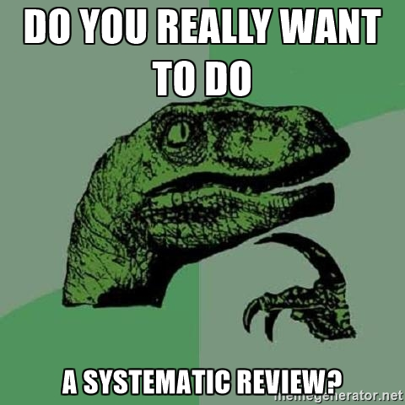
Notes:
We often get questions at the reference desk from undergrads saying “I need help with a systematic review”
What’s the language that everyone’s using when they talk about systematic reviews?
Should we force our understanding of SRs into their mold – or enforce our own understanding of it on them?
What’s the liaison’s role?
What level of training does everyone need?

Slide 11
2 nutritional sciences labs looking at micronutrients, pregnancy, health outcomes
Individual undergraduate lab members submit SR request to library:
“I’m doing a systematic review, can you help??”
Explanation of
systematic review
methodology
Consultations on development of structured search strategy
In the future… embedded library support for systematic reviews in the labs
Notes:
SR work in Nutrition is an example of a department that has adapted the idea of systematic review work to match the structure of the work they do
Rolling SR projects that are passed down to new freshman lab members when seniors graduate, leading toward eventual publication
Kate has been putting together ideas to meet the specific needs of this group, as opposed to forcing them to adhere to a more traditional SR process

Slide 12
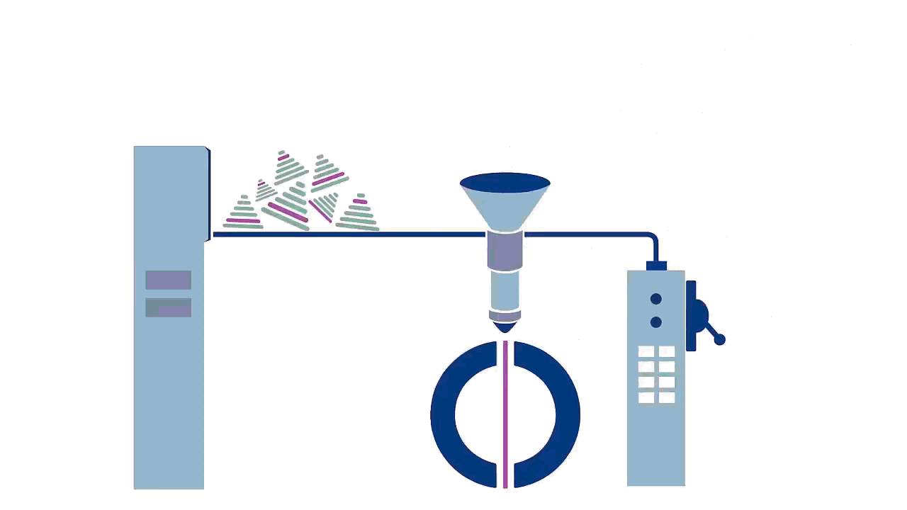
Questions?
http://cccrg.cochrane.org/animated-storyboard-what-are-systematic-reviews

