Slide 1
Scholarly Publishing: Instruction for Undergraduate Students
Michelle Price
Lavery Library, St. John Fisher College
Upstate New York Science Librarians Meeting
October, 2016

Slide 2
General Biology

Slide 3
General Biology
Big Picture Understandings
Scientific information is published with different audiences in mind.
Scientific discovery is a cumulative process.
Topics Covered
Open Access
Article Processing Charges
Author Instructions
Peer-Review Process
Notes:
Where to put the frames?

Slide 4
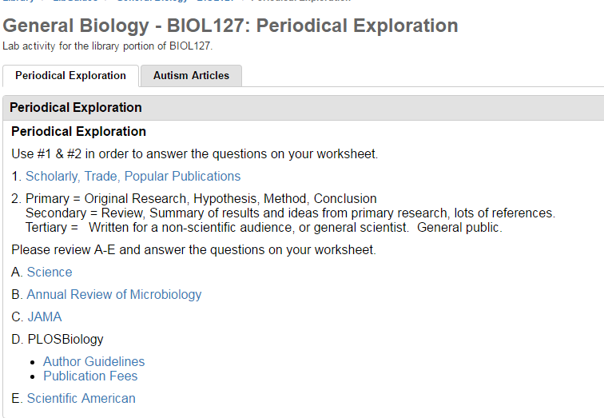
General Biology - Activities
Notes:
Where to put the frames?

Slide 5
General Biology - Activities
Worksheet Discussion questions:
What are the positives and negatives of charging authors to publish?
How are the purposes of Scholarly and Popular publications different? The same?
What does Peer-Reviewed mean? What are the positives and negatives of this process?
How does submission style affect the quality and content of articles published?

Slide 6
Advanced Anatomy

Slide 7
Advanced Anatomy
Topics Covered:
Figures in Scholarly Books and Popular Science Books
References vs Acknowledgements
Access to Scholarly Books
A Scholarly Book Chapter vs. a Scholarly Article

Slide 8
Advanced Anatomy - Activities
Weekly Private Journals with Librarian
6 out of 12 entries were about the scholarly book
Student Response:
…. A cheaper book is more likely to be bought because people don't mind spending 10 dollars but do mind about spending almost a 100 dollars. Therefore, more people will have access to You Inner Fish than they will Animal Body Size and Fish Oocyte. This causes a major separation because people who have more money and are maybe more knowledgeable will get the more expensive books and those who don't have that much money and may be less knowledgeable will get the cheaper book…….

Slide 9
Summer Fellows

Slide 10
Summer Fellows
Topics Covered:
Length of Peer Review Process
Authorship vs Acknowledgements – ICMJE
Instructions for Authors – Cover Letters
Open Access, Article Processing Charges

Slide 11
Summer Fellows - Activities
Weekly Emails: Content, Act, Reflect
What determines who is an author of a scholarly article? What if someone helped you create the tables for your article, are they a co-author of the article? Think about it and then look at this site from the ICMJE http://www.icmje.org/recommendations/browse/roles-and-responsibilities/defining-the-role-of-authors-and-contributors. In your own words, who is an author and who deserves acknowledgment?
Student Response:
An author is an individual who meets the four criteria of authorship as stated by the ICMJE. This includes contributing to the design, acquisition or interpretation of either the work or data of the work. Additionally they must be a part of drafting or revising the work. have final approval of the version which is to be published, and finally must agree to be accountable for all aspects of the work.
An individual should be acknowledged as a contributor if they did not meet all four of the author criteria, but did assist in the project. Contributors can be individually recognized for their assistance, or in a group if more than one person helped in that area.

Slide 12
Summer Fellows - Activities
Weekly Emails: Content, Act, Reflect
Perspectives on Researching and Publishing
Student Responses:
I now also understand that publishing research articles can be a long process filled with many checkpoints along the way and several peer reviews. My lab hasn't talked much about publishing but we may talk more about it as we continue our project.
Before this summer project started, I didn't know about Open Access, mostly because I've always been able to access the articles I've needed through Fisher. Now I understand that there are no set policies for Open Access because it is still so new.

