Slide 1
Analyzing Trends in Discovery Layer Effectiveness Using High Impact Referrals
Robert Boissy, Director of Marketing &
Account Dev. - Americas

Slide 2
High Impact Referrals: Publisher View
High impact referrals lead to sessions that lead to downloads
Plain old traffic that leads to sessions on a publisher platform are good, but not great
Platform analytics have evolved enough on the publisher side to trace high impact referrals
Not as easily pieced together on the library side, but is this changing?
Implications for technical services and bibliographic instruction
Specific referring sources producing more downloads?
Specific referring sources producing more denials?
Specific referring sources doing better for journals, others for books?
Use simple A-B time period comparison to look at trends
Temper download and denial “sessions” with examination of COUNTER stats

Slide 3
Referrals Analysis – In Order of Obviousness
Increased downloads year on year
Increased traffic year on year
Decreased denials year on year (for clients with good portfolios of our content)
Referring sources that lead to more download sessions
For journal articles
For eBook chapters
Referring sources that lead to denial sessions
The relationship of downloads to FTE by Carnegie Class (Use Lookup site)
Carnegie Class | Avg FTE Tested | Avg Chapter Downloads per “Good” month | Avg Downloads per FTE per “Good” Month
Baccalaureate | 2295 | 1593 | .69
Doctoral Higher | 18857 | 8518 | .45
Doctoral Highest | 31067 | 55261 | 1.78
Good means March or October.
This benchmark for eBooks.
Bacc. – tested 15.
D Higher – tested 16.
D Highest – tested 44.
Tested 3 years of March
and October.

Slide 4
Example : Cornell University – Analyzing the Better than Average – Jan 2015-Sept 2015 vs Jan 2016-Sept 2016
Doctoral Highest Research with over 21,000 FTE
Latest “good” month March 2016 had 76,568 chapter downloads for a rate of 3.53/FTE
Well above average for their class
Overall traffic Jan 2015-Sept 2015 vs Jan 2016-Sept 2016 was ~ the same 155k sessions
Subset of total downloads had decreased from 479k to 299k but this counts a whole book download as just 1 download
Total articles downloaded rose from 171k to 194k
Total book chapters downloaded rose from 636k to 960k (downloading bigger books?)
This means the discovery environment drove more article and many more chapter downloads with the same traffic level
Denials sessions for journals was halved, as were actual denials
Low numbers of denials sessions for books stayed the same though actual denials for chapters rose a little (denial of a whole book counts all the chapters as denials)

Slide 5
Final
Download sessions overall dropped by % for 9 of top 10 referring sources. Library catalog doubled its download sessions from 2k to 4.1k. 3.9k of download sessions for eBooks came from the catalog. 3.5k of denials sessions for eBooks from Google+Google Scholar (62% of total denials sessions)
No one in publishing should be putting down the Google family of search services
But it is hard not to be equivocal on this
For Cornell the Google tools account for more than 40% of the download sessions, even though their overall % of download sessions was trending down
As stated, the Google percentage of denials sessions was 62% of the total, though in fairness this was trending down, as were all top 10 referrers for denials sessions - a good thing!
Google download sessions trending down, catalog download sessions trending up, overall downloads - especially of eBooks chapters - trending up
A case for library tools bringing more impact to the discovery layer
Denials analysis is always an ongoing activity – often a timing issue

Slide 6
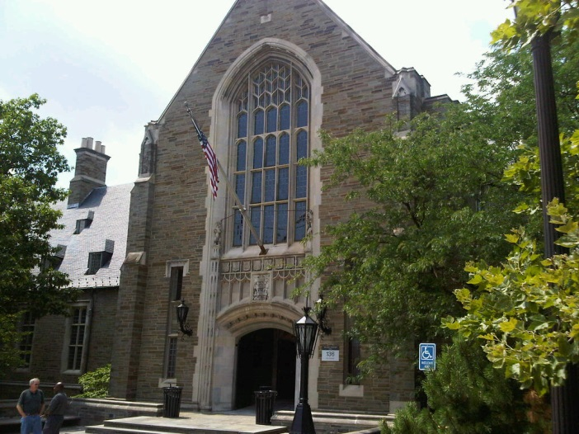
Thank you – Robert.Boissy@SpringerNature.Com
For high impact referral reports for your school:
Email: Mitch.Moulton@Springer.Nature.Com Account Dev – Northeast
Email: Lauren.Cash@SpringerNature.Com Licensing Manager – Northeast (University)
Email: Danny.Jiang@SpringerNature.Com Licensing Representative – Northeast (College)
Sincere thanks to Cornell for letting me use their data for this presentation

