Slide 1

Biodiversity Heritage Library:
A Successful Collaboration,
A Fully Open Access Collection
Marty Schlabach
Mann Library, Cornell University
Upstate New York Science Librarians Conference
Cazenovia College, Cazenovia, NY
October 25, 2013

Slide 2
Biodiversity Heritage Library is…
A consortium of 15 natural history, botanical libraries and research institutions
An open access digital library for legacy biodiversity literature
An open data repository of taxonomic names and bibliographic information
An increasingly global effort

Slide 3
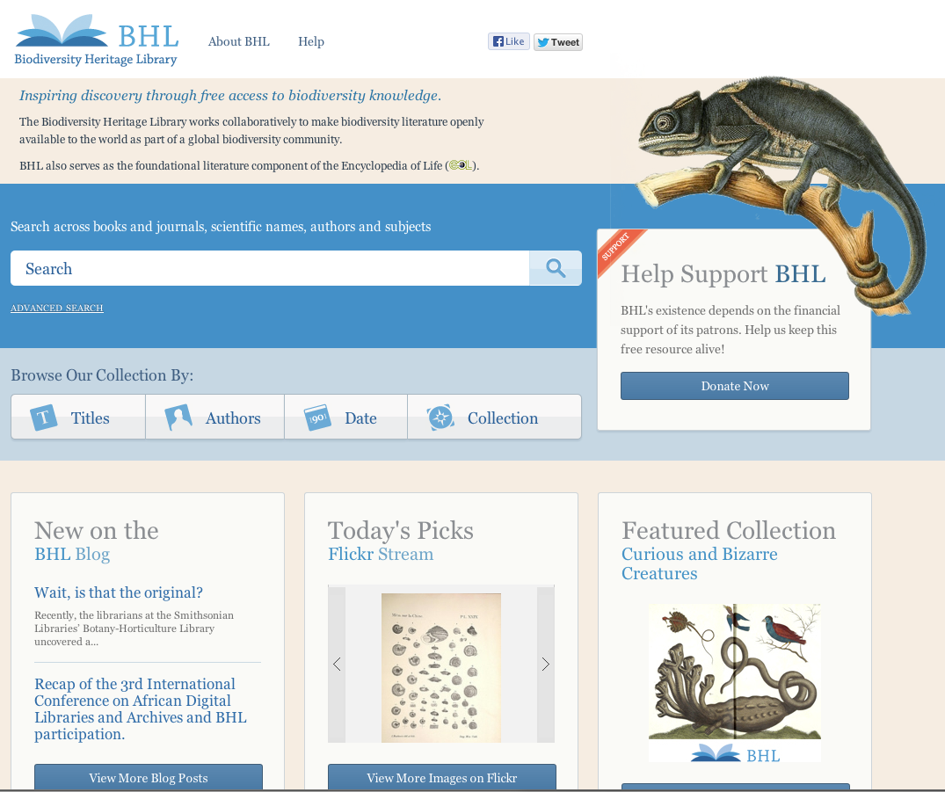
http://biodiversitylibrary.org
Now online
63,831 titles
119,859 volumes
41.8 million pages
Notes:
A free & open access digital library for biodiversity literature and primary source materials (field books)
A consortium of 15 libraries working together to run a virtual library branch
A collection of content from the 15 member BHL consortium and other Internet Archive contributors
Anyone is free to access & download BHL materials

Slide 4
Initial Motivation
Scientists described what is known as the ‘taxonomic impediment’:
  Library, specimen, and archival collections upon which their research depends are housed in museums and libraries in large cities and are out of easy reach of many researchers, particularly when in the field.

Slide 5
“Tackling the published literature housed in library collections, while no small task, was identified as an achievable first step toward relieving the burdens of this impediment.”

Slide 6
BHL’s Beginnings
Formed in 2006 by 10 collaborating libraries
Smithsonian Libraries assumed administrative responsibilities
Missouri Botanical Garden library took on the technical lead
Mass scanning began in 2007
  Member libraries selected materials from their local collections for scanning

Slide 7
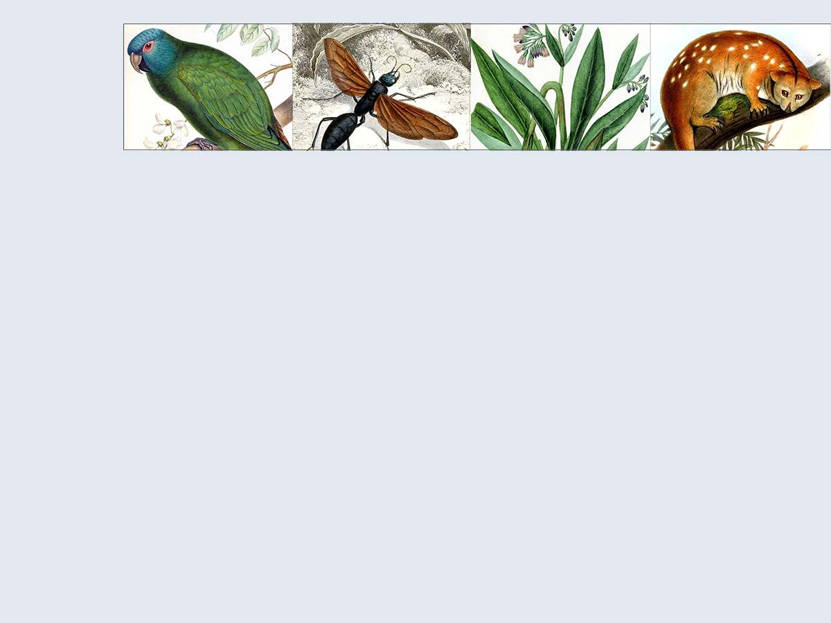
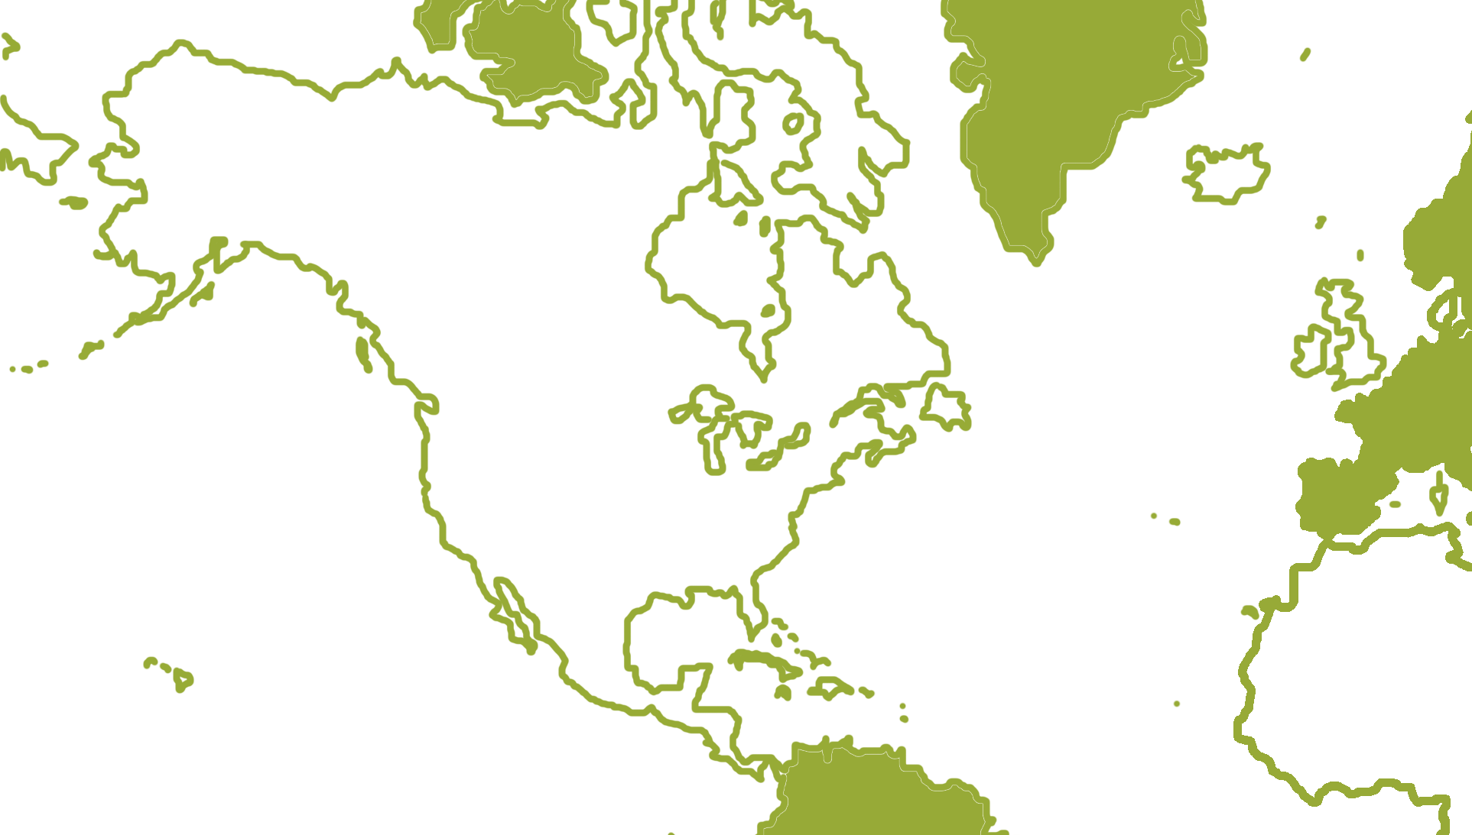

Core BHL Member Institutions

Slide 8
Collaboration of 15 Libraries
Expanded from Initial 10 Libraries
Smithsonian Libraries
Missouri Botanical Garden
New York Botanical Garden
Field Museum
Marine Biological Lab/Woods Hole Oceanographic Institute
California Academy of Sciences
Cornell
US Geological Service
American Museum of Natural History
Kew Gardens
Natural History Museum, London
Harvard Botany Library
Harvard Museum of Comparative Zoology Library
Academy of Natural Sciences of Philadelphia
Library of Congress

Slide 9
BHL Administrative Staff
BHL Secretariat (Smithsonian)
  Program Director: Martin Kalfatovic
  Program Manager: Carolyn Sheffield
  Collections Coordinator: Bianca Crowley
BHL Technical Team (Missouri Botanical Garden)
  Technical Director: William Ulate
  Lead Developer: Mike Lichtenberg
BHL Global Team (Missouri Botanical Garden)
  Global Project Coordinator: William Ulate

Slide 10
Organizational Structure
Executive Committee
  Chair, Nancy Gwinn, Smithsonian
  Vice-Chair, Connie Rinaldo, Harvard MCZ
  Secretary, Susan Fraser, NY Botanical Garden
  Ex Officio, William Ulate, BHL Technical Director
  Ex Officio, Martin Kalfatovic, BHL Program Director
Collection Committee
  Representatives from all member libraries
Technical Group
  Representatives from most member libraries

Slide 11
How is BHL Funded?
Grants
Annual membership dues
User donations
In-Kind contributions from member organizations

Slide 12
Communication Among Collaborators
Regular conference calls
Periodic in-person meetings
Email Lists
Issue Tracking System (Gemini)
WikiSpaces
Google Docs
Vidyo

Slide 13
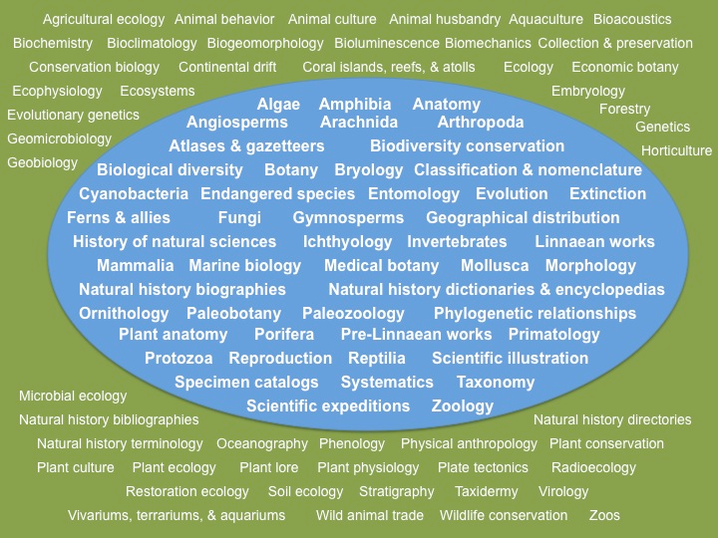
Collection Policy

Slide 14
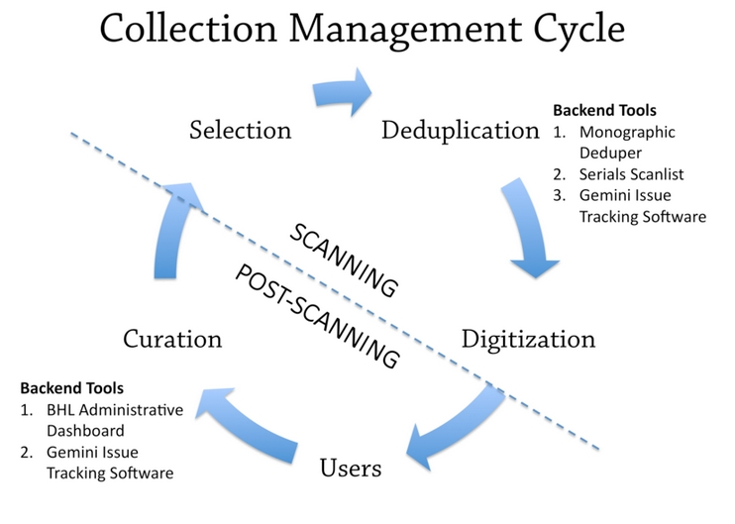
Notes:
User request driven

Slide 15
Also Collaboration with
Internet Archive (archive.org)
  Much of the scanning done at IA scan centers
  IA hosts the digital content
  BHL ingests metadata from IA
Encyclopedia of Life (eol.org)
  BHL included in EOL funding proposal to MacArthur Foundation provided initial funds
  EOL links from their specie descriptions to the relevant literature in BHL

Slide 16
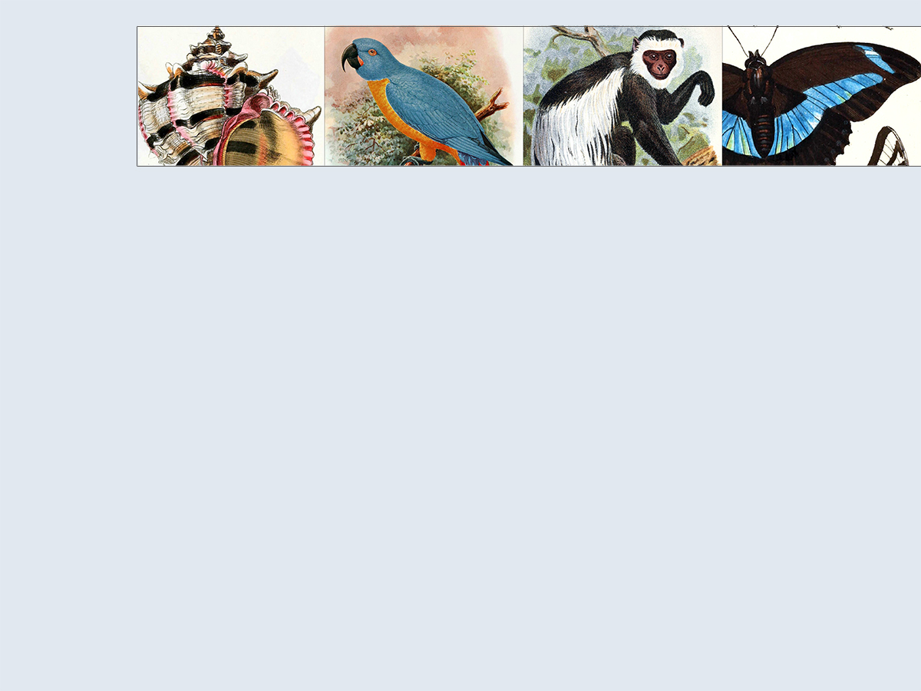






Expanding Collaboration: Global Partners
BHL Australia

Slide 17
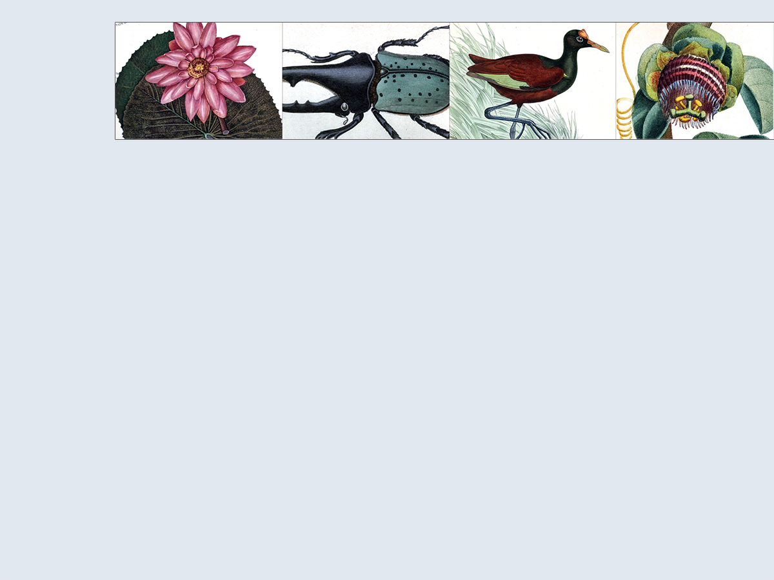





Beyond the Silo: Social Media
blog.biodiversitylibrary.org
www.facebook.com/BioDivLibrary
@BioDivLibrary
www.flickr.com/photos/biodivlibrary/sets
pinterest.com/biodivlibrary

Slide 18
Biodiversity Heritage Library
http://biodiversitylibrary.org

Slide 19
Who uses BHL?
Developed to meet the needs of the taxonomic community
But of value to most fields of biology, even agriculture
Also of interest for wide array of beautiful illustrations

Slide 20
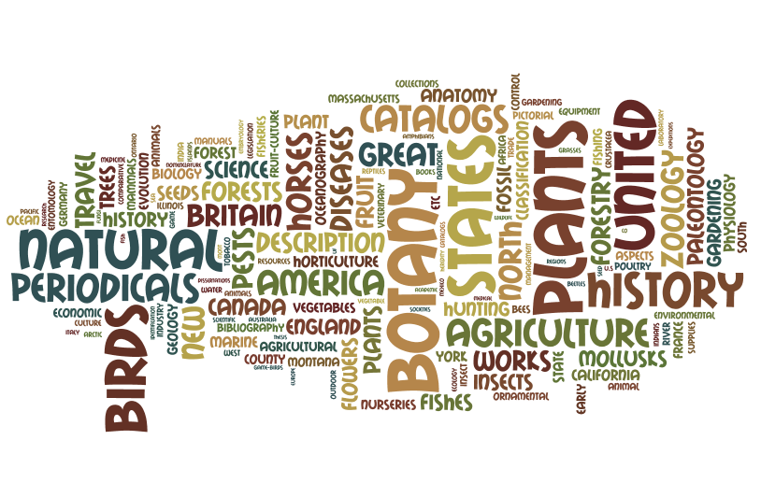
BHL Subject Tag Cloud

Slide 21
Impact
“I would like thank you all very much for invaluable work and support you do. I just got a pdf-file from more than century old (1893) journal paper (regional naturalist society paper, published in Finland), to get copy I should take 500 mile drive to our university library. Now I am got it fastly in high-quality pdf-copy. Cordial thanks and all success in continuing your highly valuable mission.” [conservation biologist from Estonia]

Slide 22
Impact
“You are a wonderful resource. I maintain a Website that describes the plant genus Opuntia (prickly pear cacti). There is no way I could maintain such a site without access to literature from 100-200 years ago. Most of the cactus species were discovered long ago; I find it invaluable to put up PDF files to document each species in the literature as I document them photographically. I am a botanist, but I work in the pharmaceutical field (not so many botanical jobs out there). Your library makes it possible for me to continue working with plants in a meaningful and scientific manner.”

Slide 23

Acknowledgements
All BHL members and staff who collectively contribute to BHL
Cornell University Library for membership and digitization support
Especially for assistance with this presentation
  Martin Kalfatovic, BHL Program Director
  Bianca Crowley, BHL Collection Coordinator

Slide 24
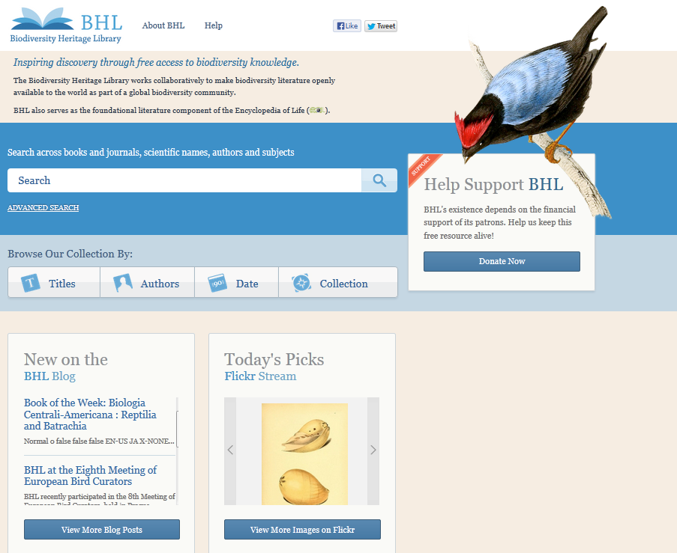

Slide 25
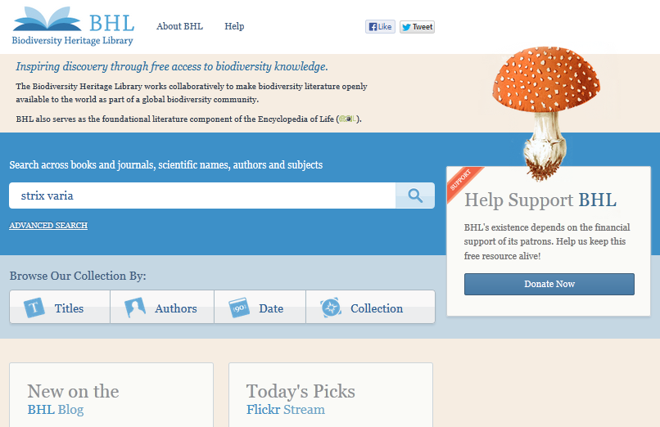

Slide 26
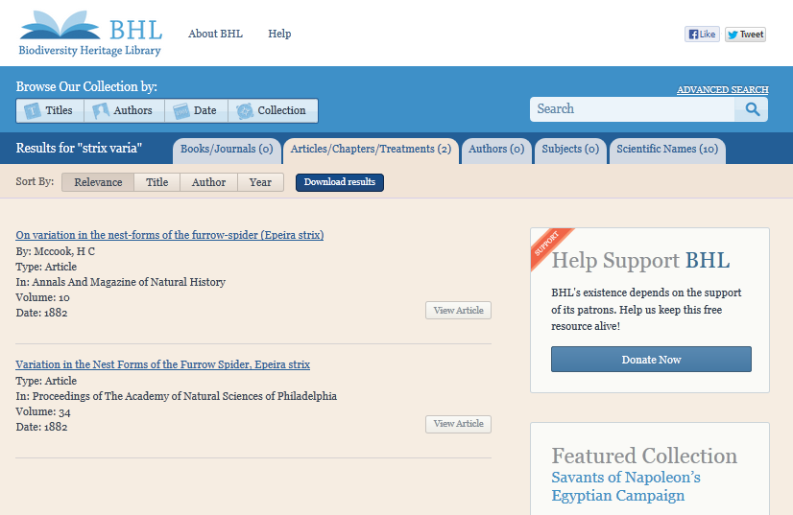

Slide 27
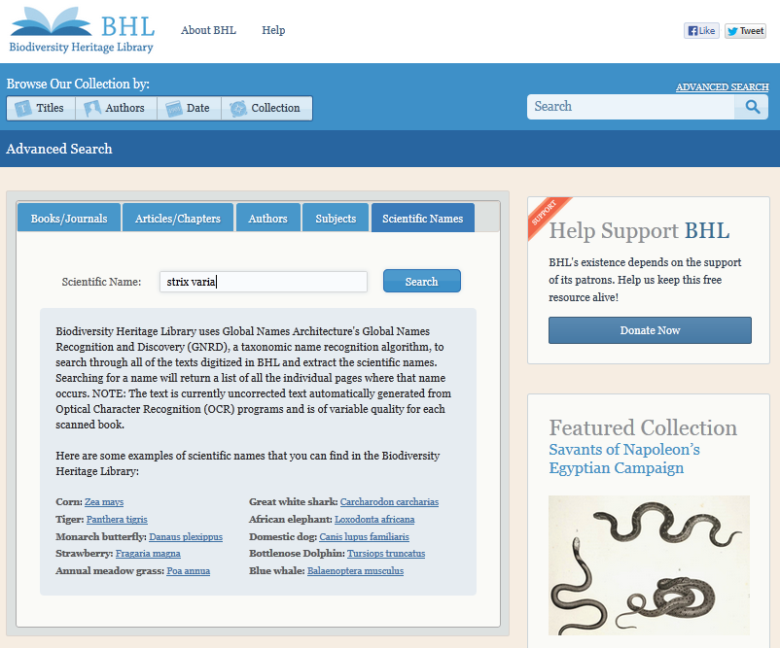

Slide 28
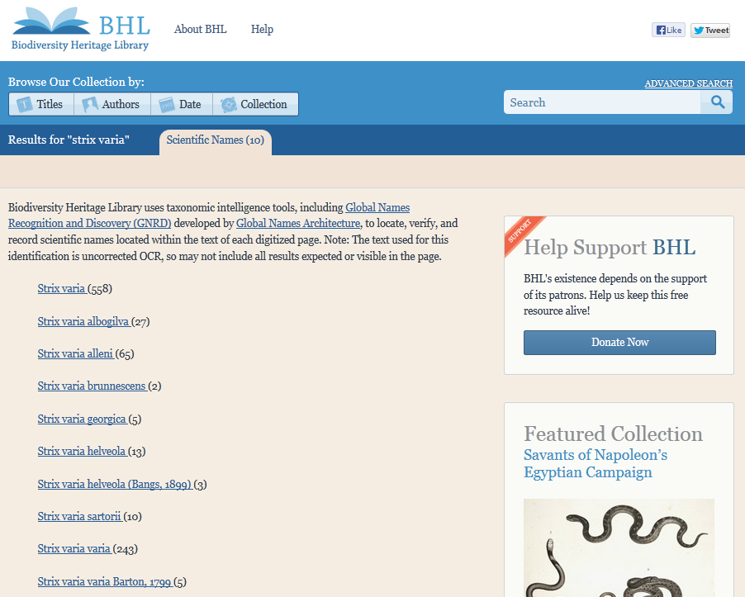

Slide 29
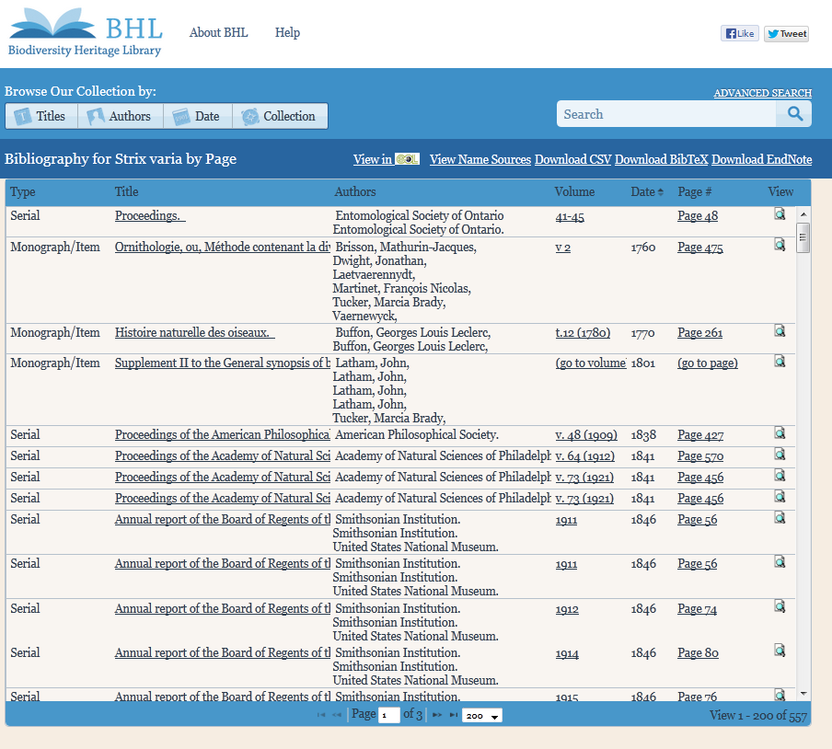

Slide 30
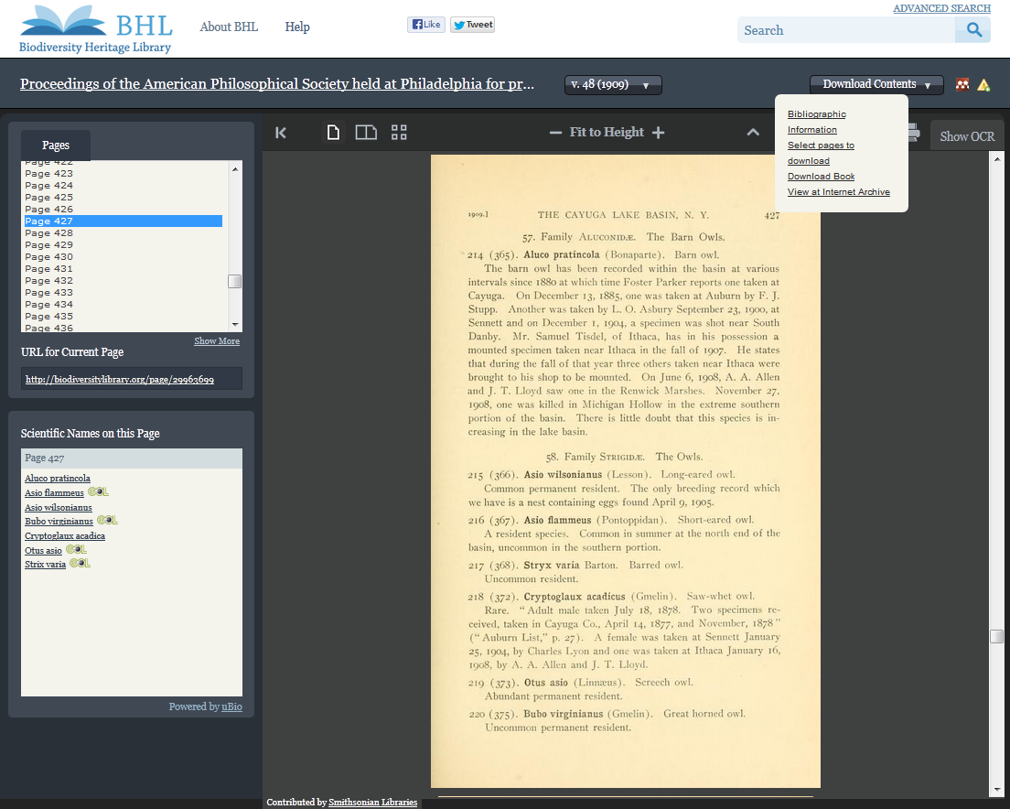

Slide 32
Initial Collaboration of 10 Libraries
Smithsonian Libraries
Missouri Botanical Garden
New York Botanical Garden
Field Museum
California Academy of Sciences
Marine Biological Lab/Woods Hole Oceanographic Institute
American Museum of Natural History
Academy of Natural Sciences of Philadelphia
Kew Gardens
Natural History Museum, London
Harvard Botany Library
Harvard Museum of Comparative Zoology Library

Slide 33
Outreach & Promotion
Blog
Twitter
Flickr
Facebook
Pinterest

Slide 34
New Members

Slide 35
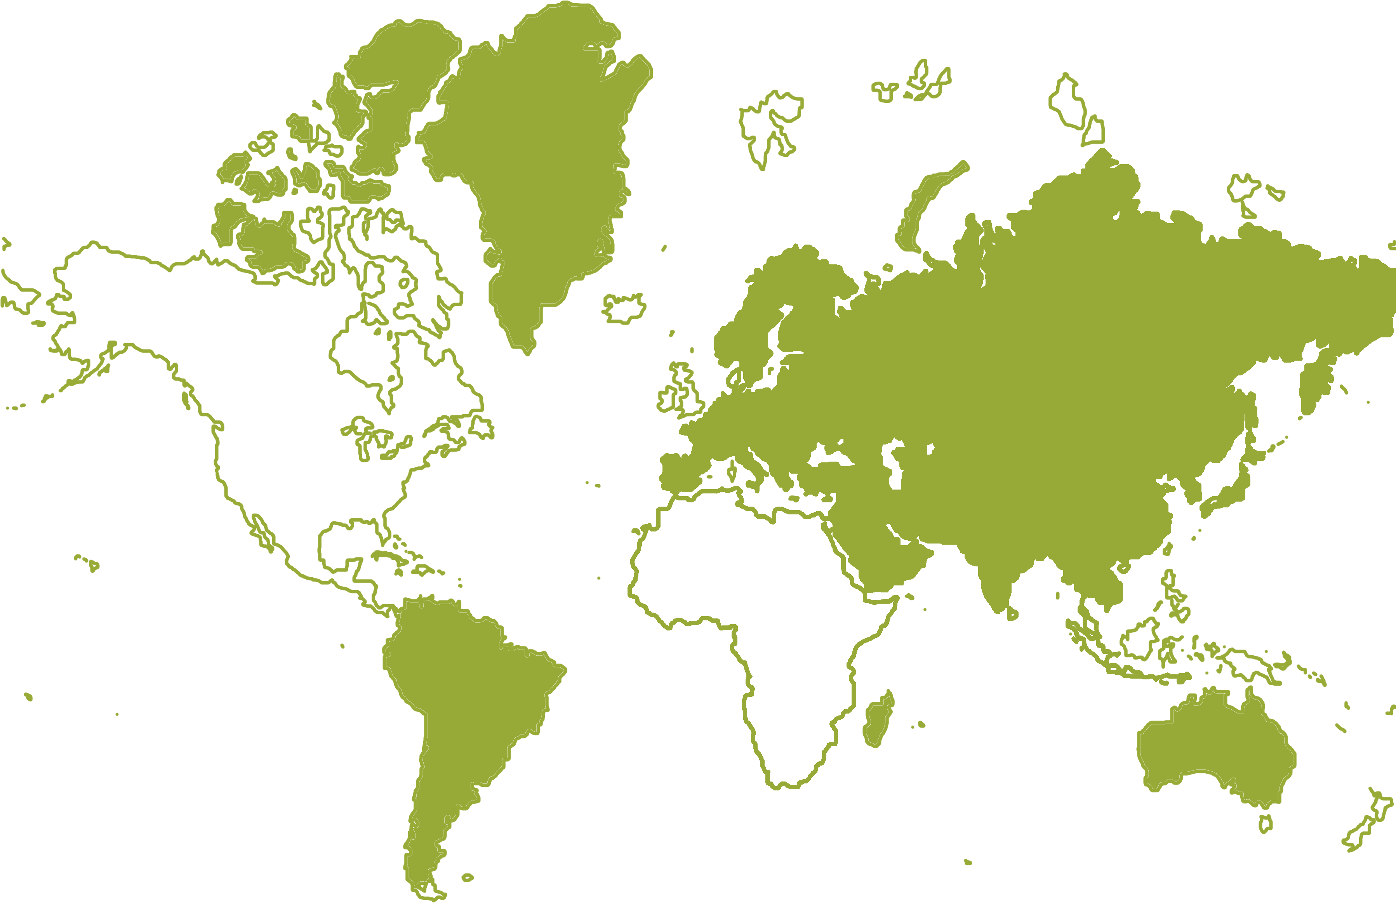
Global Partners

