Slide 1
Collaborating to Improve Biological Sciences Students’ Writing and Research Skills
Tina Chan, SUNY Oswego
Upstate New York Science Librarians Meeting
October 23, 2015

Slide 2
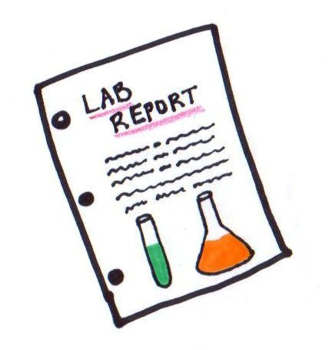
How the Collaboration Started
Since 2013, workshop called Writing Papers in the Biological Sciences, sponsored by the Writing Center.
Presented by the biological sciences librarian, biological sciences advisement coordinator, and biological sciences faculty member.
Teach the fundamentals of writing laboratory reports.
Primarily geared towards first year undergraduate biological sciences students.

Slide 3

How the Collaboration Grew
Two hour writing labs offered starting in spring 2015.
Drop-in to meet with a biological sciences faculty member and/or librarian.
Writing labs held one week prior to papers due.
Five students, two additional faculty members showed.

Slide 4

The Future
Appointment-based writing lab; drop-ins welcome.
Encourage biological sciences faculty members to participate.
Three additional faculty members will participate in fall 2015 writing lab.
Writing workshops to include hands-on activity.

Slide 5
Final Thoughts
Writing workshops a success.
The writing center does an excellent job promoting all workshops.
Great partnership between the library and the biological sciences department.
Advice on offering a writing workshop and/or writing lab.

Slide 6
Thank you!
Tina Chan
tina.chan@oswego.edu

