Slide 1
Library Video Collaborations
Jill Powell, Jeremy Cusker, Sean Taylor
Cornell University
Upstate New York Science Librarians Meeting, Cornell Plantations
Oct 23, 2015

Slide 2
Background
Result of recent faculty survey:
33% of engineering faculty didn’t know about our instructional services
32% say fewer than half their undergrads can evaluate information critically
Director of College of Engineering’s Teaching Excellence Institute:
Helps faculty with grants and course reviews.
Faculty eager to get her assistance.
Courses EngrD 2020 (Statics), MSE 3030 (Thermodynamics), BME 4110 (Human Health)
Goal –
Provide just in time instruction integrated in homework assignments
Compatible with flipped classroom
Assessments to go out mid semester
8 videos created within a month

Slide 3
Collaborators
Director, Engineering Teaching Excellence Institute (Kathy Dimiduk)
Library IT (Sean Taylor, Matt Ryan)
Engineering Librarians (Jeremy Cusker, Jill Powell)
Engineering professors (Mike Thompson, Nozomi Nishimura, Meredith Silberstein)
Research & Assessment Unit – editing and design (Zsuzsa Koltay, Carla DeMello, Melanie Lefkowitz)
AULs and Directors (Xin Li, Erla Heyns, Kornelia Tancheva)
Assessment (Gaby Castro Gessner)

Slide 5
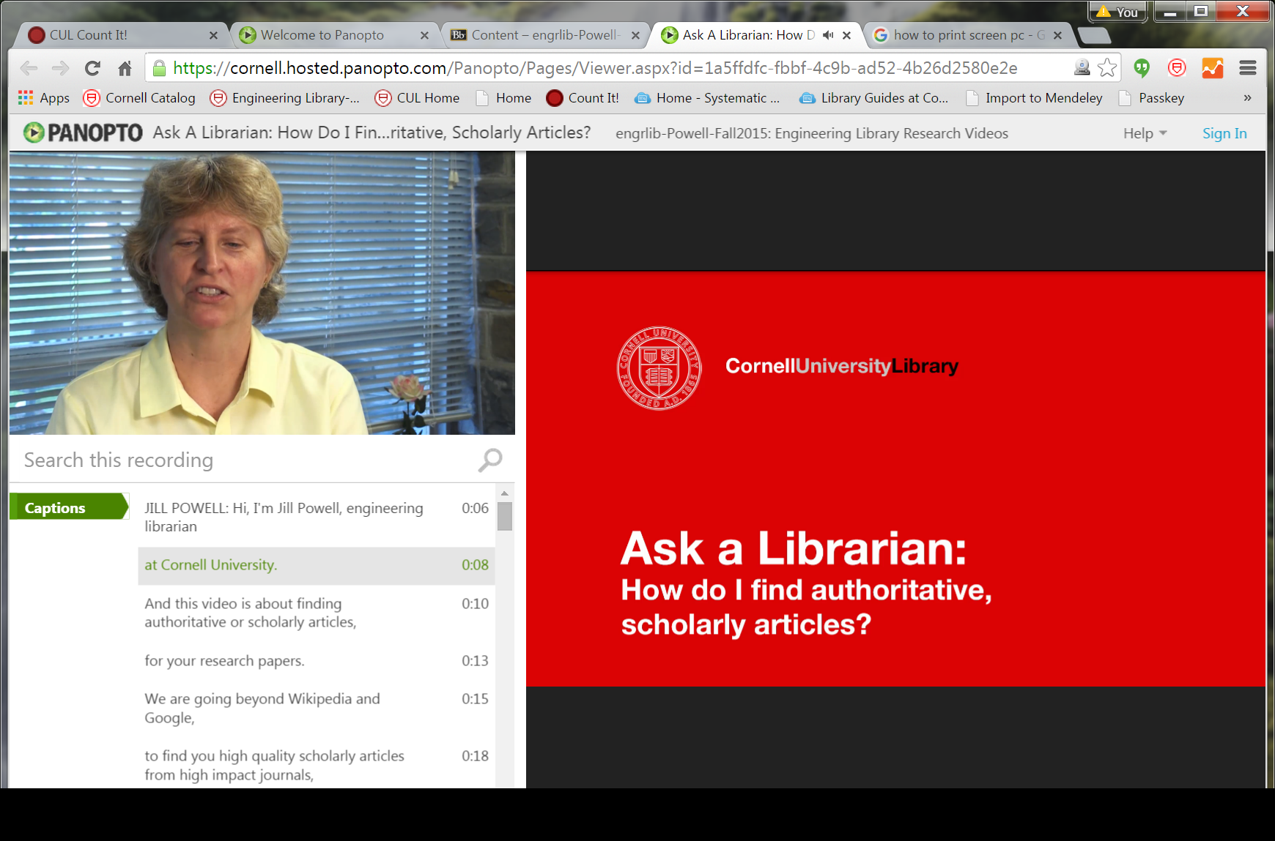

Slide 6
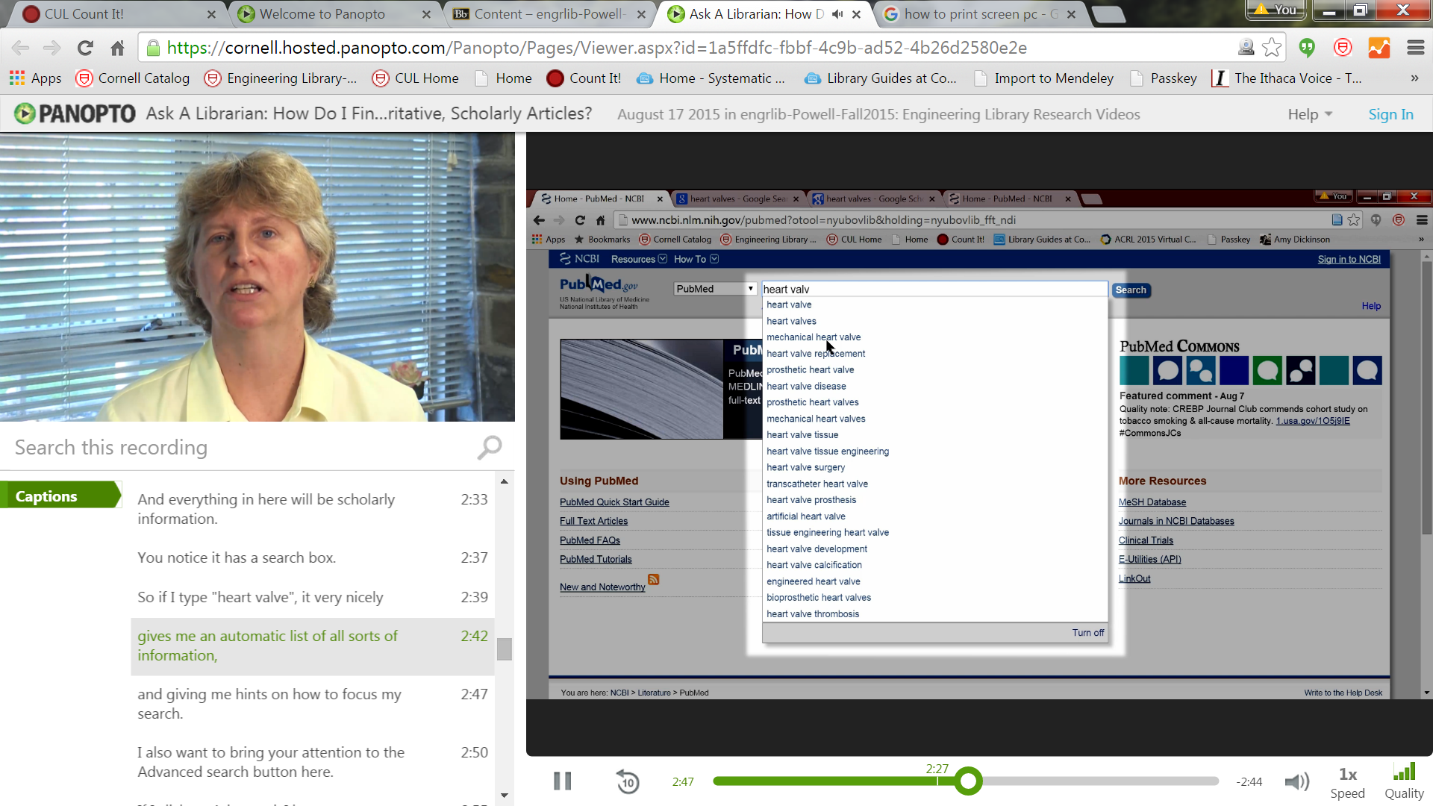

Slide 7
What Worked Well
Tech support – brought microphones, lights, editing, audio postproduction, etc.
Opportunity to reach a large number of students; more than through regular instruction sessions
…and in ENGRD classes that don’t normally have library instruction (50% of all sophomores)
Consistency (branding, slides, citation info, contact info)
Director of Teaching Excellence Institute key
All parties seemed interested in the videos

Slide 8
Challenges
Large number of people involved: took too much time to communicate current status
Short time-frame for writing scripts, editing, several takes
Lack of communication from faculty: Other priorities, gone for summer
Goal of having assessment figures right away
Midway through videos: Our homepage changed, had to edit several videos.
Small errors: incorrect fonts, small spelling errors.

Slide 9
Challenges, cont’d
Can’t capture uncompressed version (limitation of Panopto), limits some editing options
Unified graphic design looked good but complicated editing process (font matching, etc.)
Happened during summer (vacations)

Slide 10
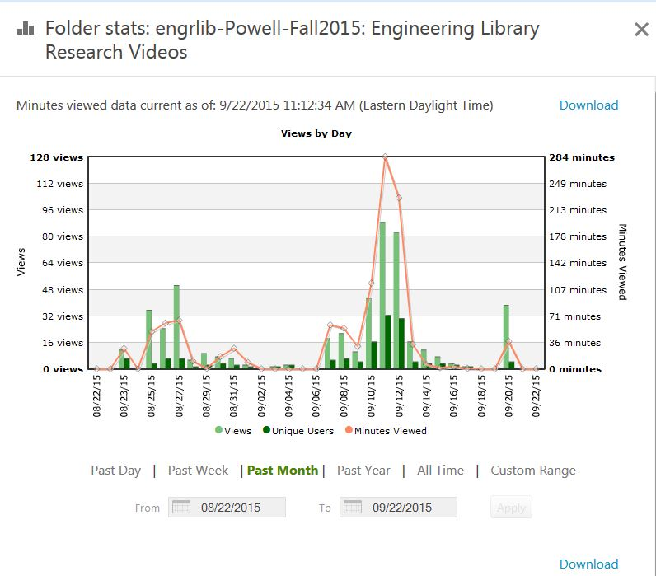

Slide 11
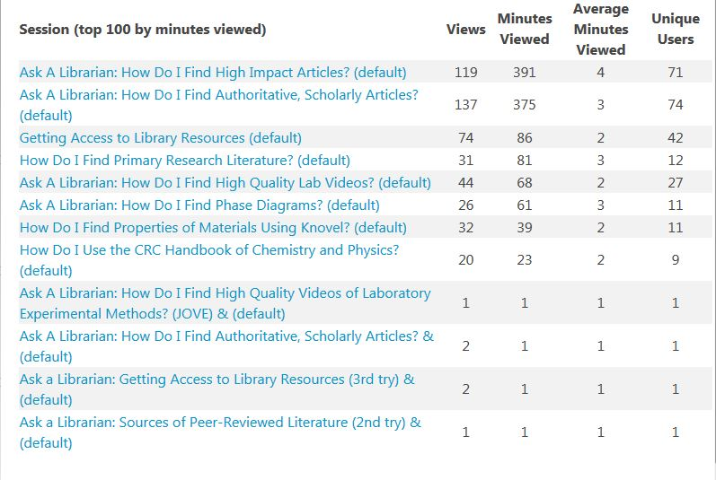

Slide 12
Next time around...
Short- to medium-term: Make small changes, swap out individual slides/voiceover to reflect UI changes, new syllabi
Longer term: develop a workflow to produce and update these

Slide 13
Questions? Want to see the finished videos? http://bit.ly/1YBNDsi

