Slide 1
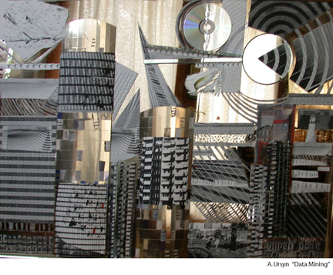
Data Mining
Data Fusion
Kathy Chiang
Upstate 2010
http://www.ursyn.com/twod/pages/Data%20Mining.htm

Slide 2
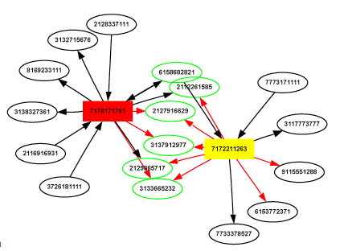
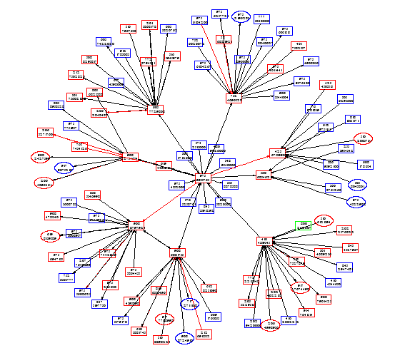

Slide 3
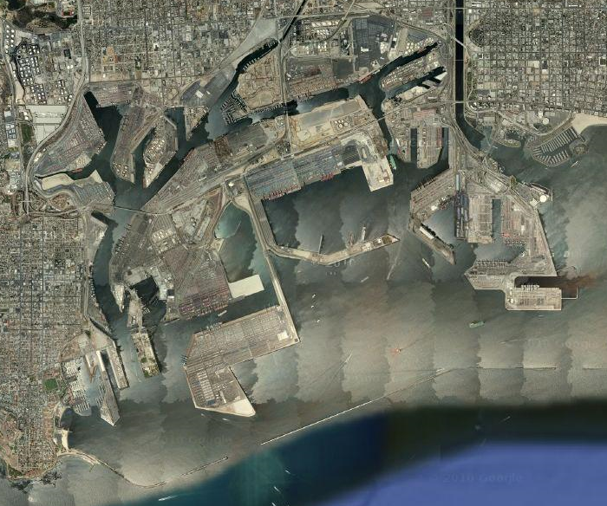
Los Angeles Harbor --google maps

Slide 4
Data Mining
Data Fusion

Slide 6
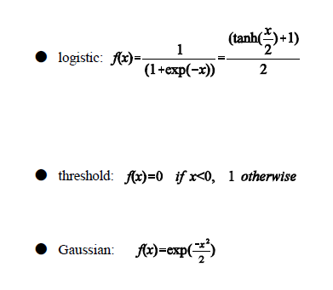
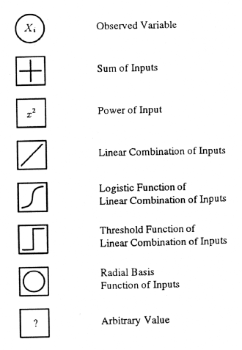
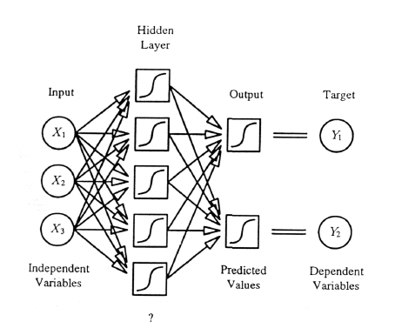
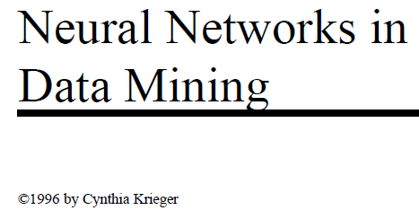
Algorithms

Slide 7
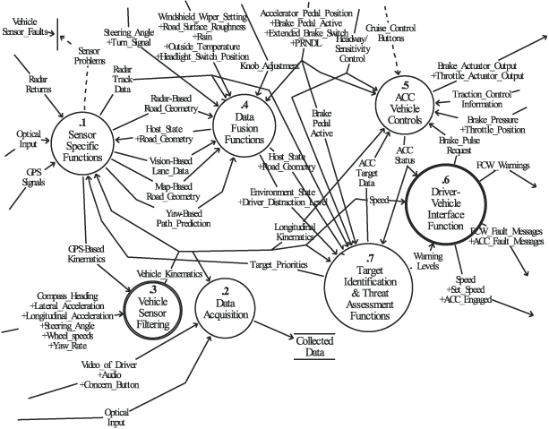
“automatically or semi-automatically transforming information from different sources and different points in time into a representation that provides effective support for human or automated decision making”
Bostrom, H. On the Definition of Information Fusion as a Field of Research

Slide 8
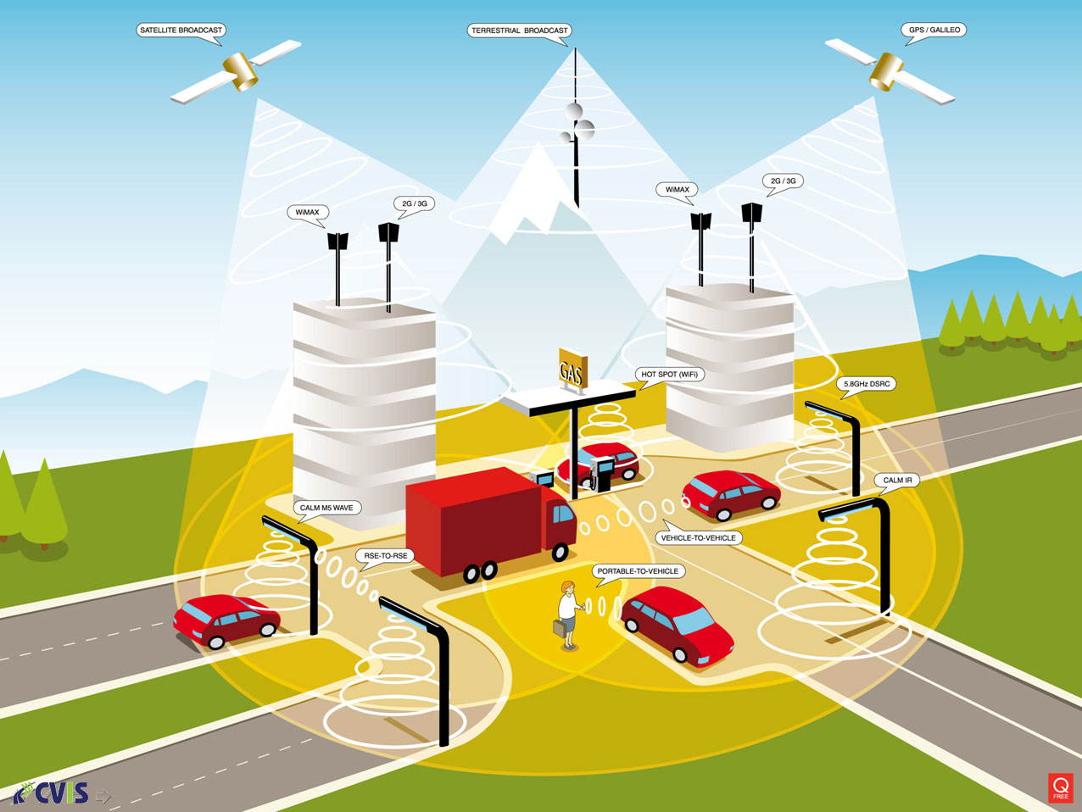
http://cvis.odeum.com/images/CVIS_CALM_copyrights.jpg

Slide 9
Temporal, dynamic

Slide 10
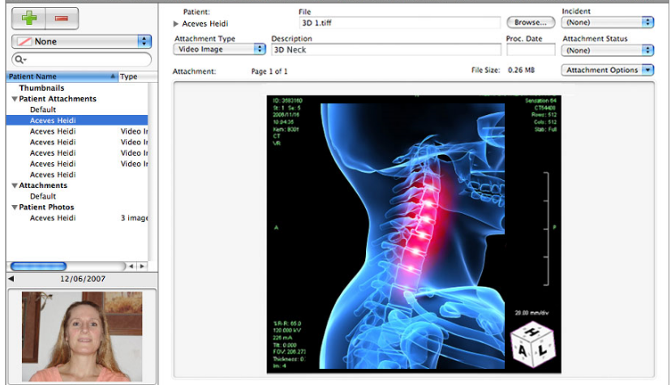
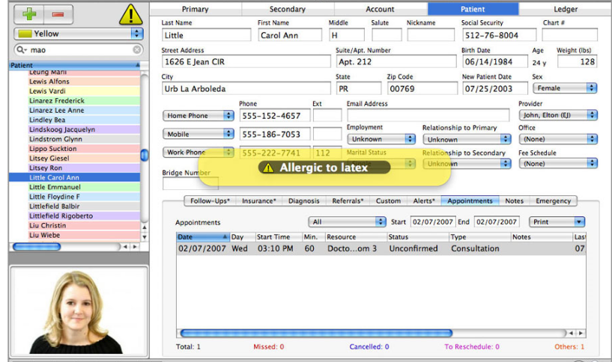
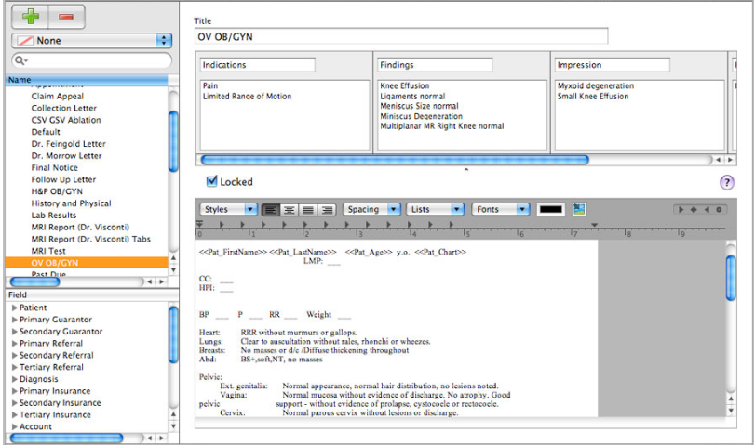
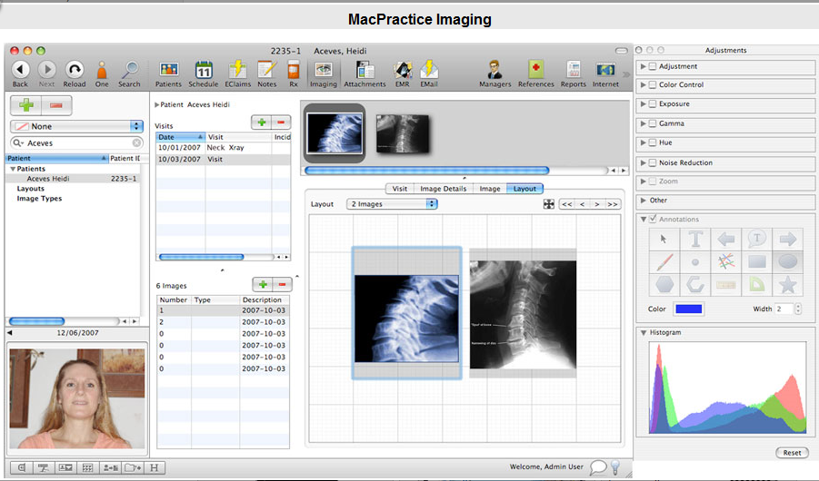
http://www.macris.com/mp/dc/emr/

Slide 11
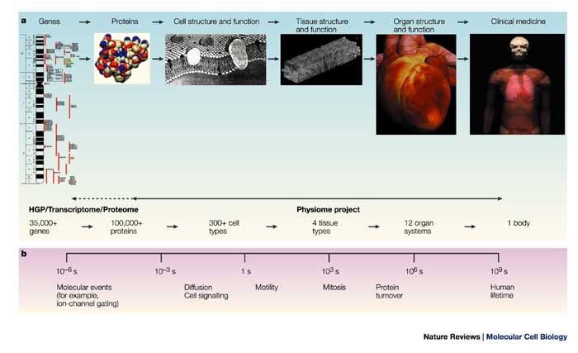
Integration from proteins to organs: the Physiome Project
Peter J. Hunter and Thomas K. Borg
Nature Reviews Molecular Cell Biology 4, 237-243 (March 2003)
doi:10.1038/nrm1017

Slide 12
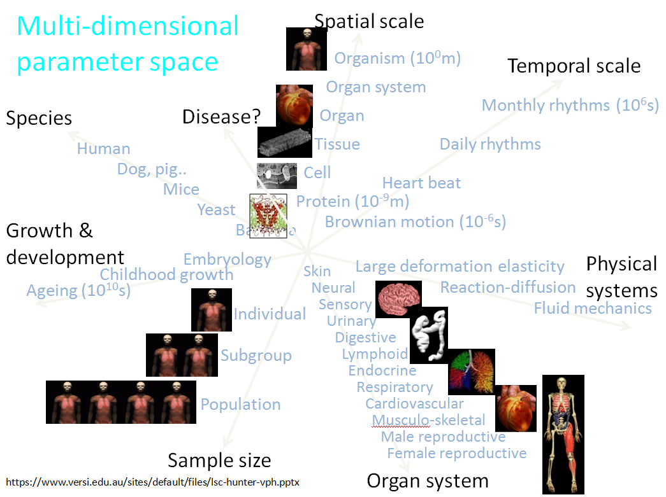
Expertise
Scales

Slide 13
DATA
Scales
Dynamic
Algorithms
Expertise
Libraries

Slide 14
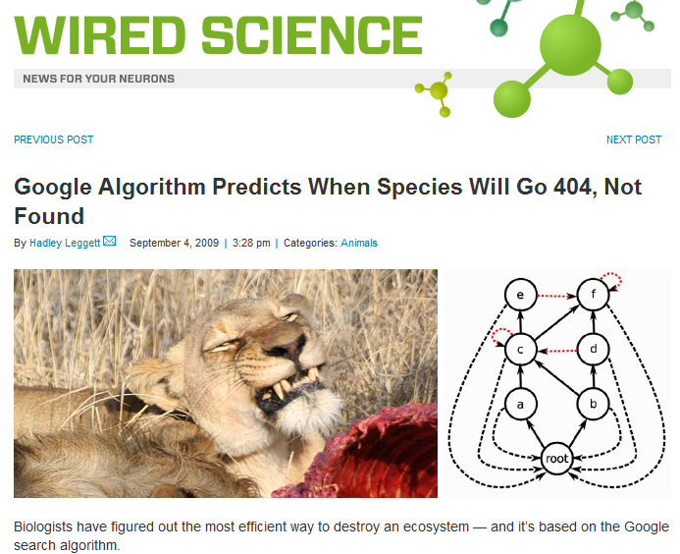
Algorithms
http://www.wired.com/wiredscience/2009/09/googlefoodwebs/

Slide 15
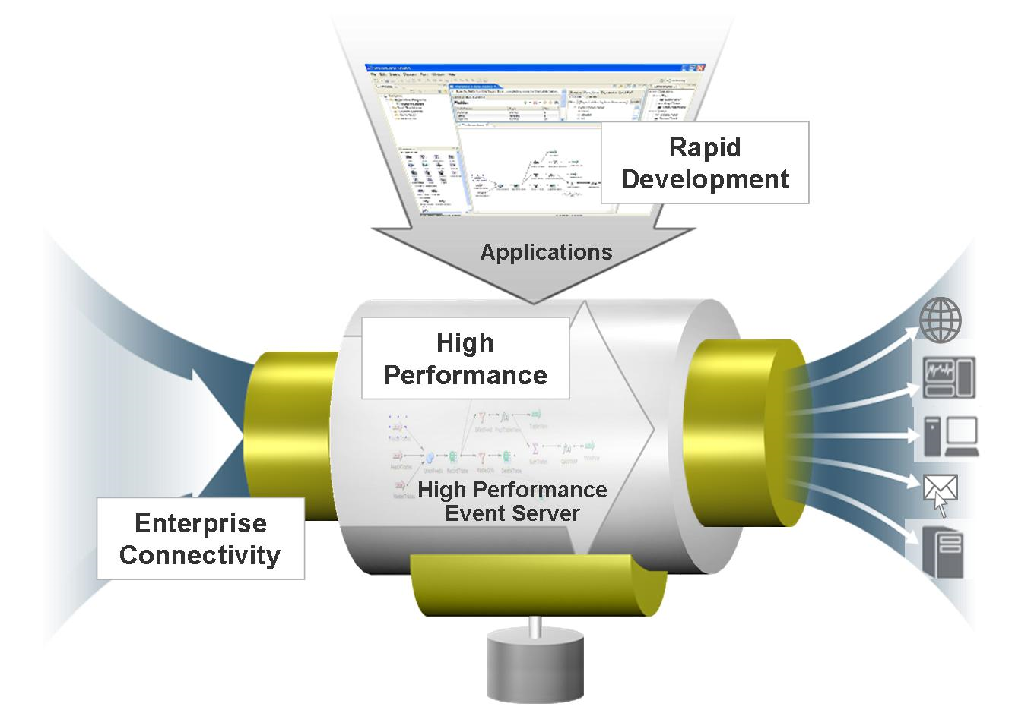
www.streambase.com

Slide 17
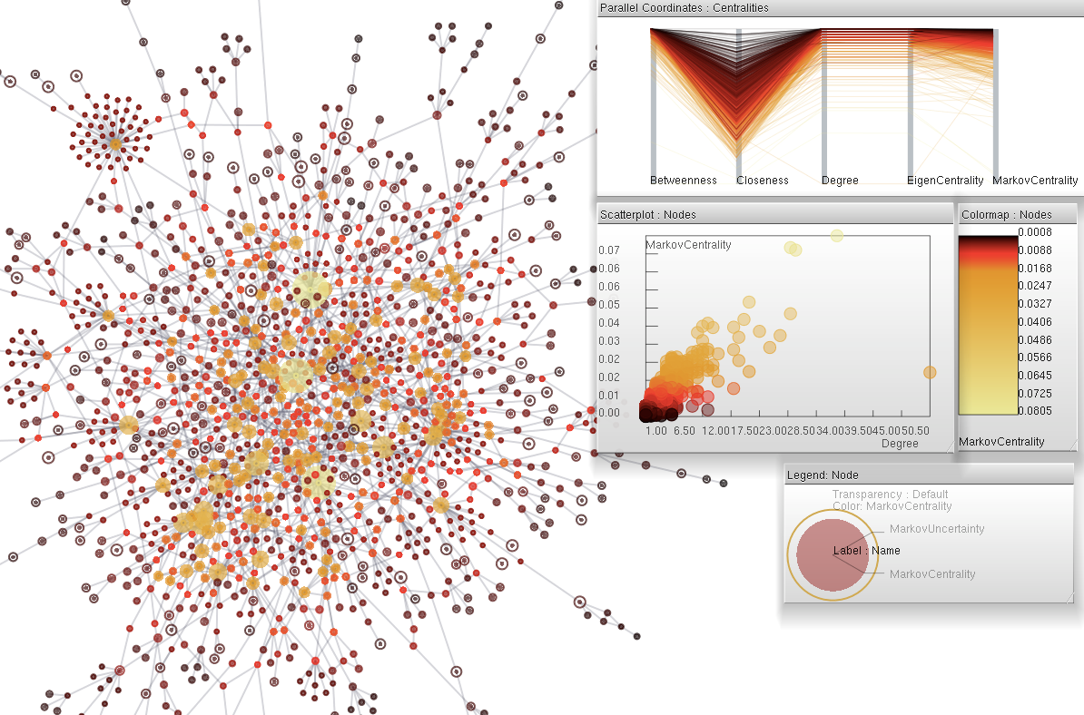
http://fodava.gatech.edu/

Slide 18
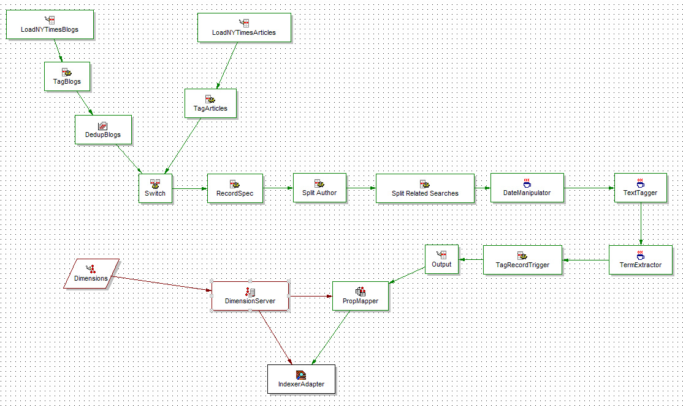
Transforming Raw Data into Valuable Content
Endeca’s Information Transformation Layer (ITL) provides content acquisition and enrichment capabilities to help you efficiently combine information from any source into a single integrated view and add value on top of the raw data.
http://www.endeca.com/products-information-access-platform-information-transformation-layer.htm

Slide 19
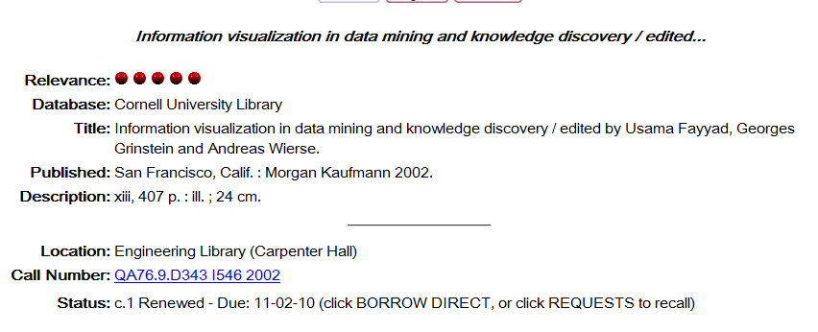

Slide 20
You have this

Slide 21
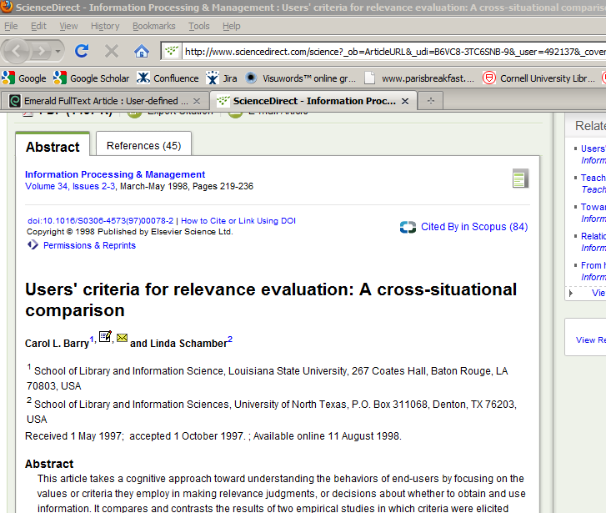
You have corresponded with this author

Slide 22
Questions?
ksc3@cornell.edu
Paper at: http://docs.lib.purdue.edu/iatul2010/conf/day1/4/
This material is based upon work supported by the National Science Foundation under Grant No. III-0712989.
Any opinions, findings, and conclusions or recommendations expressed in this material are those of the author(s) and do not necessarily reflect the views of the National Science Foundation.

