Slide 1
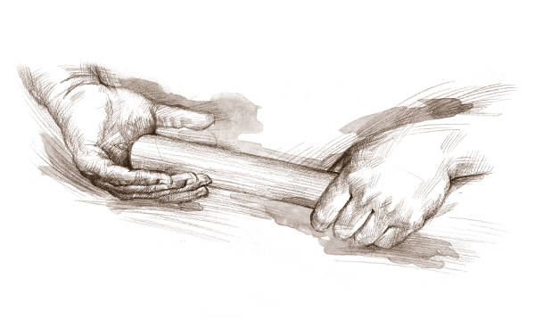
Gamifying Citation Management: A Mendeley Relay Race
Lauren Stern
NYSCILIB Meeting
October 24, 2014

Slide 2
What is Citation Management?
Software that can be used to collect, store, organize, and share research.
Academic citation managers typically provide auto-cite options, simplifying the writing process.
Retrieved from edgeoftheweb.co.uk

Slide 3
Goal
Make students aware of what citation management is (and how it makes their lives better).
Motivate students to try a citation manager.
All citation management platforms have pros and cons; selected Mendeley for its slick interface and annotative features.
Retrieved from mendeley.com

Slide 4
Challenge #1: Increase Motivation
Cognitive, Social, and Emotional Motivations
[Domínguez et al. 2013]
Cognitive: Don’t understand what citation management is, or how it can help them now or in the future. Need to know relevance [Kapp 2012].
Social: Incorporate social elements into game; environment in which game is completed also adds social component.
Emotional: Citations are booooooring. Identify the Goldilocks difficulty level.

Slide 5
Challenge #2: Segment Complex Learning
The Goldilocks Zone
Challenges must be appropriately difficult; not too easy (boring) or too difficult (frustrating).
Segmenting learning: tasks with too few steps may be overwhelming, and hinder comprehension; conversely, tasks with too many steps may hinder comprehension as a result of “redundant information between steps and/or an excess of details” [Nadolski et al. 2005].

Slide 6
Student Characteristics
Undergraduate biology majors, many of whom are athletes and intend to go to grad school.
Retrieved from minifigures.lego.com and toysnbricks.com

Slide 7
MDA Framework
Mechanics, Dynamics, Aesthetics
[Hunicke, LeBlanc, and Zubek 2004]
Mechanics
Definition: rules of play.
Interactions dictated by Mendeley interface, but rules of play follow relay race.
Dynamics
Definition: behavior of mechanics in system; interactions between player and game.
Relay race.
Aesthetics
Definition: the tone and affective experience of play.
Challenge (“game as obstacle course”) and fellowship (“game as social framework”) (p. 2)

Slide 8
MDA Framework
Mechanics, Dynamics, Aesthetics
[Hunicke, LeBlanc, and Zubek 2004]
Design game from aesthetics backwards, to mimic user experience.
Retrieved from Hunicke, LeBlanc, and Zubek 2004, p. 2

Slide 9
The Mendeley Relay Race
Series of challenges to explore possibilities of citation management and functionalities of Mendeley.
Students work in teams, in competition with one another. As one student finishes a challenge, they bring the answer to the front and exchange it for the next challenge.

Slide 10
The Mendeley Relay Race

Slide 11
Our Results
What did you think of the relay race?
Motivation? Learning? Fun?
Retrieved from latimesblogs.latimes.com

Slide 12
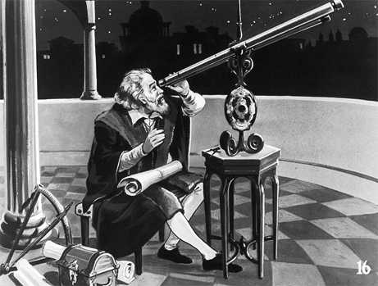
Their Results
In general, students far more engaged than teaching citation management in traditional way.
Environment less than ideal (students physically hard to reach, isolated behind enormous computer screens).
Feedback system like Monopoly: students that fell behind were less motivated to continue, because they felt they couldn’t catch up and win.
Longterm results: unknown.
Retrieved from news.nationalgeographic.com

Slide 13
References
Domínguez, A., et al. 2013. Gamifying learning experiences: Practical implications and outcomes. Computers & Education 63 (Apr. 2013), 380-392. DOI=http://dx.doi.org/10.1016/j.compedu.2012.12.020.
Hunicke, R., LeBlanc, M., and Zubek, R. 2004. MDA: A formal approach to game design and game research. In Proceedings of the AAAI Workshop on Challenges in Game AI. (San Jose, United States, July 25 - 26, 2004). AAAI ‘04. AAAI Press, Menlo Park, CA.
Kapp, K. M. 2012. Games, gamification, and the quest for learner engagement. T+D 66, 6 (Jun. 2012), 64-68.
Nadolski, R. J., Kirschner, P. A., Eroen, J. J., and van Merriënboer, J. G. 2005. Optimizing the number of steps in learning tasks for complex skills. British Journal Of Educational Psychology 75, 2 (Jun. 2005), 223-237. DOI=http://dx.doi.org/10.1348/000709904X22403.

