Slide 1
Introducing BrowZine™
Janet Pease
Syracuse University
jlpease@syr.edu
October 24, 2014

Slide 2
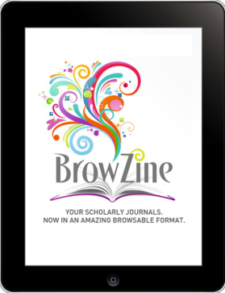
What is it?
A free app from Third Iron that is downloaded to a mobile device (Apple and Android (as of mid-October 2014!))
Started in 2011
Works by uniting articles from databases into complete journals, then arranging them by subject on a library-branded newsstand
Includes both OA and subscription journals

Slide 3
What it can do for users
After choosing their subscribing institution users can:
Easily browse and/or read complete scholarly journals in a format optimized for tablet devices
Create a bookshelf of favorite journals
Be alerted when new editions of journals are published
Save articles for offline reading
Easily export articles to Zotero, Mendeley, RefWorks, Dropbox and other services
Share articles using Social Media

Slide 4
Screen Shots
My Bookshelf
Table of Contents

Slide 5
What it can do for libraries
Brand the app with the library’s identity
Extend library outreach by delivering content to the devices our patrons are using in a way they want to use it
Increase usage of existing resources
Monitor mobile usage statistics

Slide 6
Some issues…
Not all subscribed journals are included
Users can only get full-text for publishers BrowZine has agreements with
This is a growing list and libraries can request additional publishers
Content only back to 2005
Not all OA publishers are included
Some problems adding titles to My Bookshelf
Example: Science is not found using a title search, but AAAS Science is – NOT intuitive!

Slide 7
Conclusion
Browzine™ has a lot of potential and we would be interested in both positive and negative feedback from others who subscribe to it

Slide 8
THANK YOU!!

