Slide 1
Flight of Citation Management Systems
Dianne Dietrich – Jill Wilson – Cornell University
Notes:
This presentation was given to chem grads originally and was well received with the format, etc. Librarians and faculty ask wonder the same thing – which is one is better?
None, depends on what type of research you’re doing, what types of documents you are working with and your personal preferences. This presentation will aim to get this point across.
This might be a good model for you to use for your outreach and presentations!

Slide 2
What is this citation flight…?
Notes:
What is a citation flight?
Just image and then explain?
Our goals for today to you
Img scr http://seccowinebar.com/2011/11/flight-night-every-monday-swb/
2

Slide 3
Today’s flight contains:
Endnote
Refworks
Mendeley
Zotero
ChemWorx
JabRef
Notes:
http://www.shaktisfinedining.com/ = img src
3

Slide 4
Endnote, a vintage for the ages, this citation manager fairly basic but with some variances.
Notes:
JW

Slide 5
Tasting notes:
Get it at: campus store (purchase)
Cost: Starts at $119*
References stored: locally
Platforms: Mac and PC
Browsers: all
BibTeX: Export in BibTeX format
Notes:
Depends on the version – academic over $200
Cayuga White
5

Slide 6
You might like Endnote…
Notes:
You might like it you prefer your references stored locally and don’t mind paying for something standard.

Slide 7
Refworks, a tried and true citation management system, pairs well with most databases. Great with SciFinder and INSPEC, and not bad with Reaxys. Enjoy anywhere with web access.
Notes:
DD

Slide 8
Tasting Notes
Get it at: refworks.cornell.edu
Cost: Free (site license!)
References stored: remotely on the web, and local backup possible
Platforms: Mac, PC and Linux
Browsers: all
Import/Export BibTeX: Yes!
Notes:
“tasting notes”
8

Slide 9
You will enjoy RefWorks if…
Endnote
Customer support
GetIt! Cornell
→ Bottom Line – Standard table wine
Notes:
Import bibliographies from Word or Excel (mail merge)
PDFs stored on server
Searches full text articles
GetIt Cornell! works well.
Shared references (RefShare)
This may work for you if…
- you use WORD and Excel a lot
You don’t want to worry about where your PDFs are stored
You use GetIt Conell quite often from the catalog
- you want to share references among people (RefShare)
(make this slide) – image – ask Virginia
Pairs well with.. !!!!!!!!!!!!!
9

Slide 10
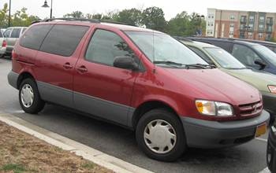
Notes:
It’s roomy, easy to drive and to customize, has excellent customer service/reliability and is a bit outdated on the features. It’s a 1998 Toyota Sienna…
10

Slide 11
A great citation manager for beginners; it goes well with most chemistry databases but beware – the bookmarklet doesn’t always play nice! Choose from desktop, web or combine the two.
Notes:
JW
Watch This Folder option
11

Slide 12
Tasting Notes
Get it at: mendeley.com
Cost: Free up to 2GB (pay for more)
References stored: remotely on the web, local backups
Platforms: Mac, PC and Linux
Browsers: all
Import/Export BibTeX: Yes!
Notes:
Riesling – all around easy white wine

Slide 13
You will enjoy Mendeley if…
Piles of stuff
Organize me (in one click)!
Socialize me!
→ Bottom line: Easy sweet white wine with sophistication
Notes:
Piles of stuff = watch this folder option
Organize me – automatic syncing
Extracts data from imported PDFs
PDFs stored on server and locally
Searches full text
GetIt Cornell! – not so much
Can create group
You might like if
You work in “piles” – that is, you might have some PDFs on your local machine and on the web. You can sync web and desktop, watch folders
Something low barrier – works well with most databases, browsers
Are really into the social aspects, like creating groups
Piles!
13

Slide 14
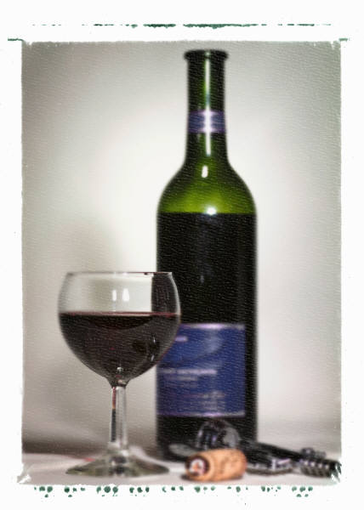
An open source software, Zotero’s particulars make it a must-have for FireFox lovers. With the plugin, you can easily import items from the web with the option of archiving a snapshot.
Notes:
DD
Like a red pinot noir (fussy, but approachable!)

Slide 15
Tasting Notes
Get it at: zotero.org
Cost: Free up to 100MB (pay for more)
References stored: remotely on the web, local backups
Platforms: Mac, PC and Linux
Browsers: Firefox Only!
Import/Export BibTeX: Yes!
Notes:
Standalone version too
Wine: picky, like a pinot noir

Slide 16
You will enjoy Zotero if…
Firefox
You enjoy sharing
Local PDF control
→ Bottom Line: A particular red, like pinot noir.
Notes:
You might like if
You’d rather have your PDFs stored locally If you use books too
You’re into group sharing
You only user Firefox as a browser
Extracts metadata from imported PDFs
Store PDFs locally
Full text search: yes!
GetIt Cornell!: need configuration, but can work
Can create groups to share references
16

Slide 17
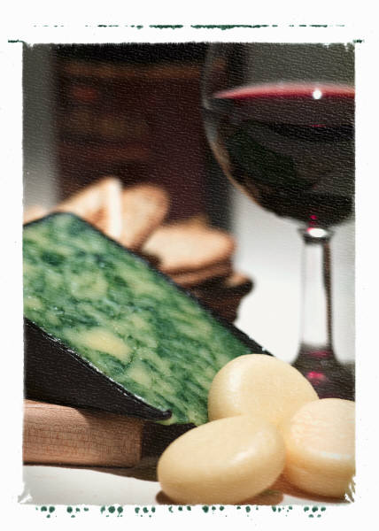
ChemWor
A new vintage, built specifically for chemists to work with SciFinder and other scientific databases. Pairs well with citations, calendar systems, and lab group workflows.
Notes:
17

Slide 18
Tasting Notes
Get it at: acschemworx.org
Cost: Free (just need ACS ID, but that’s free too)
References stored: remotely on the web
Platforms: Mac, PC. Linux too!
Browsers: all
Import/Export BibTeX: Yes!
Notes:
Blended wine.

Slide 19
You will enjoy ChemWorx if…
ACS style > Other styles
Lab Groups/sharing
Syncing web and desktop
…and a little more.
→ Bottom Line: If you like blends, try this!
Notes:
You might like if
You predominately work with ACS style
You like the option of having a web and desktop version
You’re into sharing citations
You want a little more with your manager – like caledars, lists, etc.
Your professor/PI is looking for a virtual solution for your lab?
Web and desktop applications
GetIt Cornell!: Not quite..
Can share references with groups
Neat features: ACS style friendly, does other things like calendar syncing, workflow tasks lists, etc.
19

Slide 20
Don't be fooled by its complex flavor; JabRef packs a punch for power-users. Download directly from arXiv, customize your interface, and more. Pair with a variety of user-contributed plugins.
Notes:
Open source (pretty sure)

Slide 21
Tasting Notes
Get it at: http://jabref.sourceforge.net/
Cost: Free
References stored: Locally
Platforms: Java-based; all platforms
Browsers: N/A
Import/Export BibTeX: Designed exclusively for BibTeX
Notes:
Port

Slide 22
Bonus tastings!
Papers * BibDesk * EasyBib
Notes:
Papers – Mac only, costs money. Hard cider? Something very specific?
BobDesk?
(JabRef – made for BibTex pros and lovers. Consider this a port wine)
EasyBib – exactly like it sounds, not exactly grad level but it’s there. Consider this a wine cooler.
Use these in your communities if you’d like for your presentations.
22

Slide 23
What are your favorites?

Slide 24
Don’t drink bad wine - Let us help!
Pslref@cornell.edu
Leah McEwen (lrm1); Dianne Dietrich (dd388); Jill Wilson (jew248)
CUL-CITE-L@list.cornell.edu
Workshops at Olin/Uris, Mann and even us.

Slide 25
Image References
http://www.acschemworx.org/
icoblog.wordpress.com (Endnote)
http://jabref.sourceforge.net/
http://www.mendeley.com/
http://www.refworks.com/
http://seccowinebar.com/2011/11/flight-night-every-monday-swb/
http://www.shaktisfinedining.com/
https://www.zotero.org/

