Slide 1
Connecting the Outreach Dots: Librarians and Graduate Students at Cornell Collaborating on Dynamic Programs in Chemistry Research and Professional Development
Jill Wilson Outreach Coordinator for Engineering, Math and
Physical Sciences Libraries Cornell University

Slide 2
The PSL (Physical Sciences Library)
Virtual Library
Research Library
Services, digital collections
Reinvigorated outreach
Embedded subject librarians

Slide 3
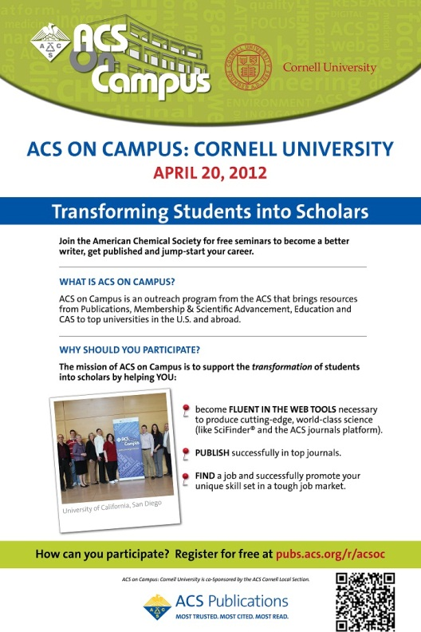

Slide 4
Bringing ACSOC to Cornell
Graduate students
Faculty
ACS!
Librarians (subject, outreach)

Slide 5
Making ACSOC our own
In-house developed modules
NSF grants
SciFinder Ninja
Communicating your science
Mixed panelists and moderators
Local flavor

Slide 6
Attendees

Slide 9
Feedback
“…really efficient way to network and gain access to new information without having to leave town!”
“I finally figured out how an ACS article is published…”
“I would absolutely recommend ACS on campus to a colleague.”
“I learned the importance of networking and I learned about many new resources that the ACS offers.”
“…good recommendations for my students in regards to building their resumes and things to consider when presenting their scientific work,”

Slide 10
Great! What else?
ACS local graduate student chapter
More SciFinder workshops
Library recognition
Relationships strengthened

Slide 11
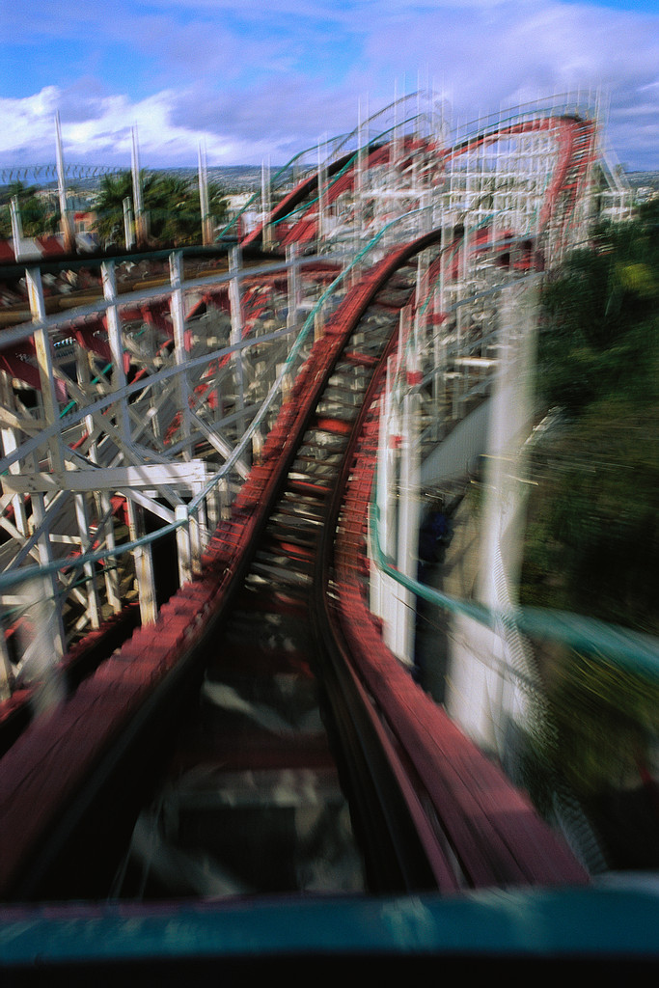
We keep going -
Other workshops
More instruction
Cross-campus connections

Slide 12
Public speaking workshop
Presentation skills outside of teaching
Logistics
Murphy’s law
Dress, communicating science, etc.

Slide 13
ChemCon? (or “unconference”)

Slide 14
Wherever we may go…
We are better librarians (Yes? Yes!)
Outreach is better, different, unconventional
Ownership of library – users’ library

Slide 15
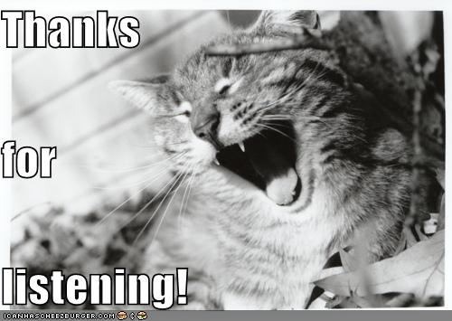
Jill Wilson
jew248@cornell.edu

