Slide 1
Questions to be Asked & Answered on NLP’s Role in Improving
Semantic Annotation for IR
Elizabeth D. Liddy
Dean, iSchool
Syracuse University
Syracuse, New York, USA

Slide 2
Overview Questions
What was early information retrieval like? (before it was called search!)
How was NLP first applied to the task?
Which levels of language analysis were utilized?
  Which were successful? Which were not?
Why were other levels not incorporated ?
Do we now see that the higher levels can and need to be included?
If they are, how might they change how we do IR, as well as what tasks we use it for?

Slide 3
Overview Questions
What was early information retrieval like? (before it was called search!)
How was NLP first applied to the task?
Which levels of language analysis were utilized?
  Which were successful? Which were not?
Why were other levels not incorporated ?
Do we now see that the higher levels can and need to be included?
If they are, how might they change how we do IR, as well as what tasks we do it for?

Slide 4
Everything has Changed!
 | Early IR | Today

Slide 5
Everything has Changed!
 | Early IR | Today
Users | Professional Searchers

Slide 6
Everything has Changed!
 | Early IR | Today
Users | Professional Searchers | Everyone!

Slide 7
Everything has Changed!
 | Early IR | Today
Users | Professional Searchers | Everyone!
Sources | Bibliographic Databases

Slide 8
Everything has Changed!
 | Early IR | Today
Users | Professional Searchers | Everyone!
Sources | Bibliographic Databases | Web, Enterprise Systems, Mobile

Slide 9
Everything has Changed!
 | Early IR | Today
Users | Professional Searchers | Everyone!
Sources | Bibliographic Databases | Web, Enterprise Systems, Mobile
Genres | Scientific, Legal, Medical Reports

Slide 10
Everything has Changed!
 | Early IR | Today
Users | Professional Searchers | Everyone!
Sources | Bibliographic Databases | Web, Enterprise Systems, Mobile
Genres | Scientific, Legal, Medical Reports | News, Blogs, Ads, Tweets, Email

Slide 11
Everything has Changed!
 | Early IR | Today
Users | Professional Searchers | Everyone!
Sources | Bibliographic Databases | Web, Enterprise Systems, Mobile
Genres | Scientific, Legal, Medical Reports | News, Blogs, Ads, Tweets, Email
Technology | Dedicated Terminals

Slide 12
Everything has Changed!
 | Early IR | Today
Users | Professional Searchers | Everyone!
Sources | Bibliographic Databases | Web, Enterprise Systems, Mobile
Genres | Scientific, Legal, Medical Reports | News, Blogs, Ads, Tweets, Email
Technology | Dedicated Terminals | Laptops & Mobile

Slide 13
Everything has Changed!
 | Early IR | Today
Users | Professional Searchers | Everyone!
Sources | Bibliographic Databases | Web, Enterprise Systems, Mobile
Genres | Scientific, Legal, Medical Reports | News, Blogs, Ads, Tweets, Email
Technology | Dedicated Terminals | Laptops & Mobile
Queries | Boolean

Slide 14
Everything has Changed!
 | Early IR | Today
Users | Professional Searchers | Everyone!
Sources | Bibliographic Databases | Web, Enterprise Systems, Mobile
Genres | Scientific, Legal, Medical Reports | News, Blogs, Ads, Tweets, Email
Technology | Dedicated Terminals | Laptops & Mobile
Queries | Boolean | 2.5 words

Slide 15
Everything has Changed!
 | Early IR | Today
Users | Professional Searchers | Everyone!
Sources | Bibliographic Databases | Web, Enterprise Systems, Mobile
Genres | Scientific, Legal, Medical Reports | News, Blogs, Ads, Tweets, Email
Technology | Dedicated Terminals | Laptops & Mobile
Queries | Boolean | 2.5 words
Tasks | Authoritative Information

Slide 16
Everything has Changed!
 | Early IR | Today
Users | Professional Searchers | Everyone!
Sources | Bibliographic Databases | Web, Enterprise Systems, Mobile
Genres | Scientific, Legal, Medical Reports | News, Blogs, Ads, Tweets, Email
Technology | Dedicated Terminals | Laptops & Mobile
Queries | Boolean | 2.5 words
Tasks | Authoritative Information | Informal, Social, Exploratory

Slide 17
Was An Opportunity for NLP Missed?
In early systems, Boolean queries were used
  AND, OR, NOT, (later added ADJ, NEAR)
  But deemed too difficult for non-trained searchers
Even though natural language provides same logic
  Modifiers – adjectives & adverbs
  Conjunctions
  Prepositional phrases
  Negations & other adverbial modifiers
System developers turned away from both Boolean queries & full NL queries
Used statistical matching alone on high-volume databases
Has led to 2.5 word Google queries of today
  Exceptions – TREC, CLEF, legal, medical

Slide 18
Overview Questions – 2
What was early information retrieval like? (before it was called search!)
How was NLP first applied to the task?
Which levels of language analysis were utilized?
  Which were successful? Which were not?
Why were other levels not incorporated ?
Do we now see that the higher levels can and need to be included?
If they are, how might they change how we do IR, as well as what tasks we do it for?

Slide 19
Levels of Language Understanding
Pragmatic
Discourse
Semantic
Syntactic
Lexical
Morphological
Synchronic Model of Language

Slide 20
Early Minimal Utilization of NLP
Inflectional stemming alone – MORPHOLOGICAL
Deletion of function words – LEXICAL
Parsing was tried and dropped – SYNTACTIC
  Too early in the development of parsers
    Technology was slow and produced too many parses
    Didn’t experiment with partial parsing
  Matching algorithms not sophisticated enough to use the resulting parses
Eventually, new resources introduced – SEMANTIC
  WordNet
  Ontologies
  Word sense disambiguation algorithms
  Named entity recognizers

Slide 21
Overview Questions
What was early information retrieval like? (before it was called search!)
How was NLP first applied to the task?
Which levels of language analysis were utilized?
  Which were successful? Which were not?
Why were other levels not incorporated ?
Do we now see that the higher levels can and need to be included?
If they are, how might they change how we do IR, as well as what tasks we do it for?

Slide 22
Does IR Today Need Semantic Annotation & Does SA need NLP?
The pure size of the collections that engines such as Google search, typically results in finding something you want, but there are 2 facts to keep in mind:
  The raw size of the web optimizes on redundancy
    You may not find the document / web site that is the best hit, because it uses a synonymous phrasing of your search
    But it is highly likely that at least someone used exactly the phrasing you searched on, and that’s what you’ll find.
  However, there are precious collections which doctors, lawyers, and scientists search, where redundancy won’t help
    There may very well be just 1 document that answers their question & the author of that document may not have used the phrase searched on.

Slide 23
Search Needs Today
Given short queries, real-time, social, & exploratory search, what could NLP be doing for IR?
  Is lexical semantic expansion on queries enough?
  Would semantic annotation of queries & documents help?
  What could higher levels of NLP on both documents & queries enable us to accomplish?
More than surface level representation & matching
  As you do when typing in a phrase whose site you want to go to – e.g. Facebook, American Airlines, Starbucks
There is an increasing recognition of applications where today’s simple, known-item search does not accomplish the user’s goals

Slide 24
Exploratory Searchⁿ

Slide 25
Exploratory Search¹
An information-seeking, problem-solving context that is open-ended
Searches are typically opportunistic, iterative, and multi-tactical
When the need is not well-defined in the user’s mind
  Broad curiosity
  Learning in unfamiliar areas
  Scientific discovery
  Decision making
  Problem solving
  Location-aware search
Differs from what librarians call ‘known item search’
  AKA, the look-up based model of IR
Semantic, discourse & pragmatic levels of language needed
  ¹White, R.W. & Roth, R.A. (2009) Exploratory Search: Beyond the Query-Response Paradigm

Slide 26
Location-aware Search
GPS
4sqsearch or m4sqsearch
Search 4Square venues by tags
  Actually searching for a type of named-entity
    Search for:
    Near:
    Within:

Slide 27
Location-aware Search
GPS
4sqsearch or m4sqsearch
Search 4Square venues by tags
  Actually searching for a type of named-entity
    Search for: Book store
    Near: Toronto Fairmont
    Within: 1 mile

Slide 28
eDiscovery – 1

Slide 29
eDiscovery – 1
  For civil and criminal legal cases, large volumes of electronic data need to be searched to find information for use as evidence
  Includes email, IM, tweets, blog postings, scanned paper documents, databases, web sites, and any other electronically-stored information which could be relevant evidence
  Current experiments are run on large heterogeneous digital collections using topical representations that approximate how real lawyers would go about effective discovery
  Results are compared to those of legal teams

Slide 30
TREC Legal Track
Topic 102. Documents referring to marketing or advertising restrictions proposed for inclusion in, or actually included in, the Master Settlement Agreement (MSA), including, but not limited to, restrictions on advertising on billboards, stadiums, arenas, shopping malls, buses, taxis, or any other outdoor advertising.
Topic 52. Please produce any and all documents that discuss the use or introduction of high-phosphate fertilizers (HPF) for the specific purpose of boosting crop yield in commercial agriculture.
Topic 13. All documents to or from employees of a tobacco company or tobacco organization referring to the marketing, placement, or sale of chocolate candies in the form of cigarettes.

Slide 31
eDiscovery – 2
  Typically many thousands of requests in a single case
    1,726 in the Philip Morris tobacco case
    Searched against 32 million records / documents
  Requests are broader and vaguer than web queries
    Many can only be satisfied across multiple documents
  High recall is important
    Jury is instructed to construe missing information as contrary to interests of party that failed to produce it
    High precision improves efficiency & reduces cost, but there are less onerous sanctions for lack of precision
  How can semantic annotation be used & evaluated?

Slide 32
eDiscovery – 3
  2 commercial systems were compared on task of categorizing documents as responsive or not, to manual attorney review, to see if IR could perform as “reasonably” as humans¹
    Judged 1,600,047 documents for “responsiveness”
  TREC legal track results:
    55% Recall & 21% Precision – best overall performer
    62% Recall & 81% Precision – best interactive Topic
  Findings – Humans, systems & TREC performed equally
    Only 71% agreement amongst TREC human assessors
    Concluded that low human agreement negates notion of ground truth on which precision and recall can be computed¹
¹Roitblat, Kershaw & Oot. (2010) Document Categorization in Electronic Discovery. JASIST

Slide 33
Recognizing Connotative Meaning

Slide 34
Recognizing Connotative Meaning
Testing feasibility of a system to detect what a text suggests beyond what is explicitly stated
  A sincere apology
  An urgent request for help
Our preliminary experiments demonstrate agreement among humans on when connotative meaning is present
  Using these results to train a ML algorithm to recognize & annotate connotative meaning
  Need author-independent features for distinguishing implicit connotation across sets of texts
  Current applications include detecting “disgruntled members” and “deceitful statements”
  Pragmatic level of language understanding

Slide 35
Pragmatics
Functional perspective - study of language in use
Aspects of language which require context to be understood
  How is the situational context grammaticalized?
Goal is to recognize the extra meaning that humans read into utterances without actually being encoded in them
Key to understanding user’s intent / plan
Important in representing / searching informal texts

Slide 36
Plan Recognition
Propositional content does not always fully communicate the speaker’s intent
How do we understand an utterance which, on the surface means one thing, but clearly means another?
  We recognize their plan! System must too.
    1a. User: Do you know when the train leaves for Boston?
    1b. System: Yes.
    2a. User: Does the train for Washington leave at 4:00?
    2b. System: No.
Current systems rely on surface-level syntax & semantics to process user’s questions, but not pragmatic knowledge – the user’s plan

Slide 37
Plan Recognition
Utterance / Request
states
hears
A
B

Slide 38
Plan Recognition
Utterance / Request
states
hears
A
B
has
infers
Goal / Plan

Slide 39
Plan Recognition
Utterance / Request
states
hears
implies
indirect
unstated
question
A
answers
B
has
infers
Goal / Plan

Slide 40
Polarity Recognition

Slide 41
Polarity Recognition
Polarity: mutual opposition; a relation between two opposite attributes or tendencies
Why annotate polarity of text?
  Negative or positive attitude of a news reporter
  Favorable or unfavorable review of a product
  Right or left political leaning of speaker
  Certainty or uncertainty about what’s reported
  Credibility or deceptiveness of statement
  Agreement or disagreement in scholarly citation
  Denotative or connotative meaning conveyed
Capability would benefit:
  Blogs
  Product sites
  Reviews

Slide 42
How is Polarity Recognition Done Now?
1 to 20 NLP features of text can be used
  Target verb, syntactic phrase type, voice, ‘affect’ word count, association w/ known set of words, etc
  Main reliance on lexical level, but taste of pragmatics included
Machine Learning based on humanly annotated data
  Typically, 50 to 100 documents
Machine Learning methods
  N-gram
  Support Vector Machine
  Naïve Bayes
Semantic Orientation: PointWise Mutual Information (SO-PMI)

Slide 43
SO-PMI - Turney & Littman
Algorithm that estimates the semantic orientation (+ or - valence) of each word in a text
  Evaluative character and degree of a word
Base the SO of a word on its statistical association with a set of positive and negative paradigm terms
Computes a measure of association using:
  Pointwise Mutual Information (PMI)
  Latent Semantic Analysis (LSA)
  Semantic distance in WordNet
http://arxiv.org/ftp/cs/papers/0212/0212012.pdf
Notes:
Paradigm – best exemplar terms

Slide 44
Paradigm Terms
Various studies use wide range of # of paradigm words
  1,300 for Hatzivassiloglou & McKeown, 1997
  14 for Turney & Littman, 2003
    + good, nice, excellent, positive, fortunate, correct, superior
    - bad, nasty, poor, negative, unfortunate, wrong, inferior
  Applications may retrain with specialized words for their domain
Humans - high agreement on SO of words
  97% agreement amongst 4 subjects (Hatzivassiloglou & McKeown, 1997)
Hatzivassiloglou, V. & McKeown, K. Predicting the Semantic Orientation of Adjectives. ACL Proceedings. 1997.

Slide 45
Computing SO-PMI
Word co-occurrence counts for PMI formula are determined using Information Retrieval
  Each content word in the ‘text’ being processed is used as a query to a search engine
  Search a corpus for each paradigm term to determine count
    Words occurring within 10 words
    Possible with 14 queries / runs for each term in text (if using Turney & Littman)
Compute + or - valences of words from text to determine text’s overall orientation

Slide 46
Does Polarity Annotation Matter in Users’ Searches?
Product Reviews
  81% of Internet users search for product reviews
    20% do so on each typical day
  73% - 87% say reviews have a significant influence on their purchases
  32% have provided a rating on a product, service, or person via an online rating system
Political Opinions
  In recent US elections, 34% Americans searched the web to find perspectives that differed from their own

Slide 47
Application 1 – Classifying Reviews
Task – processing new reviews
  Part-Of-Speech tagging
  Recognition of phrases with ADJs or ADVs
  Calculate SO-PMI of each phrase
  Compute average SO of extracted phrases
  Assign + or – to the review
Challenge
  Positive reviews may have words with negative SO, although subjective evaluation is positive (and vice versa)
Typical performance is in range of 80% – 95%

Slide 48
Application 2 – Shopping Engines
Shopping.com
Epinions
Dealtime
Provide product reviews
  More than simple thumbs up or thumbs down
  Summarized form
  Detailed reviews
Data is mined from full reviews
  Pros
  Cons
Next Goal
  More specialized focus of SO

Slide 49
Sample Reviews of iPod
Pros:
- Wi-Fi and Safari, you'll never be lost again
- Beautiful graphics and screen
- Very slim and lightweight
- Cover Flow is a beautiful feature
- Can see photos on portable device with amazing graphics
- It's set up so you can surf the web and still listen to your music at the same time
Cons:
- Wi-Fi can be temperamental
- Safari keyboard is missing some needed symbols
- No hard drive capability
- Awful headphones

Slide 50
SentiWordNet
A lexical resource in which each Synset of WORDNET is annotated with 3 numerical scores
  Is it subjective or objective?
  If subjective is it Positive or Negative?
  To what degree are terms contained in the Synset subjective?
      E.g. Weakly, Mildly, Strongly (Positive or Negative)
As a graded lexical resource, it appears to provide enough information to capture nuances
Freely available for research purposes, with a Web-based graphical user interface
Esuli & Sebastiani, (2006). SENTIWORDNET: A Publicly Available Lexical Resource for Opinion Mining.

Slide 51
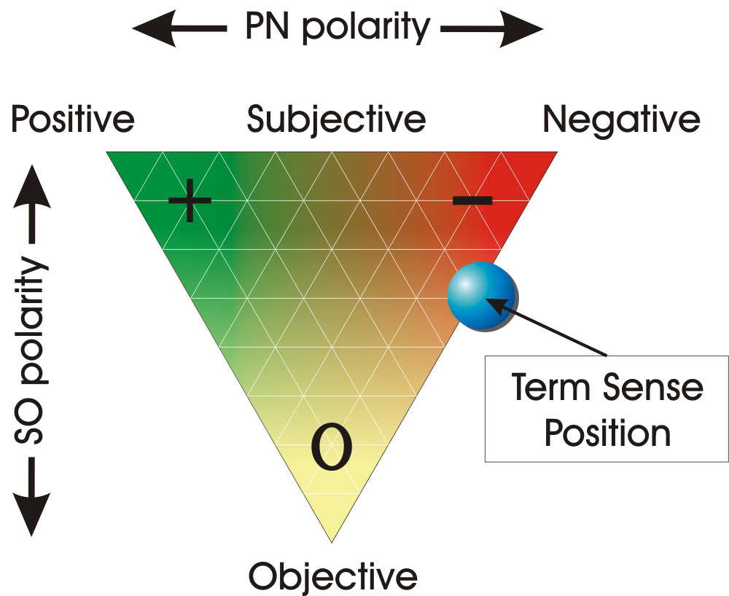
SentiWordNet Synset Evaluation

Slide 52
SentiWordNet Evaluation
Produced a human labelling of a subset of 1,000 WORDNET synsets to use as a “gold standard”
  Synsets were tagged by five different evaluators
  For each synset, each evaluator attributes a score for each of the three labels of interest such that the three scores sum up to 1.0 through a graphical interface
Evaluated human scores as compared to scores assigned automatically to the same synsets in SentiWordNet
  Results showed that use of SentiWordNet produces a significant improvement over baseline system that did not use a specialized specialized lexical resource
  Significant improvement over other opinion-related lexical resources.

Slide 53
SentiWordNet Evaluation
Produced a human labelling of a subset of 1,000 WORDNET synsets to use as a “gold standard”
  Synsets were tagged by five different evaluators
  For each synset, each evaluator attributes a score for each of the three labels of interest such that the three scores sum up to 1.0 through a graphical interface
Evaluated human scores as compared to scores assigned automatically to the same synsets in SentiWordNet
  Results showed that use of SentiWordNet produces a significant improvement over baseline system that did not use a specialized lexical resource
  Significant improvement over other opinion-related lexical resources.

Slide 54
Application 3 – Predicting Dow Jones Industrial Average
Based on measures of collective public mood
Sentiments expressed in millions of tweets were 87.6% accurate at predicting daily ups & downs in DJ Industrial Average a week in advance
  9.8 million tweets from 2.7 million users
Used 2 mood-tracking tools
  OpinionFinder – positive or negative
  Google-Profile of Mood States – calm, alert, sure, vital, kind, happy
Used a self-organizing fuzzy neural network
Calmness index was best predictor
Bollen, J, Mao, H., Zeng, X. Twitter Mood Predicts Stock Market. http://arxiv.org/abs/1010.3003

Slide 55
Application 4 - “Critical” Nature of Citations
Scientific texts also contain subjective content
Indicated by ‘critical’ citing relations to documents
  Similar to Shepardizing in the legal domain which reveals whether a court ruling has been upheld or reversed
Opportunity: CiteSeer has 10,000+ hits a day
  Shows snippet of text around citation, but may not be the referring text (69% found in prior sentences)
  Could increase usefulness with “critical” relations
Citations can be enriched by indicating semantic relation
  Criticizes (theory / method / results / conclusions)
  Supports …………..
  Based on …………….
Enables more precise retrieval
  E. g. “Find papers which criticize Liddy, 2007.”
Teufel, S. Argumentative Zoning for Improved Citation Indexing. AAAI EAAT Symposium, 2004

Slide 56
Recognizing “Critical” Relations
Verb clusters identified for change, failure, contrast, etc
  Change – adapt, augment, combine, extend, modify, refine
  Failure – problematic, contradict, overgeneralize, resort to
  Contrast – be distinct from, conflict, differ from, differentiate
Produces enriched annotation for citation indexing
  Not just citation of document being referred to
  Also, indication of the nature of the critical citing relationship
  Text to which citation is referring
Trained on 80 papers on which nature of the citing relationships had been manually annotated
Evaluation showed significantly improved retrieval results when looking for critical relations between papers

Slide 57
Let’s pause, and ask….
What is it we want to accomplish in IR now?
  Is it just more relevant sites for the same 2.5 word queries?
  What about the more complex needs of financial, medical, patent, and legal professionals?
Can more sophisticated exploitation of Semantic Annotation improve retrieval?
How can NLP contribute to accomplishing this goal?
  Can the higher levels of language analysis be made computably tractable enough to use?
  Can we operationalize what we know about pragmatics for real-world, real-time search improvements?
  Will genres such as tweets, blog posts, Facebook pages provide more context, thereby enabling Pragmatics to contribute?

Slide 58
Today’s Challenges / Opportunities – 1
Real Time Search
  Emphasis on currency / ‘as it’s happening’ / recency
    E.g. Up-to-the-minute info on traffic delays
    Should this be a pull technology or a push technology against standing queries?
  More about conversations, recent news, trendy topics
  Twitter, blogs, Facebook
  Are these ‘shallow’, ‘superficial’ questions?
    Should search be done differently?
    Isn’t this the perfect opportunity to use pragmatics?
  How are parameters for currency integrated with relevancy in displaying results?
    Now add in credibility and certainty

Slide 59
Today’s Challenges / Opportunities – 2
Social / Collaborative search
  Live updates from various blogs / Twitter streams
  Is agreement important? Or uniqueness?
  Weighting by links, retweets, # of followers, Klout score
  Again, credibility & certainty!
Mobile search
  How to combine / weight geographic proximity, relevance, semantic orientation & reputation?
  Should the fact that it’s mobile, fundamentally change the way search is done?

Slide 60
Today’s Challenges / Opportunities – 3
Question-Answering in medical insurance domain
  If patient chooses a physician who is not part of their insurance plan, costs are more than if you stay ‘in network’
  Insurance company reimburses a “usual & customary rate”
  Large government investigation has found that insurance companies underpay patients for ‘out of network’ charges
$100 million government suit of companies
Syracuse University awarded contract to build new system
  Determine fairer rates based on new algorithms run on all medical insurance claim data provided by physicians across the US
  Build a consumer web site, which interacts with consumers on very complex questions
    Ultimate challenge for IR’s use of NLP & SA
      Diagnosis, treatment, specialist, geozips, etc
      Tremendous differences in language usage between consumers vs. medical personnel

Slide 61
Again, Let’s pause, and ask….
What is it we want to accomplish in IR now?
  Is it just more relevant sites for the same 2.5 word queries?
  What about the more complex needs of financial, medical, patent, and legal professionals?
Can more sophisticated exploitation of Semantic Annotation improve retrieval?
How can NLP contribute to accomplishing this goal?
  Can the higher levels of language analysis be made computably tractable enough to use?
  Can we operationalize what we know about pragmatics for real-world, real-time search improvements?
  Will genres such as tweets, blog posts, Facebook pages provide more context, thereby enabling Pragmatics to contribute?

Slide 62
Thank you!
Questions?

